Slide 1


Harmonizing European Balancing
Challenging Times for TSO’s and Regulators
20/06/2024 – Jean-Paul Harreman

Slide 2

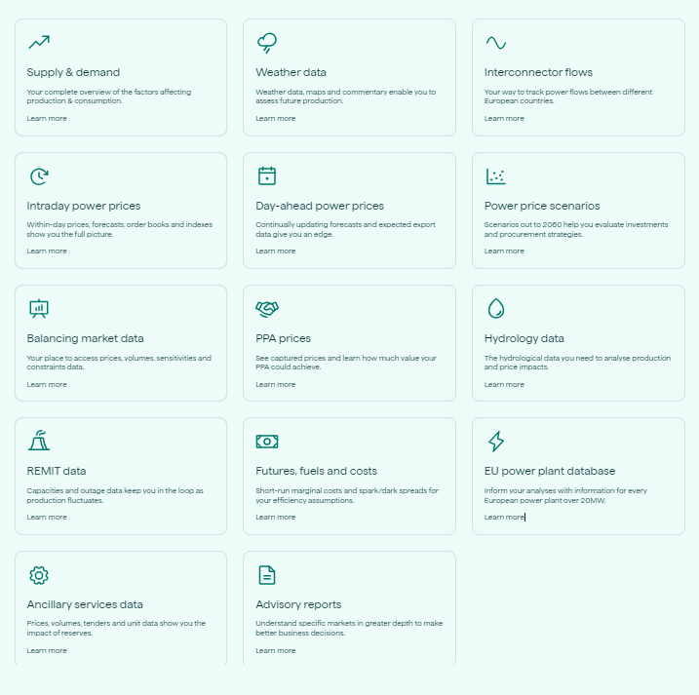

18 GW
Who are we?
Montel Analytics
Historic data, real-time data, intraday, day-ahead, forecasting, modelling, analytics, market experts…

Slide 3

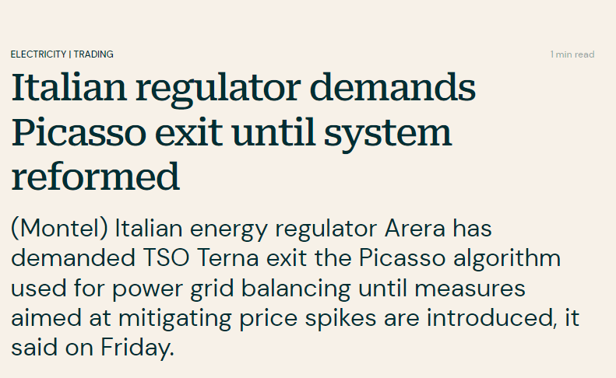
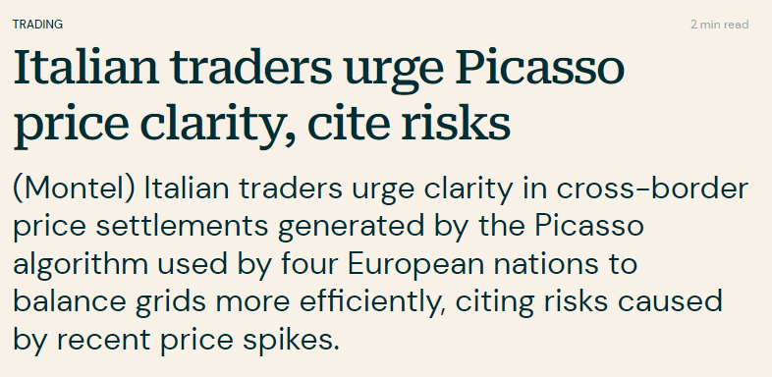
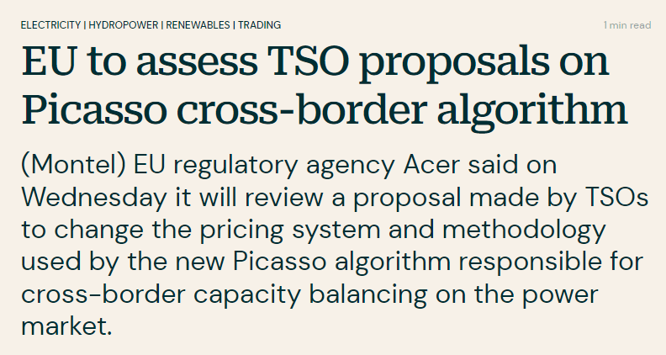
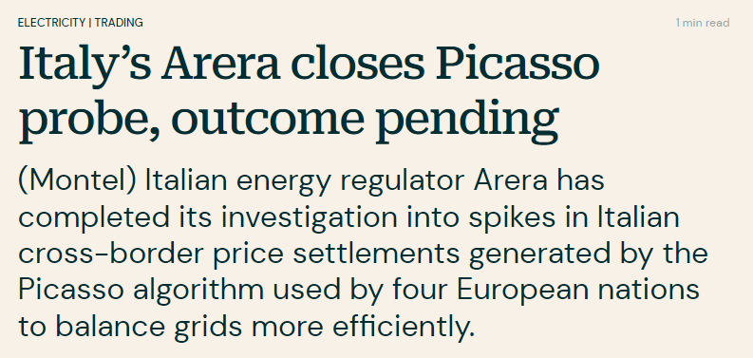

Slide 4
Harmonization of balancing markets, a logical next step?
European Harmonization Previous Steps:
From explicit flows to implicit flows: SDAC, CWE Flow-Base, Core Flow Based
Single Intra-Day Coupling of continuous trading
Start of Pan-European FCR auctions
Why would balancing activation be a logical next step for integration of markets?
It is one synchronous area, where the frequency is managed
Intraday trading driven by forecast deviations, balancing risks
Harmonizing balancing markets, harmonizing risks, levelling the playing field?
But, what about market dynamics?
Contracting of balancing capacity out-of-scope
Different market sizes
Different local rules, for trading and balancing
18 GW

Slide 5
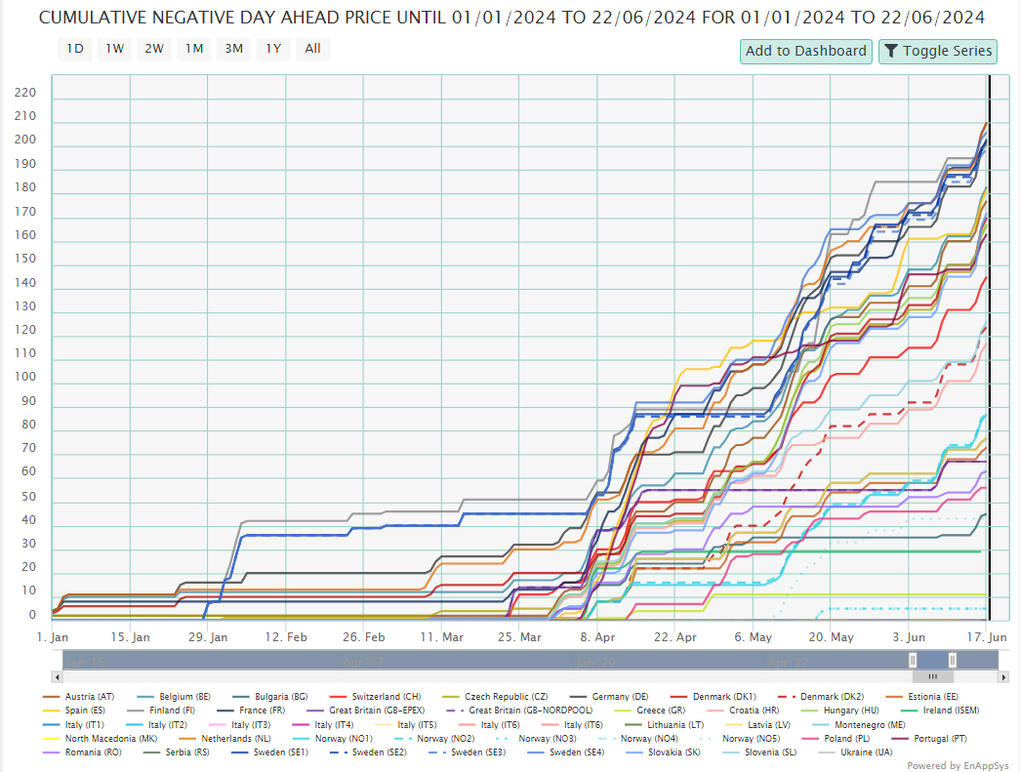
Some examples: Negative Prices
Very different price formation among countries.
Many countries are seeing negative prices in day-ahead markets.
Large differences between countries.
Some markets see no negative prices at all.
Impacts on balancing markets.

Slide 6
Some examples: Availability Prices
FCR: Market Based Availability Contracting, joint auction (DE, AT, CH, CZ, NL, BE, FR, SL, DK1).
FRR: Different availability contracting periods, weekly, daily, 4-hourly blocks
Availability prices for aFRR and mFRR wildly different across Europe
  Large differences in participating parties/assets
  Different economics, availability fee to cover ‘running out-of-merit’?

Slide 7
Some examples:
Central Dispatch vs Market Dispatch
Market-based dispatch is characterized by its reliance on competitive markets to drive operational decisions.
Central dispatch relies on a system operator making decisions based on broader economic and reliability criteria.
Can you harmonize details, when paradigms are so radically different?

Slide 8
Activation Prices Analysis
Europe-Wide Perspective

Slide 9
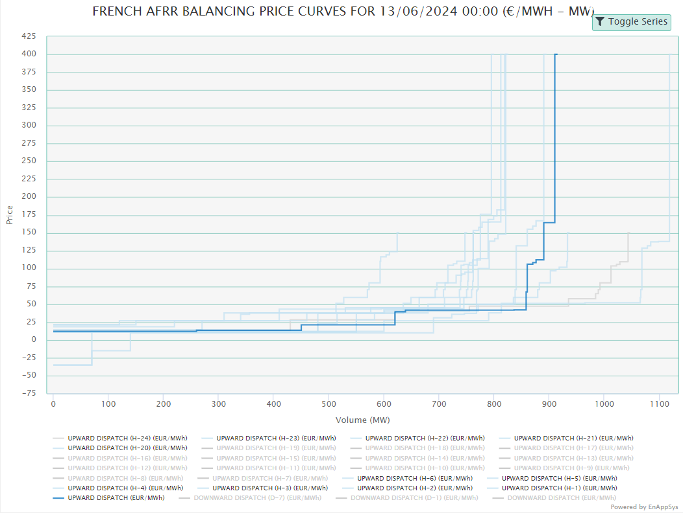
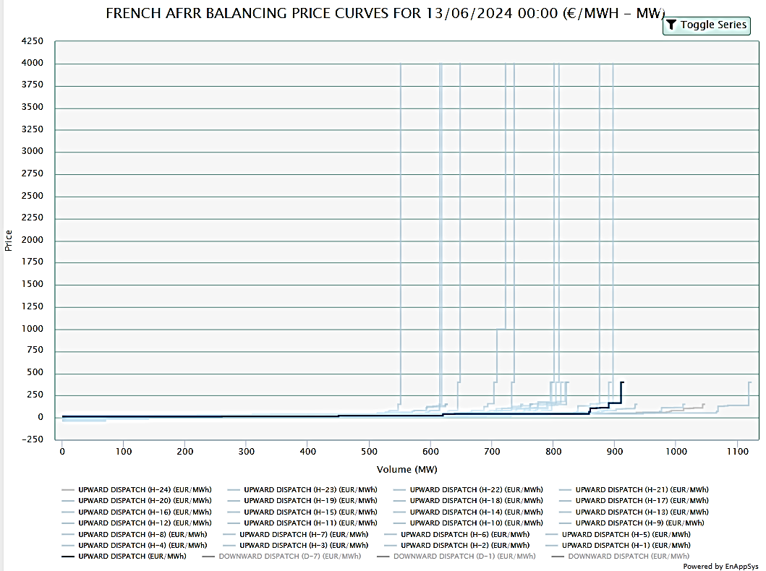
Bids for aFRR activation across Europe
Different market sizes affect the depth of the curve.
Different market rules affect ‘extreme’ bids.
Scarcity can drive the ‘tails’ of the activation merit-order.
Example: France
Scarcity!
Scarcity?
Market Depth
Variability

Slide 10
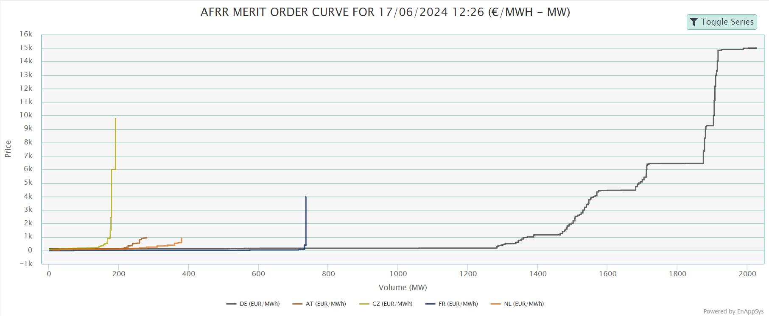
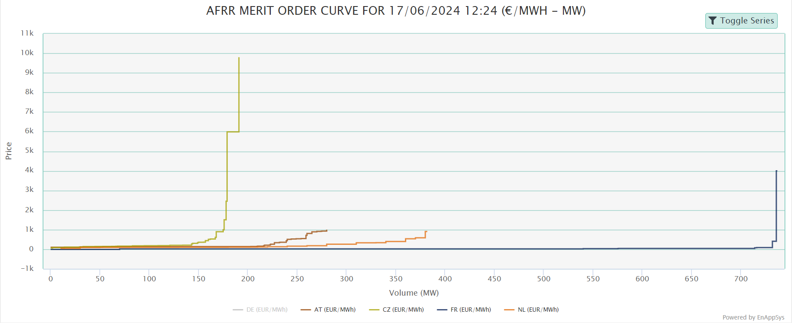
Upward Activation Prices in a European Context
CZ: € 9600
Germany: € 15.000
FR: € 4000
AT: € 1000
NL: € 1000

Slide 11
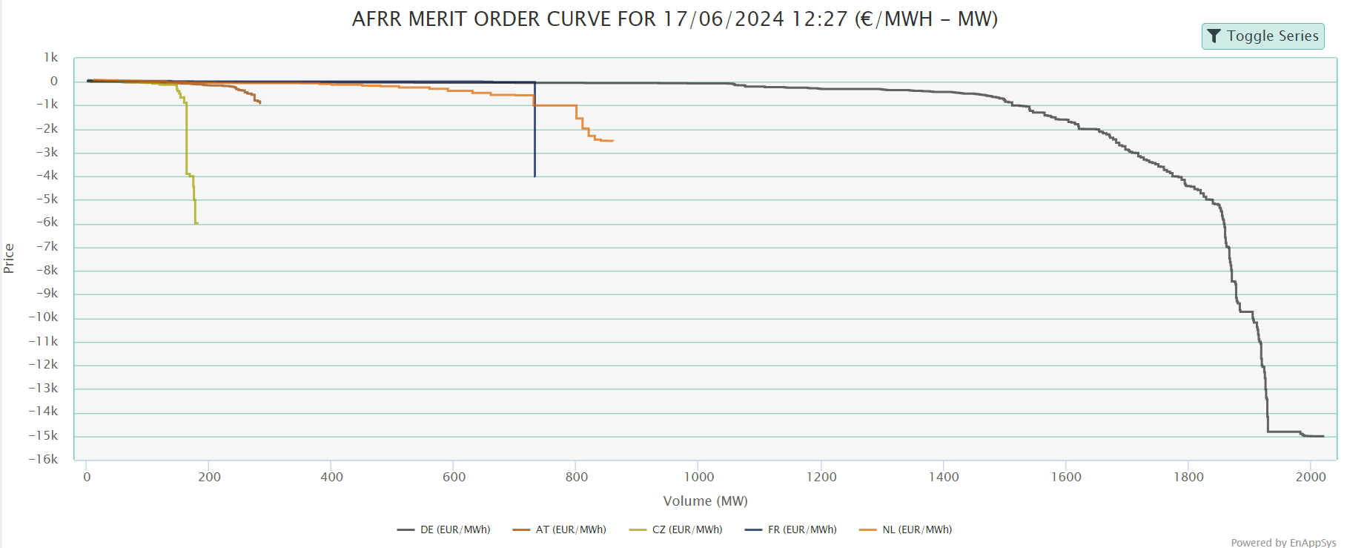
Downward Activation Prices in a European Context
AT: € -1000
NL: € -2500
FR: € -4000
CZ: € -6000
Germany: € -15.000

Slide 12
What happened?
Understanding Cross-Border Capacity for Balancing Markets

Slide 13
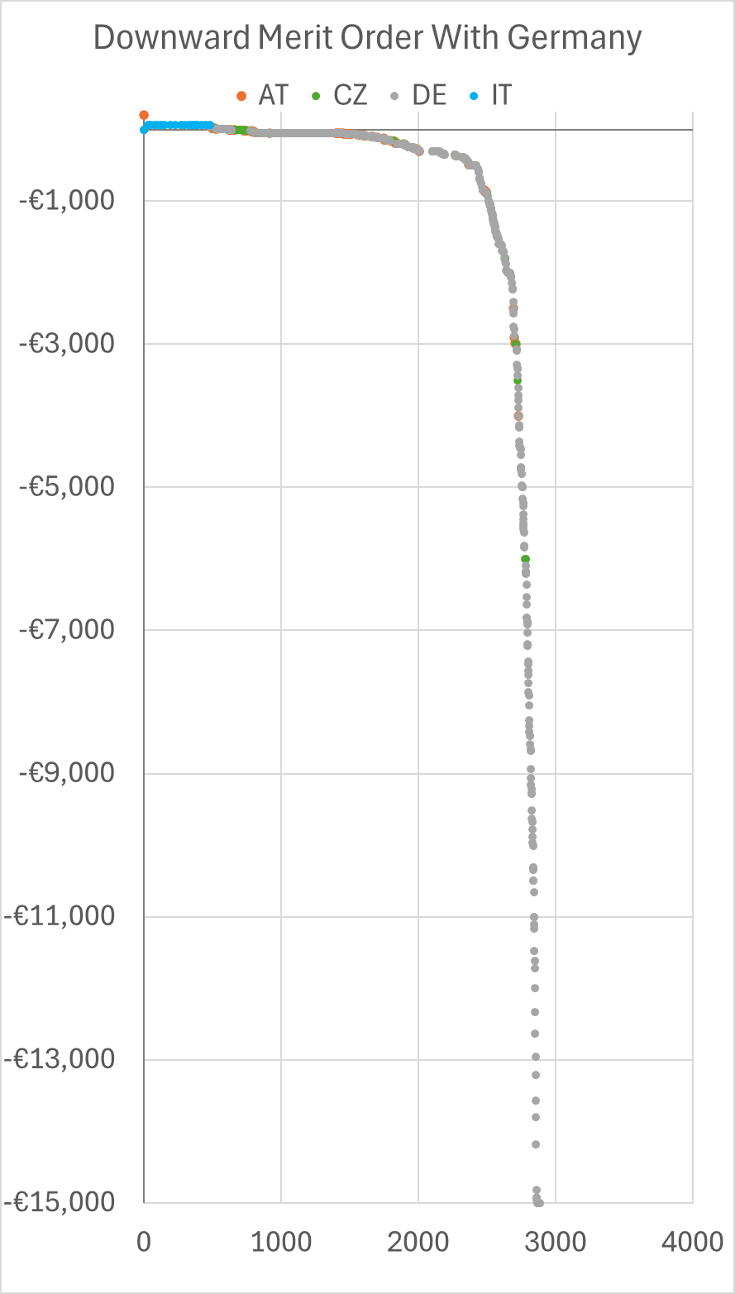
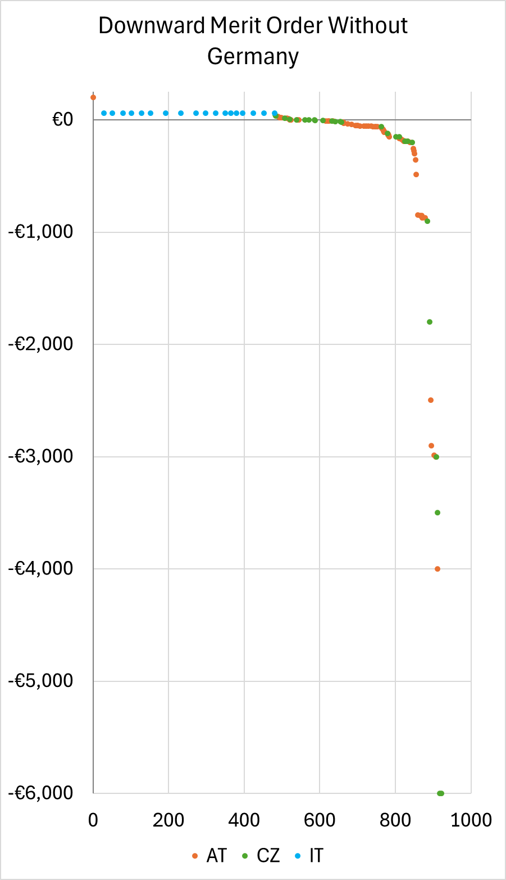
Requirements for Cross-border activation
Extreme Prices
from 500 MW
Cross-border activation implies more liquidity in balancing markets, however:
The capacity available for activation is determined by the ‘left-over’ capacity after gate-closure for intraday trading.
This can lead to unavailability of bids from a whole region, to some countries.
Almost 2000 MW
to get to extreme prices

Slide 14
What happened when we saw those extremes?
Italy ran out of downward balancing capacity in Picasso (only around 500 MW submitted).
Germany was unavailable as it could not import more power intraday (border saturated).
That leaves Austria and Czech Republic. With a balancing need of “only” several hundred MW of downward capacity, Italy’s needs were moderate.
But only moderate on the scale of Germany and Italy.
The Czech and Austrian balancing markets only have around 200 – 250 MW of balancing capacity, which means you reach the end of the merit order quickly.

Slide 15
What’s Next?
How to move forward

Slide 16
ANALYSIS
There are no easy solutions
Markets will remain different as fundamental rules are different.
Large countries bordering small countries may face volatility in Marginal Activation Prices.
Small countries may see more robustness.
Coupled markets for intraday trading will use much cross-border capacity, it is better/safer to ‘trade yourself out of trouble’ than face balancing markets.
Leaving positions open for balancing markets is a risk as it should be.
Initiatives to decrease impact of cross-border activations?
Is the market ready for balancing harmonization or do we need to align other aspects of the market first?

Slide 17

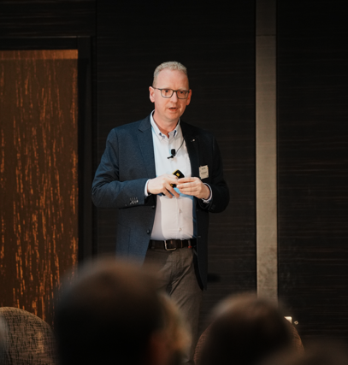
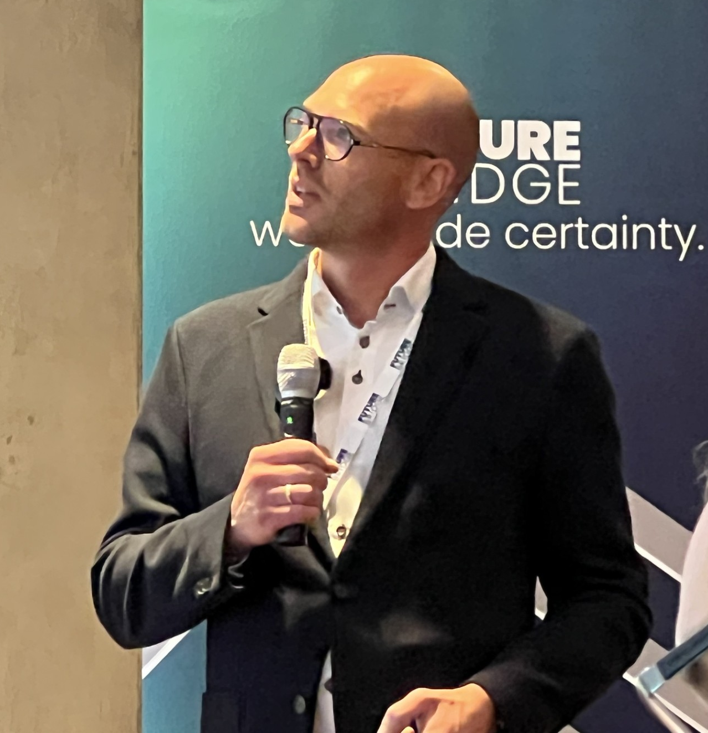

  Contact Us!
  www.montelgroup.com
  Free Trial Access Available
Jean-Paul Harreman
Montel Analytics Director
jeanpaul.harreman@montelgroup.com
+31 611 486 735
Andre Bosschaart
Head of Analytics
andre.bosschaart@montelgroup.com
+31 613 198 910

Slide 18
Helping you make sense:
Montel Analytics Products help you follow, understand and analyze balancing markets

Slide 19
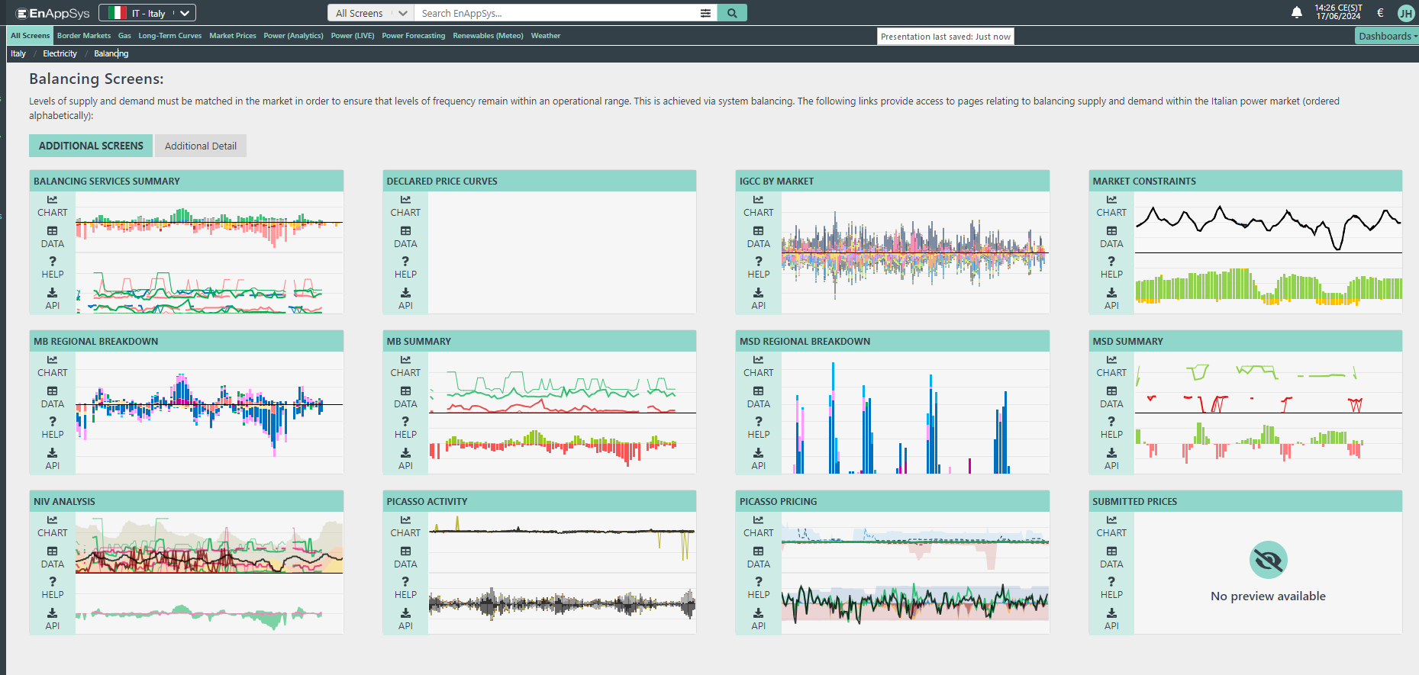
Helping you make sense
Extensive balancing data Italy
(incl. Unit Data)

Slide 20
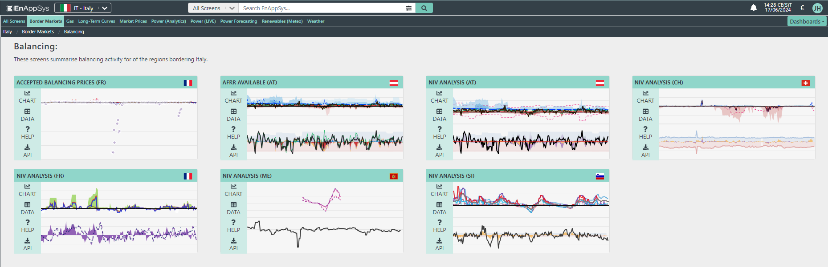
Helping you make sense
Analyse balancing markets across the border in real time

Slide 21
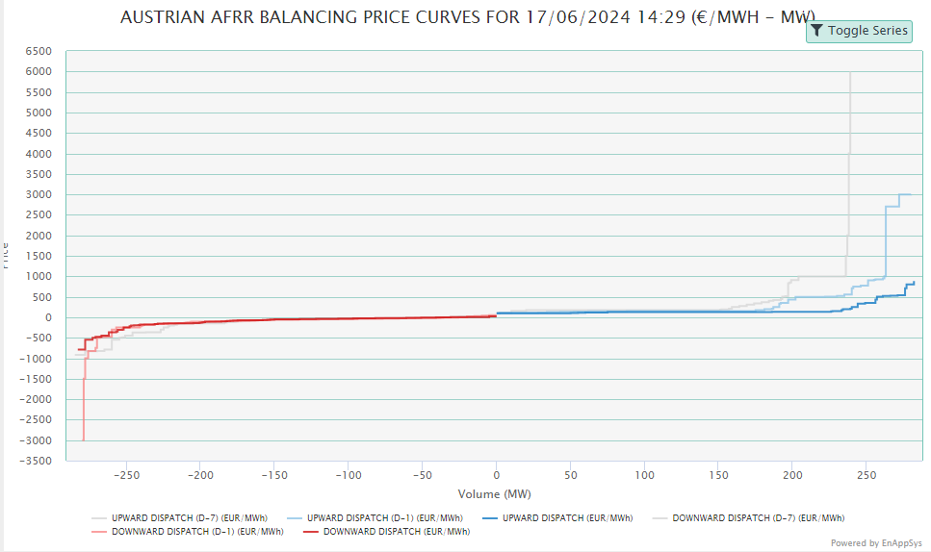
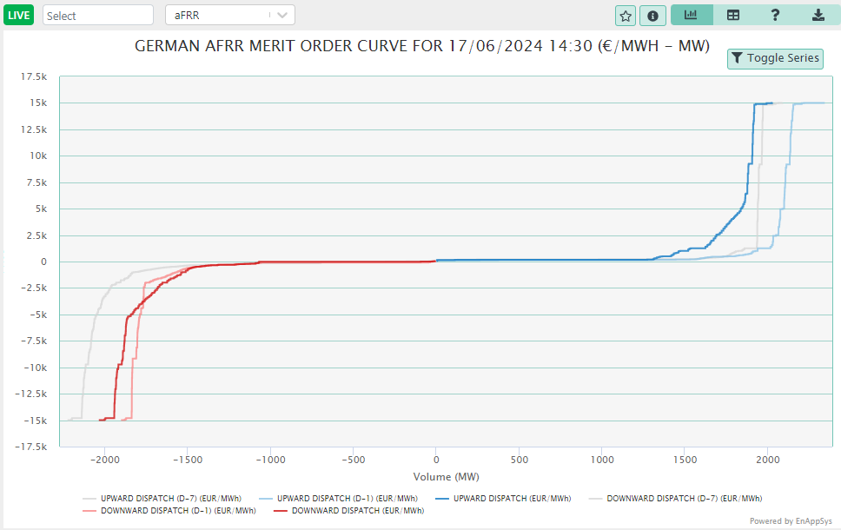
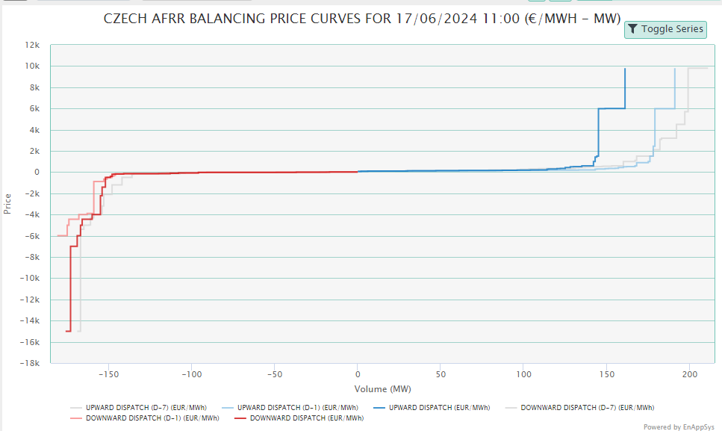
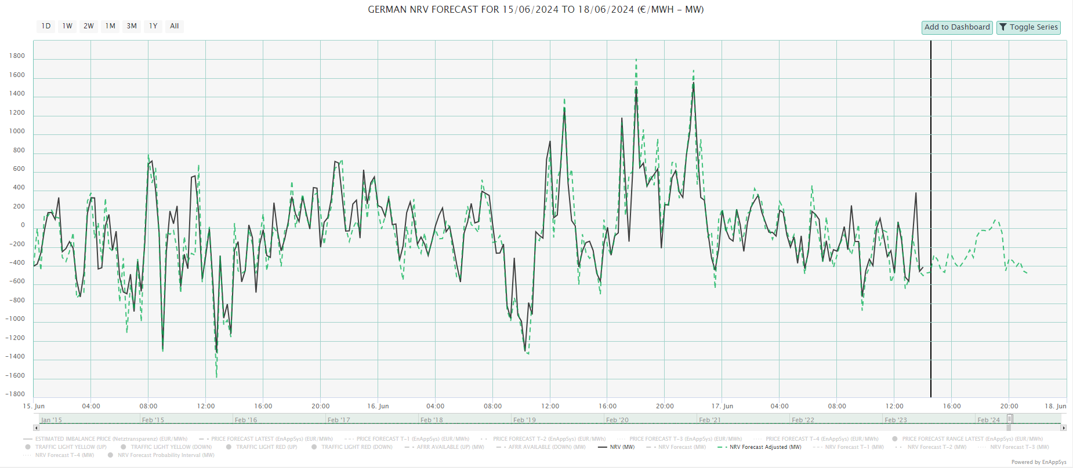
Helping you make sense
Use our balancing market sensitivities and forecasts

