Slide 1
Long-term projections and risks for renewable production in the Nordic market
Viktor Bayberdin
Senior Director Montel SysPower

Slide 2






MONTEL - SysPower– Products and services
SYSPOWER
Long Term Power Outlook (LTPO)
Profitability of RES production
Risk report
Advisory
Web tool – data, forecasts and analysis on power markets
Short, mid and long-term power forecasts
Coverage of commodities and CO2 markets
Extensive weather data
Detailed UMM information
Advanced data warehouse solution with easy data extraction possibilities
Advanced BI solution for own analysis construction
Nordic/Baltic power forecast for up to 40 years
Quarterly updated 40 years ahead power forecasts
All input assumptions and results are available through SYSPOWER dataware house
Constantly updated EMPS model though weekly and quarterly updates
Possibility for scenarios runs
Standard and tailor-made calculations
Monthly/quarterly/annual capture rates for solar, on/offshore wind for each Nordic/Baltic price area
Delivered as part of LTPO, or Nordic risk report
Models for estimations of solar/BESS profitability
Models to estimate H2 profitability
PPA analysis and area-specific report
Evaluation on market and price risks of Nordic and Baltic price area
Overview and analysis of the PPA market
Detailed price area specific reports which can be tailored for client needs
Various advisory projects
Investment analysis
Arbitrage assistance
PPA advisory and evaluation
Risk management and policy
Proven record of successful participation in many financial transactions

Slide 3

Long-Term Power Outlook (LTPO)
40 years fundamental forecast of the Nordic, Baltic and Central European power markets
Main report is published in May with base, high and low scenarios
The report presents the current status of power market and provides background for modelling inputs
Quarterly updates of the Base scenario – end of August, November, February
SYSPOWER online platform provides easy analysis, selection and download of any data and charts
Purchased by 250+ clients with 60+ subscribing on the annual basis
Commonly recognized as “bankable” reference for Nordic and Baltic long-term power forecasts
Possibility to do additional scenarios run by changing input parameters in the model based on the customer requests

Slide 4
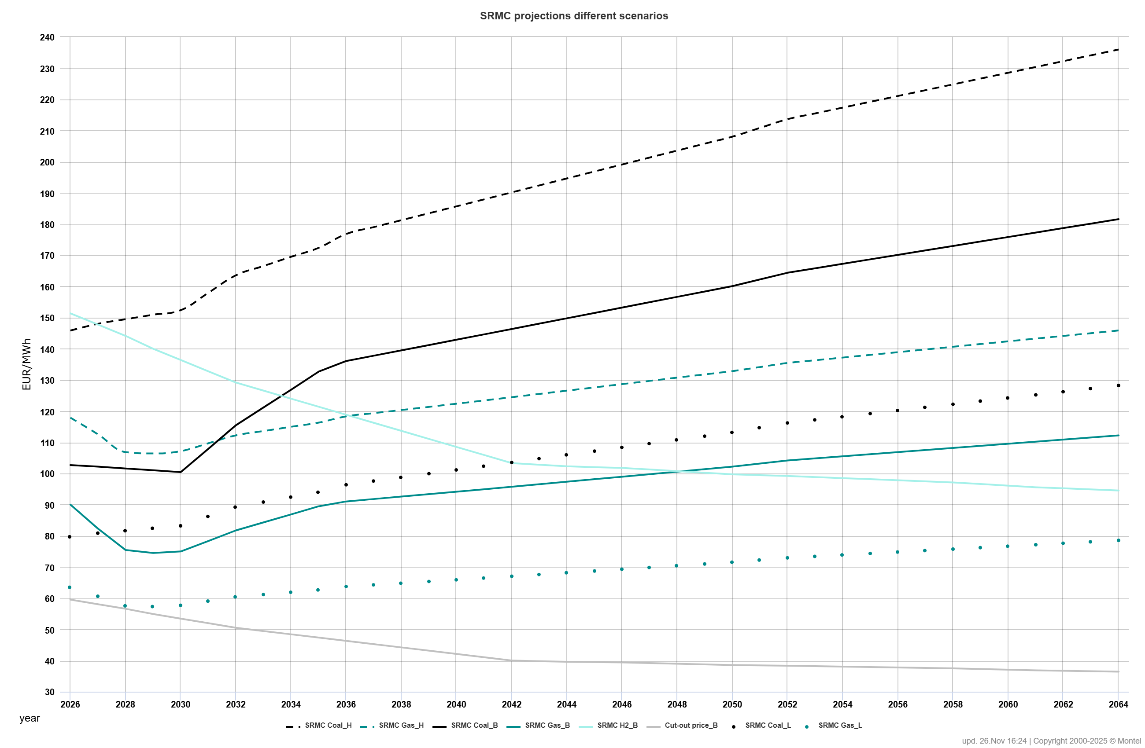
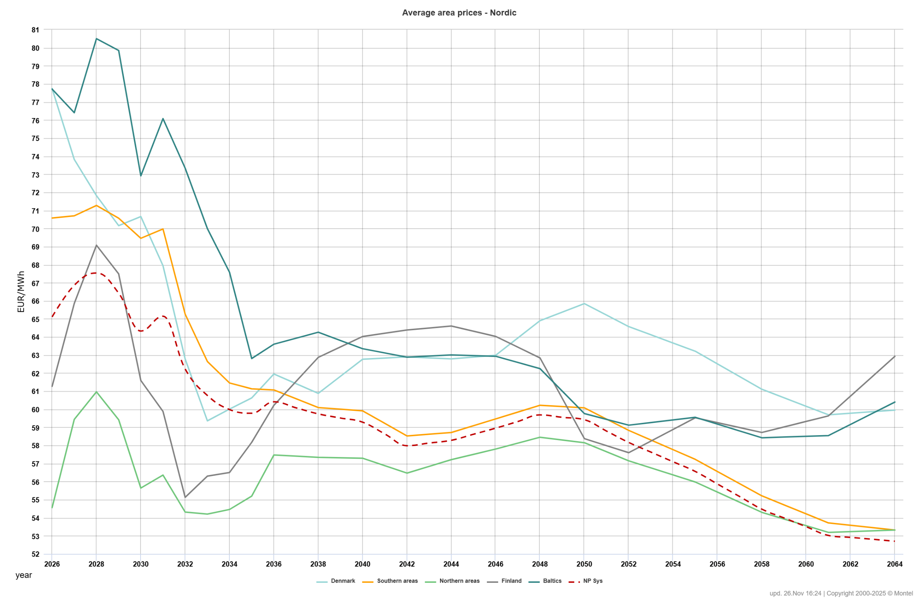
Costs and price development long-term
In the long run, coal and gas prices are expected to decrease and will be based on long-term marginal production costs.
However, CO2 prices are expected to increase and will be used as a regulatory mechanism for decarbonization.
Until 2030–2035, power prices will be supported by increasing SRMC costs due to rising CO2 prices.
With normal hydrology, the difference between southern and northern Nordic price areas is expected to persist until 2030–2035.
Prices in the southern areas are expected to remain relatively higher but will decline rapidly from the 2030s, along with a similar decline in Continental and UK prices due to the coal phase-out and increased RES.
Prices in the north will recover due to improvements in internal transmission and new demand arriving, reaching peak levels towards 2028 but declining afterward in line with southern prices.
From 2035–2045, hydrogen prices starts impact power prices, which will be gradually set by the cut-out prices of electrolyzers and the SRMC of hydrogen peak power stations.
From 2050 onwards, neither CO2 prices nor commodity prices will have any major impact as the power system becomes carbon neutral.
Coal SRMC
Gas SRMC
Electrolyzes cut-out price
H2 power plants SRMC
Other flex sources

Slide 5
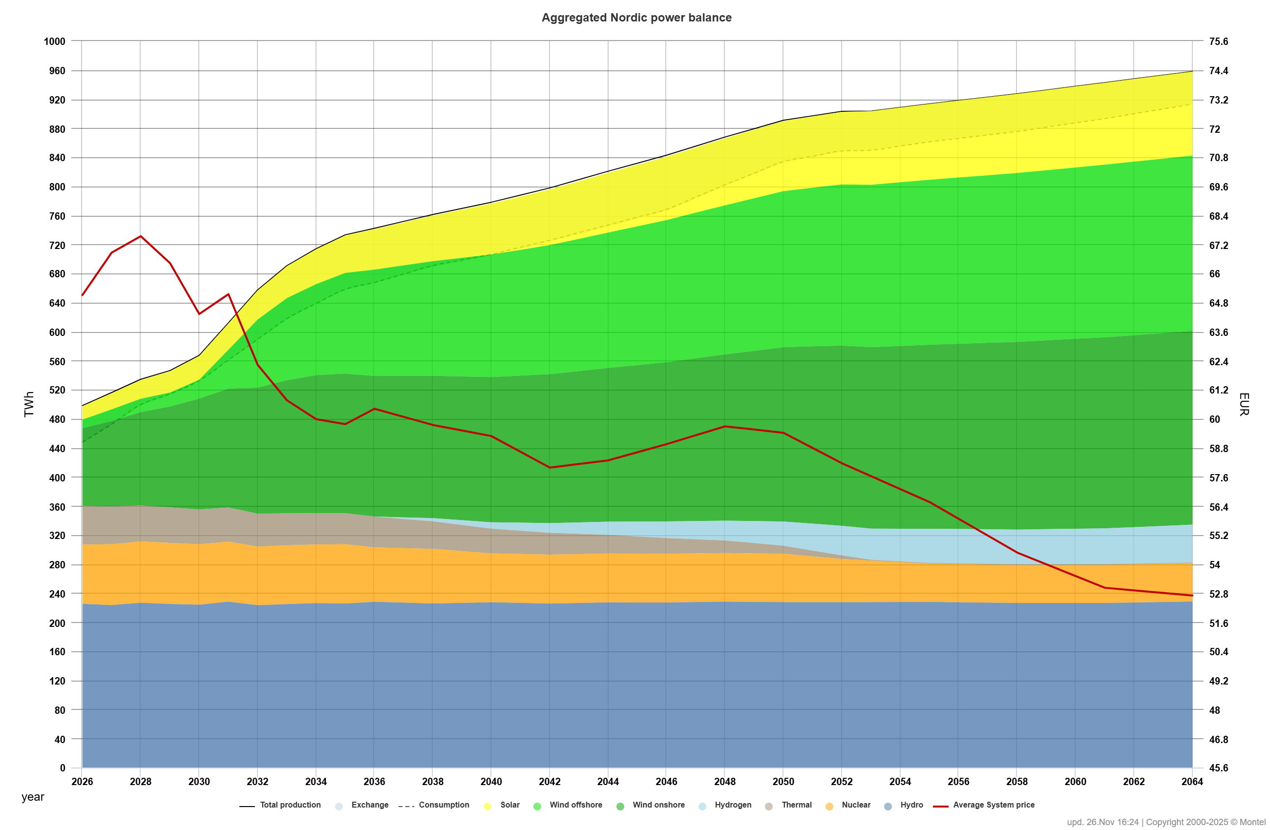
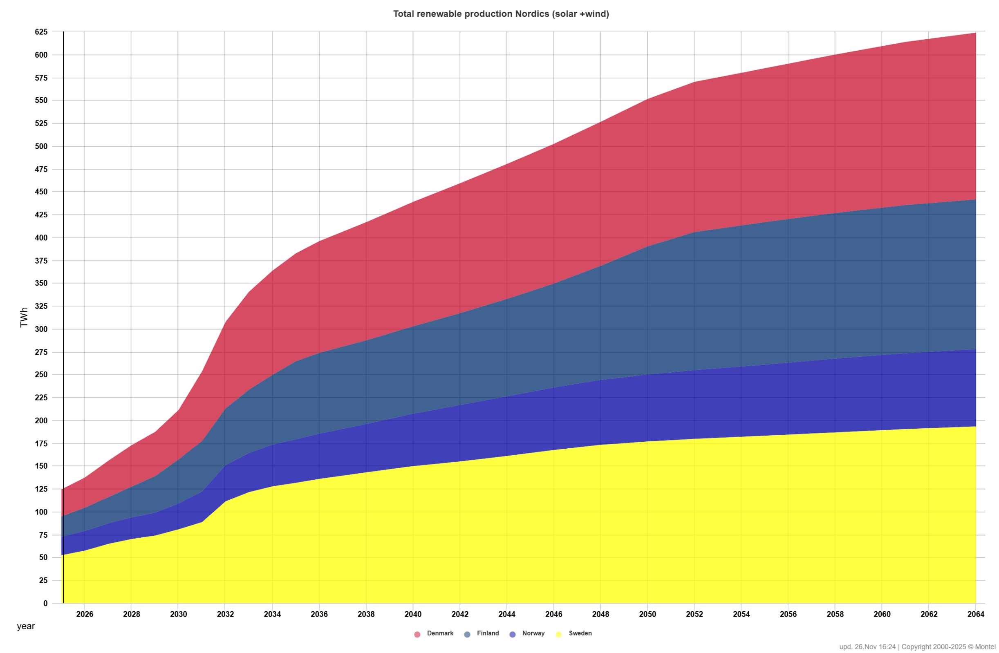
Renewable production development
Significant growth is observed in new wind capacities in Sweden and Finland, with Denmark focusing on offshore development.
Growth has been absent in Norway over the last years due to environmental opposition and a lack of interest from financial investors.
Solar is increasing strongly in the Sweden and Denmark driven by LCOE reduction and technological improvements.
All-time high prices during the 2022 energy crisis provided an additional boost, although development has been slowing down.
Strong demand growth is expected, driven by the electrification of all sectors and increased demand from new technologies such as data centers, EVs (electric vehicles), and the green hydrogen
Although growth paths will vary for each country:
  Denmark: Focus on offshore and solar energy.
  Finland: Still good prospects for onshore wind, however CR possessing and issue; offshore is supported at the political level.
  Sweden: Strong growth in solar energy and significant offshore wind development plans.
  Norway: Obstacles related to onshore wind and solar. Uncertainty regarding future support schemes for offshore wind, as it is the most expensive in the deep Norwegian sea

Slide 6
Capture rates development
Volatility in the power markets is increasing significantly, driven by the growth in RES production.
Hourly spot prices are pushed downward during periods of high wind production, resulting in the cannibalization phenomenon.
YoY and MoM variations are natural; however, the overall trend shows a strong decline in prices and increasing volatility until sufficient flexibility sources are introduced into the power system.
The level of capture rates depends on:
    The share of intermittent production.
    The share of regulating power capacity, including hydro.
    Connections to neighboring areas with flexible exchange flows.
The availability of new flexibility sources, such as batteries and hydrogen electrolyzers.
Due to low renewable depletion and significant flexibility in regulated hydro production, Norway has managed to maintain the best capture rate development, which is expected to continue.
Strong wind construction in Finland and solar deployment in DK1 (Germany) have led to the sharpest decline in capture rates.
Historical wind capture rates
Historical solar capture rates

Slide 7
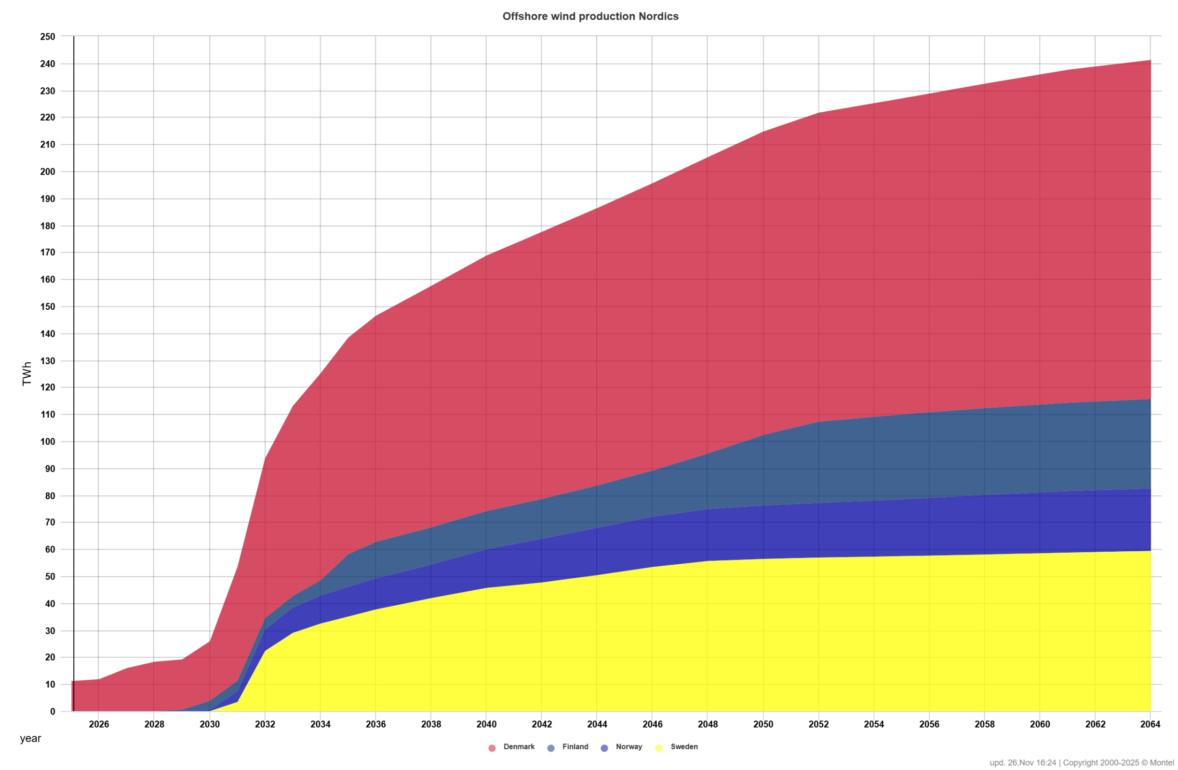
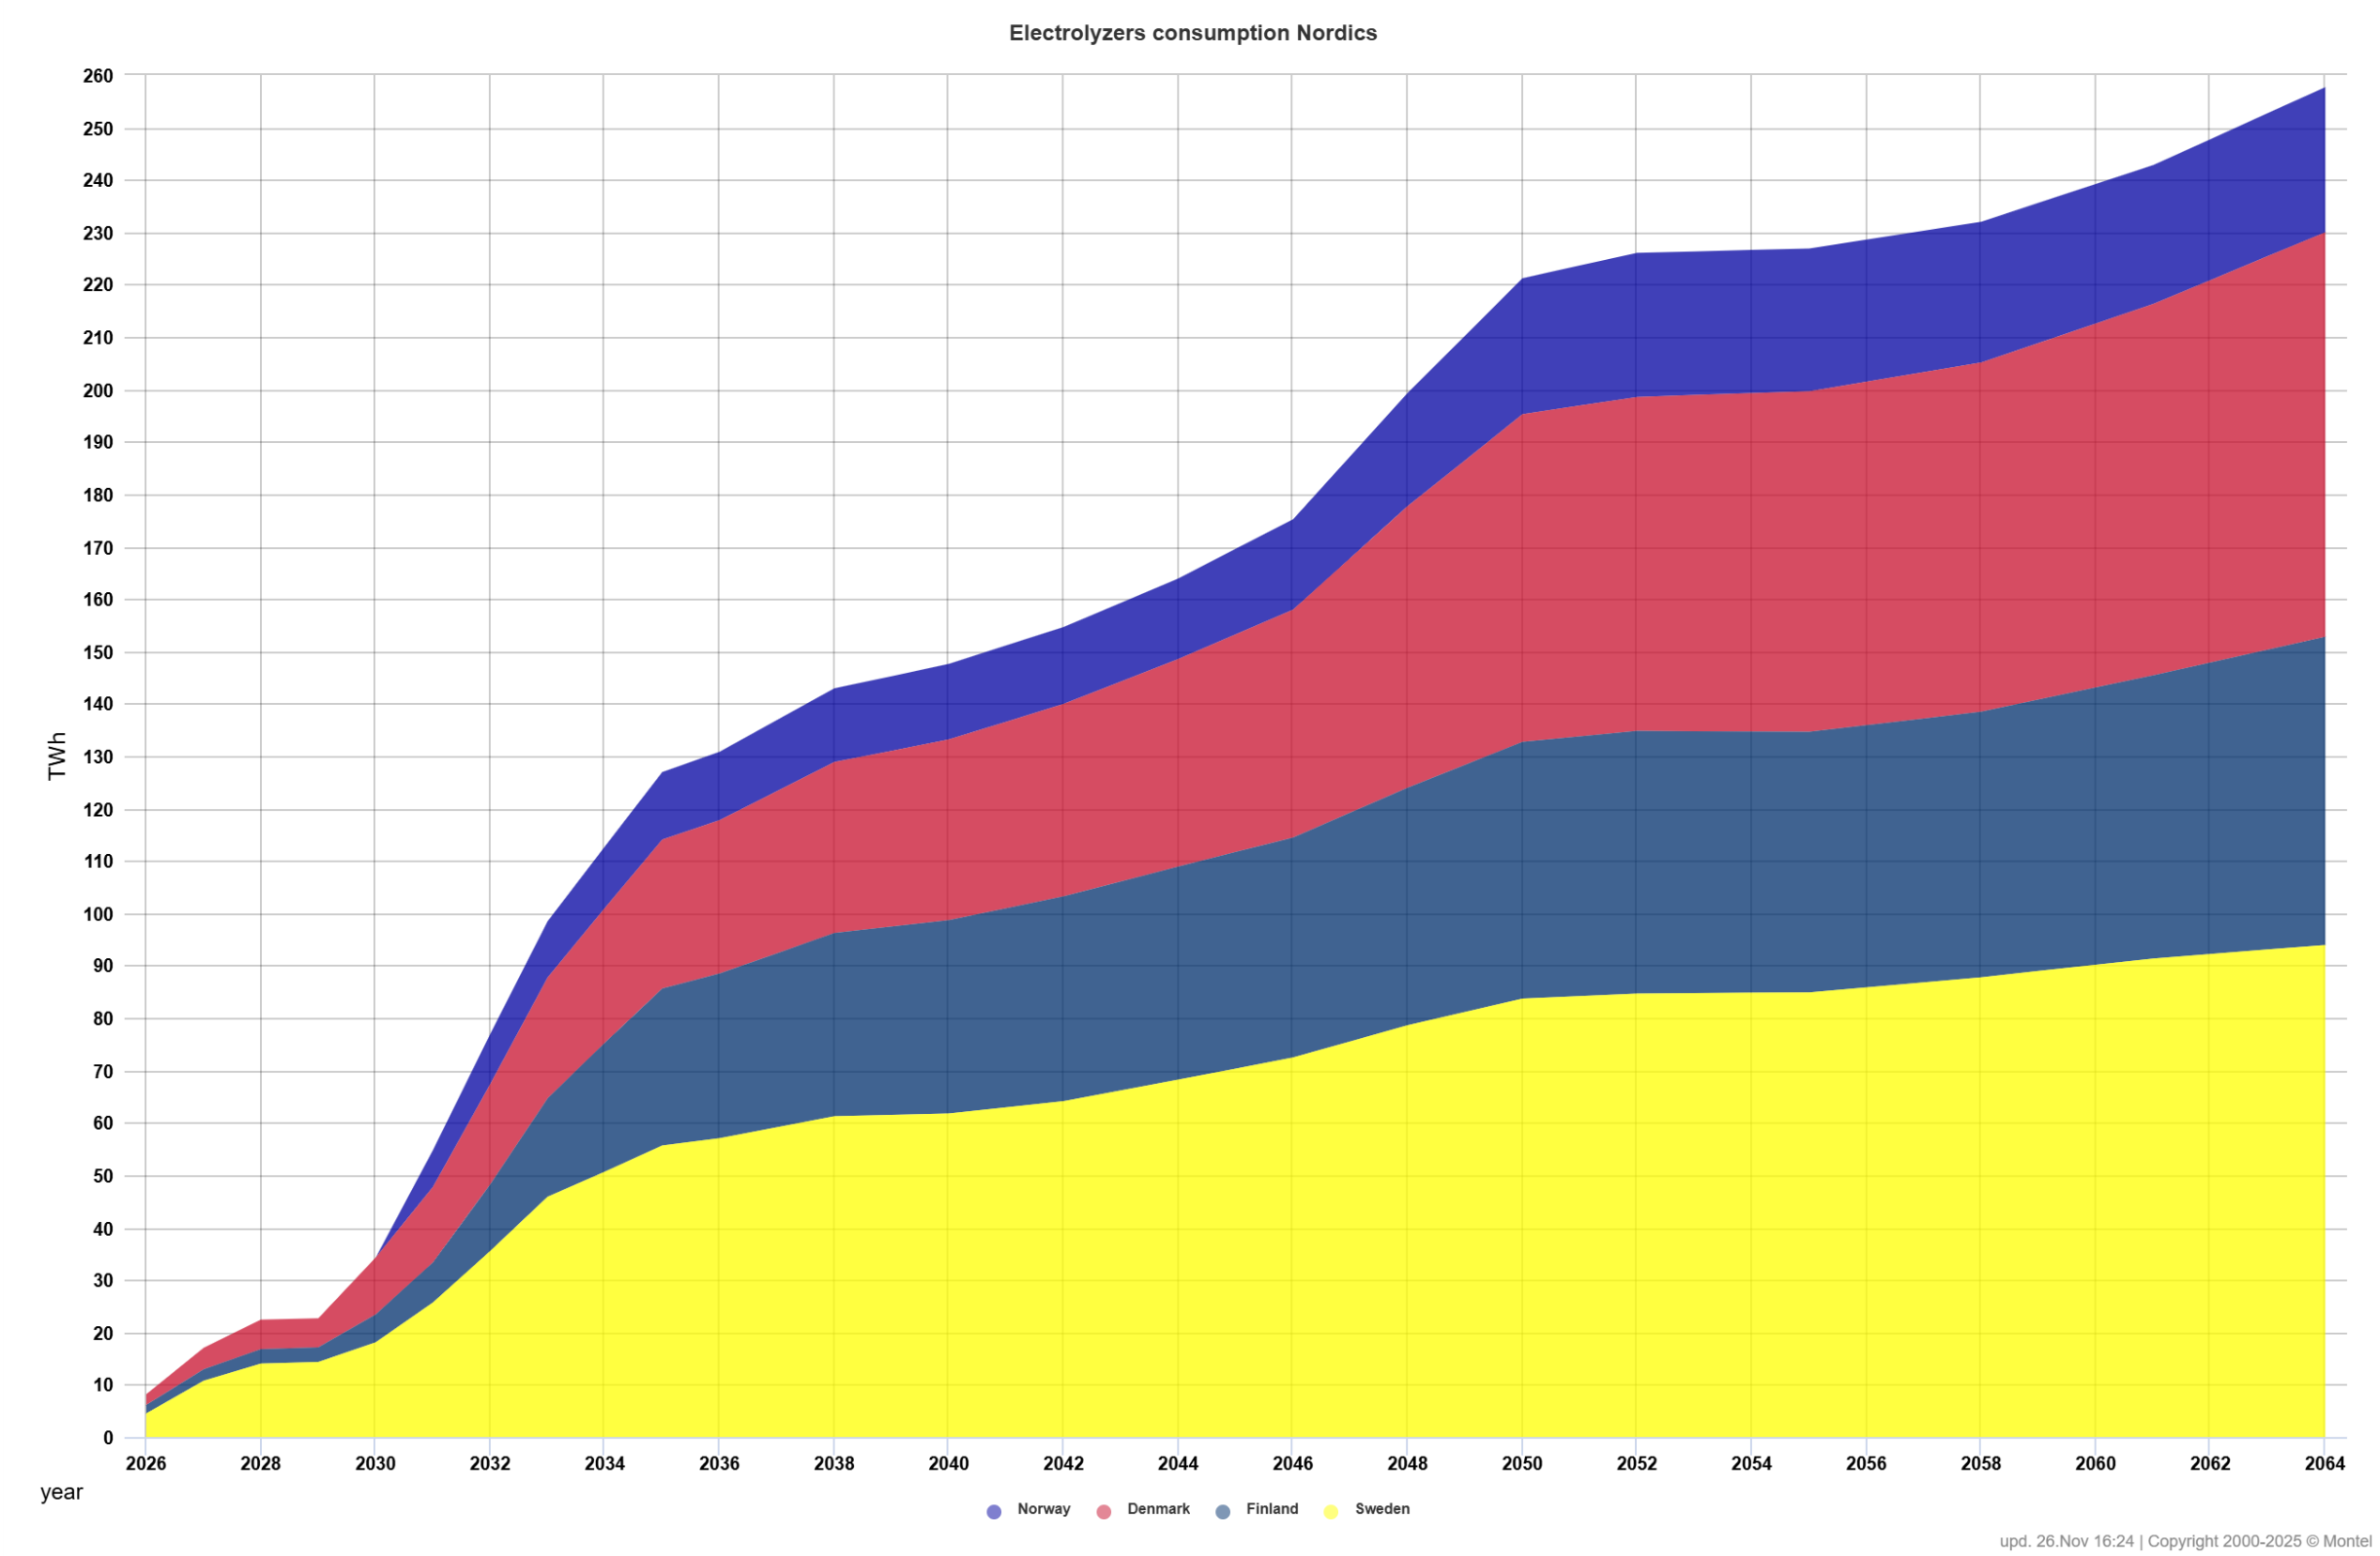
Offshore wind and hydrogen production
Significant amounts of offshore energy entering the market are strongly increasing volatility and causing a decline in capture rates.
Such development will require significant amounts of flexible sources in the form of optimized electrolyzers.
This assumes both a significant decline in the LCOE of offshore wind and the LCOH of electrolyzers. A 50–70% decline in LCOH appears overly optimistic and would require substantial technological penetration.
The competitiveness of renewable hydrogen is primarily determined by the cost of renewable power, which accounts for approximately 50% of total costs.
Additionally, capital investment in electrolyzers plays a significant role in influencing the overall cost of renewable hydrogen.
Currently, the total costs of electrolyzer operations are not profitable and require either full CAPEX subsidies or guaranteed CfD (Contracts for Difference) agreements.
H₂ demand flexibility assumes that when electricity prices rise above a certain threshold or cut-out price, electrolyzers will stop producing.
Amount of green H₂ produced in the Nordics is expected to be highly significant, reaching 30% of total consumption by 2060, still much lower compare to TSOs forecasts.

Slide 8
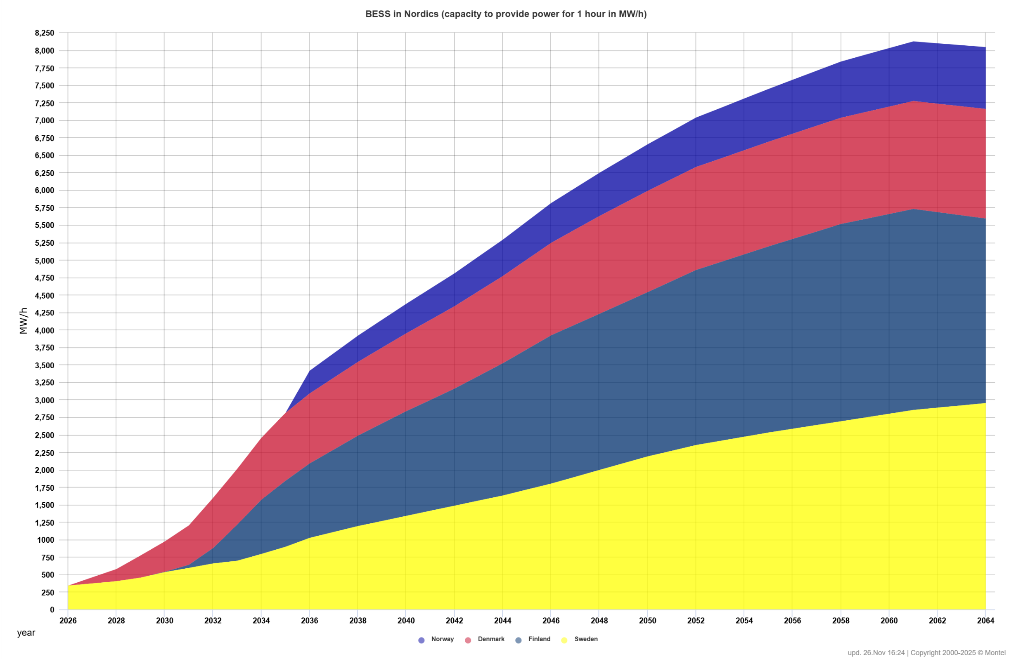
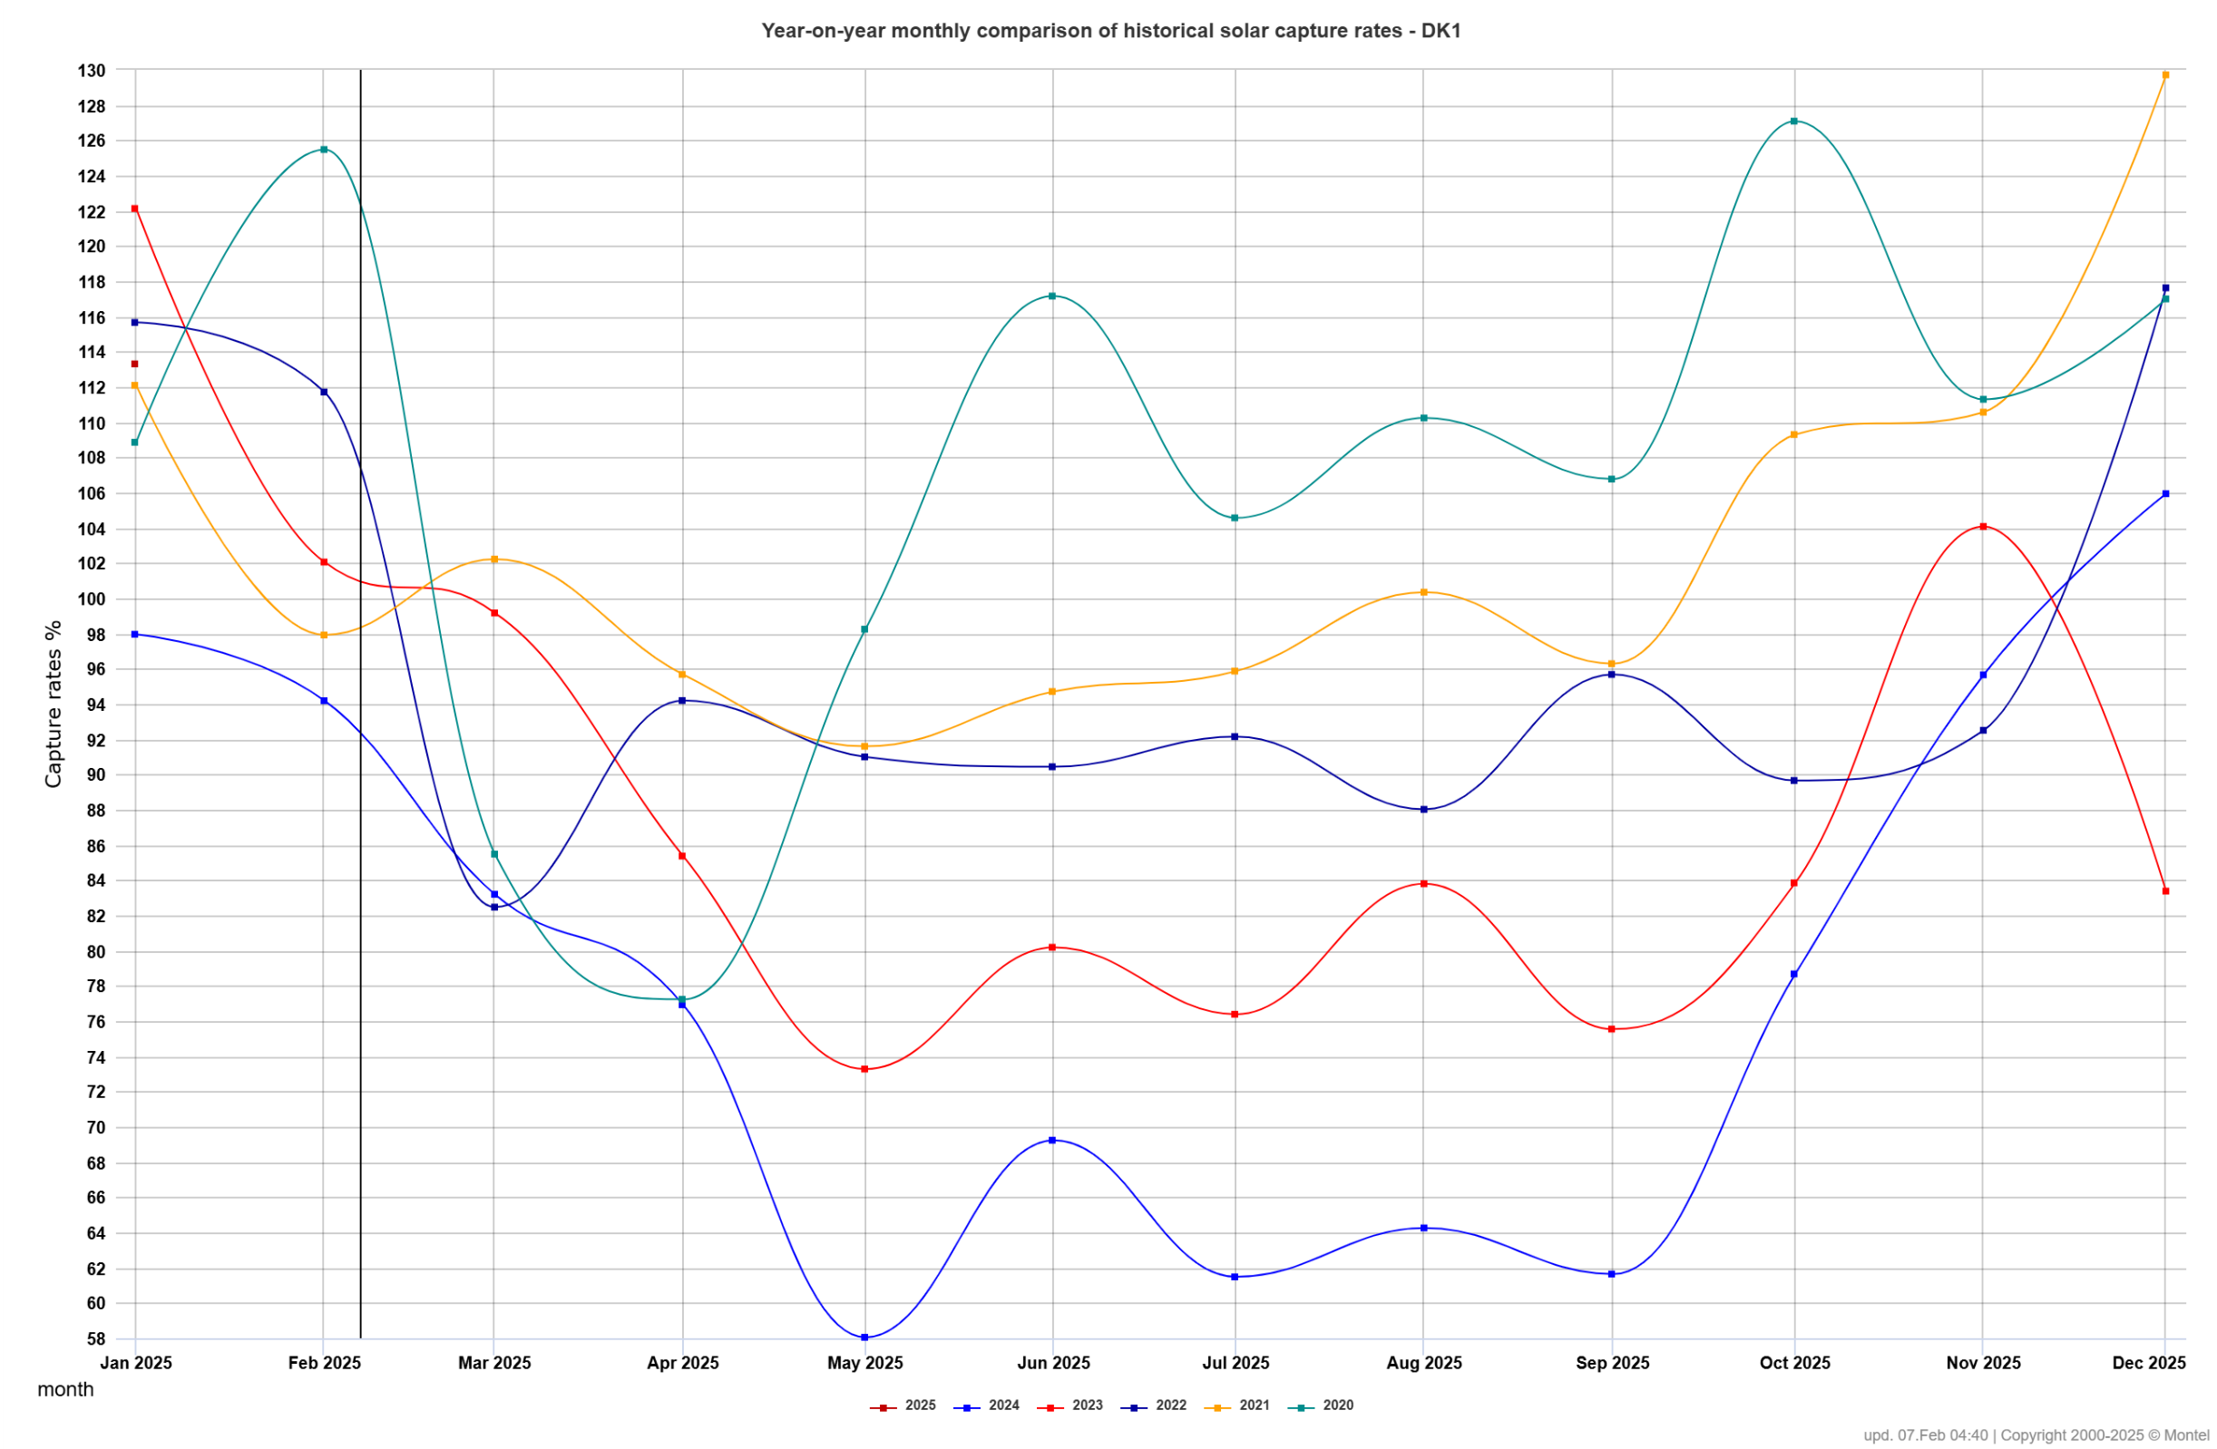
Solar and BESS
Due to the nature of solar production (primarily during daytime in summer), the impact of cannibalization is stronger compared to more stochastic wind production.
Significant solar construction development, exceeding 15–20% of installed capacity, has necessitated the construction of BESS.
Without BESS, the archived capture prices during periods of high solar production are too low to sustain solar profitability.
The issue of cannibalization has already become a significant problem in Denmark, where archived prices during summer have dropped to 55–60% of their potential value.
In Norway and Finland, the relatively modest volumes of solar capacity facilitates solar growth, as the lower penetration levels mitigate the cannibalization effects.
A "chicken or egg" dilemma persists—solar energy is not profitable without optimized BESS, but the current amounts of BESS remain insufficient and primarily utilized in the ancillary service market currently.

Slide 9
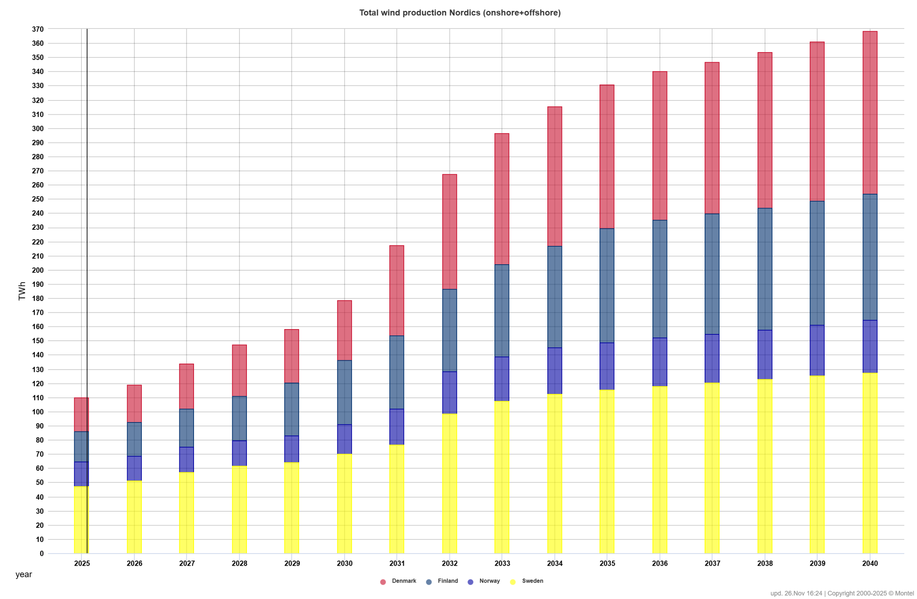
Wind production profitability
Significant differences in profitability between regions due to area price (regional power balance) and variations in capture rates.
Northern Sweden has the lowest archived prices due to oversupply, low prices, and limited transmission capacities. This also impacts development in northern Norway.
The absence of new wind production in Norway and low expectations, due to environmental objections, supports capture rates in southern areas. Market prices in these regions benefit from strong connections to European and UK markets, leading to higher profitability.
Finland has experienced significant wind energy growth in recent years, but the low flexibility of its existing power fleet and its connection to northern Sweden result in weak capture rate development, leading to relatively low archived prices.
In Denmark, onshore wind development is restricted, while extensive offshore expansion is planned in alignment with electrolyzer construction. This has led to relatively stable development despite current low capture rates and higher prices due to connection to Germany.

Slide 10
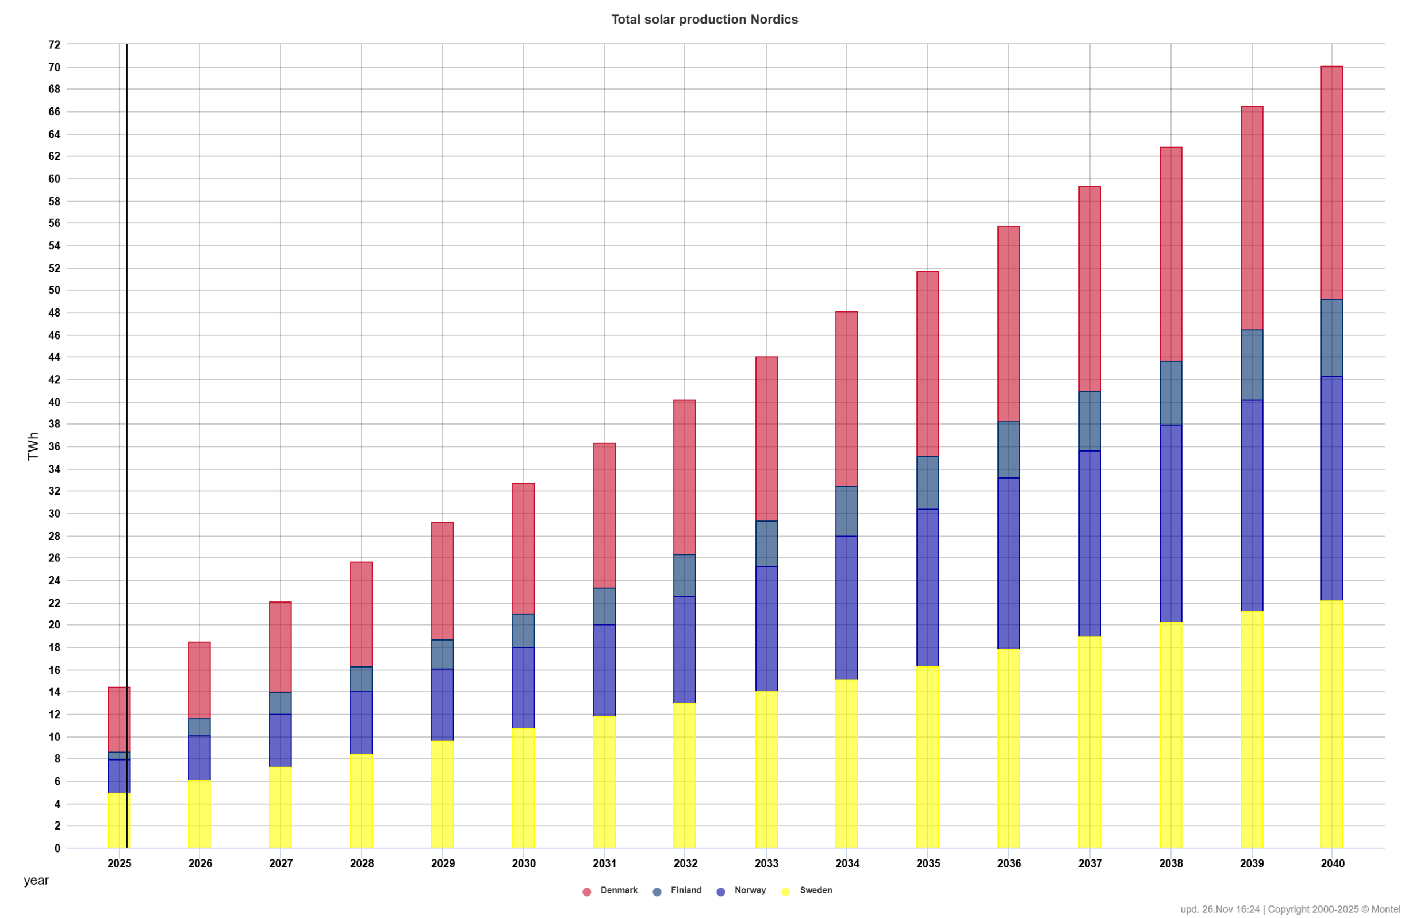
Solar production profitability
The concentration of solar production during daytime and summer assumes the construction of significant amounts of BESS , which nearly doubles the cost of solar installations in Europe.
Due to its latitude, southern areas of Scandinavia are preferred for solar development, although there are examples of solar installations further north.
However, in all areas except Norway, either stand-alone or hybrid BESS will be required to facilitate further solar penetration.
This is particularly true for southern areas, where there is a strong correlation between local solar production and European one
The lack of major solar development in Norway so far has resulted in the best capture rates and archived prices. However, administrative issues are expected to be resolved, leading to increased solar production in the future.
BESS is the least profitable in Norway compared to other countries due to a flatter price profile, which is attributed to the flexibility offered by the existing hydro resources.

Slide 11
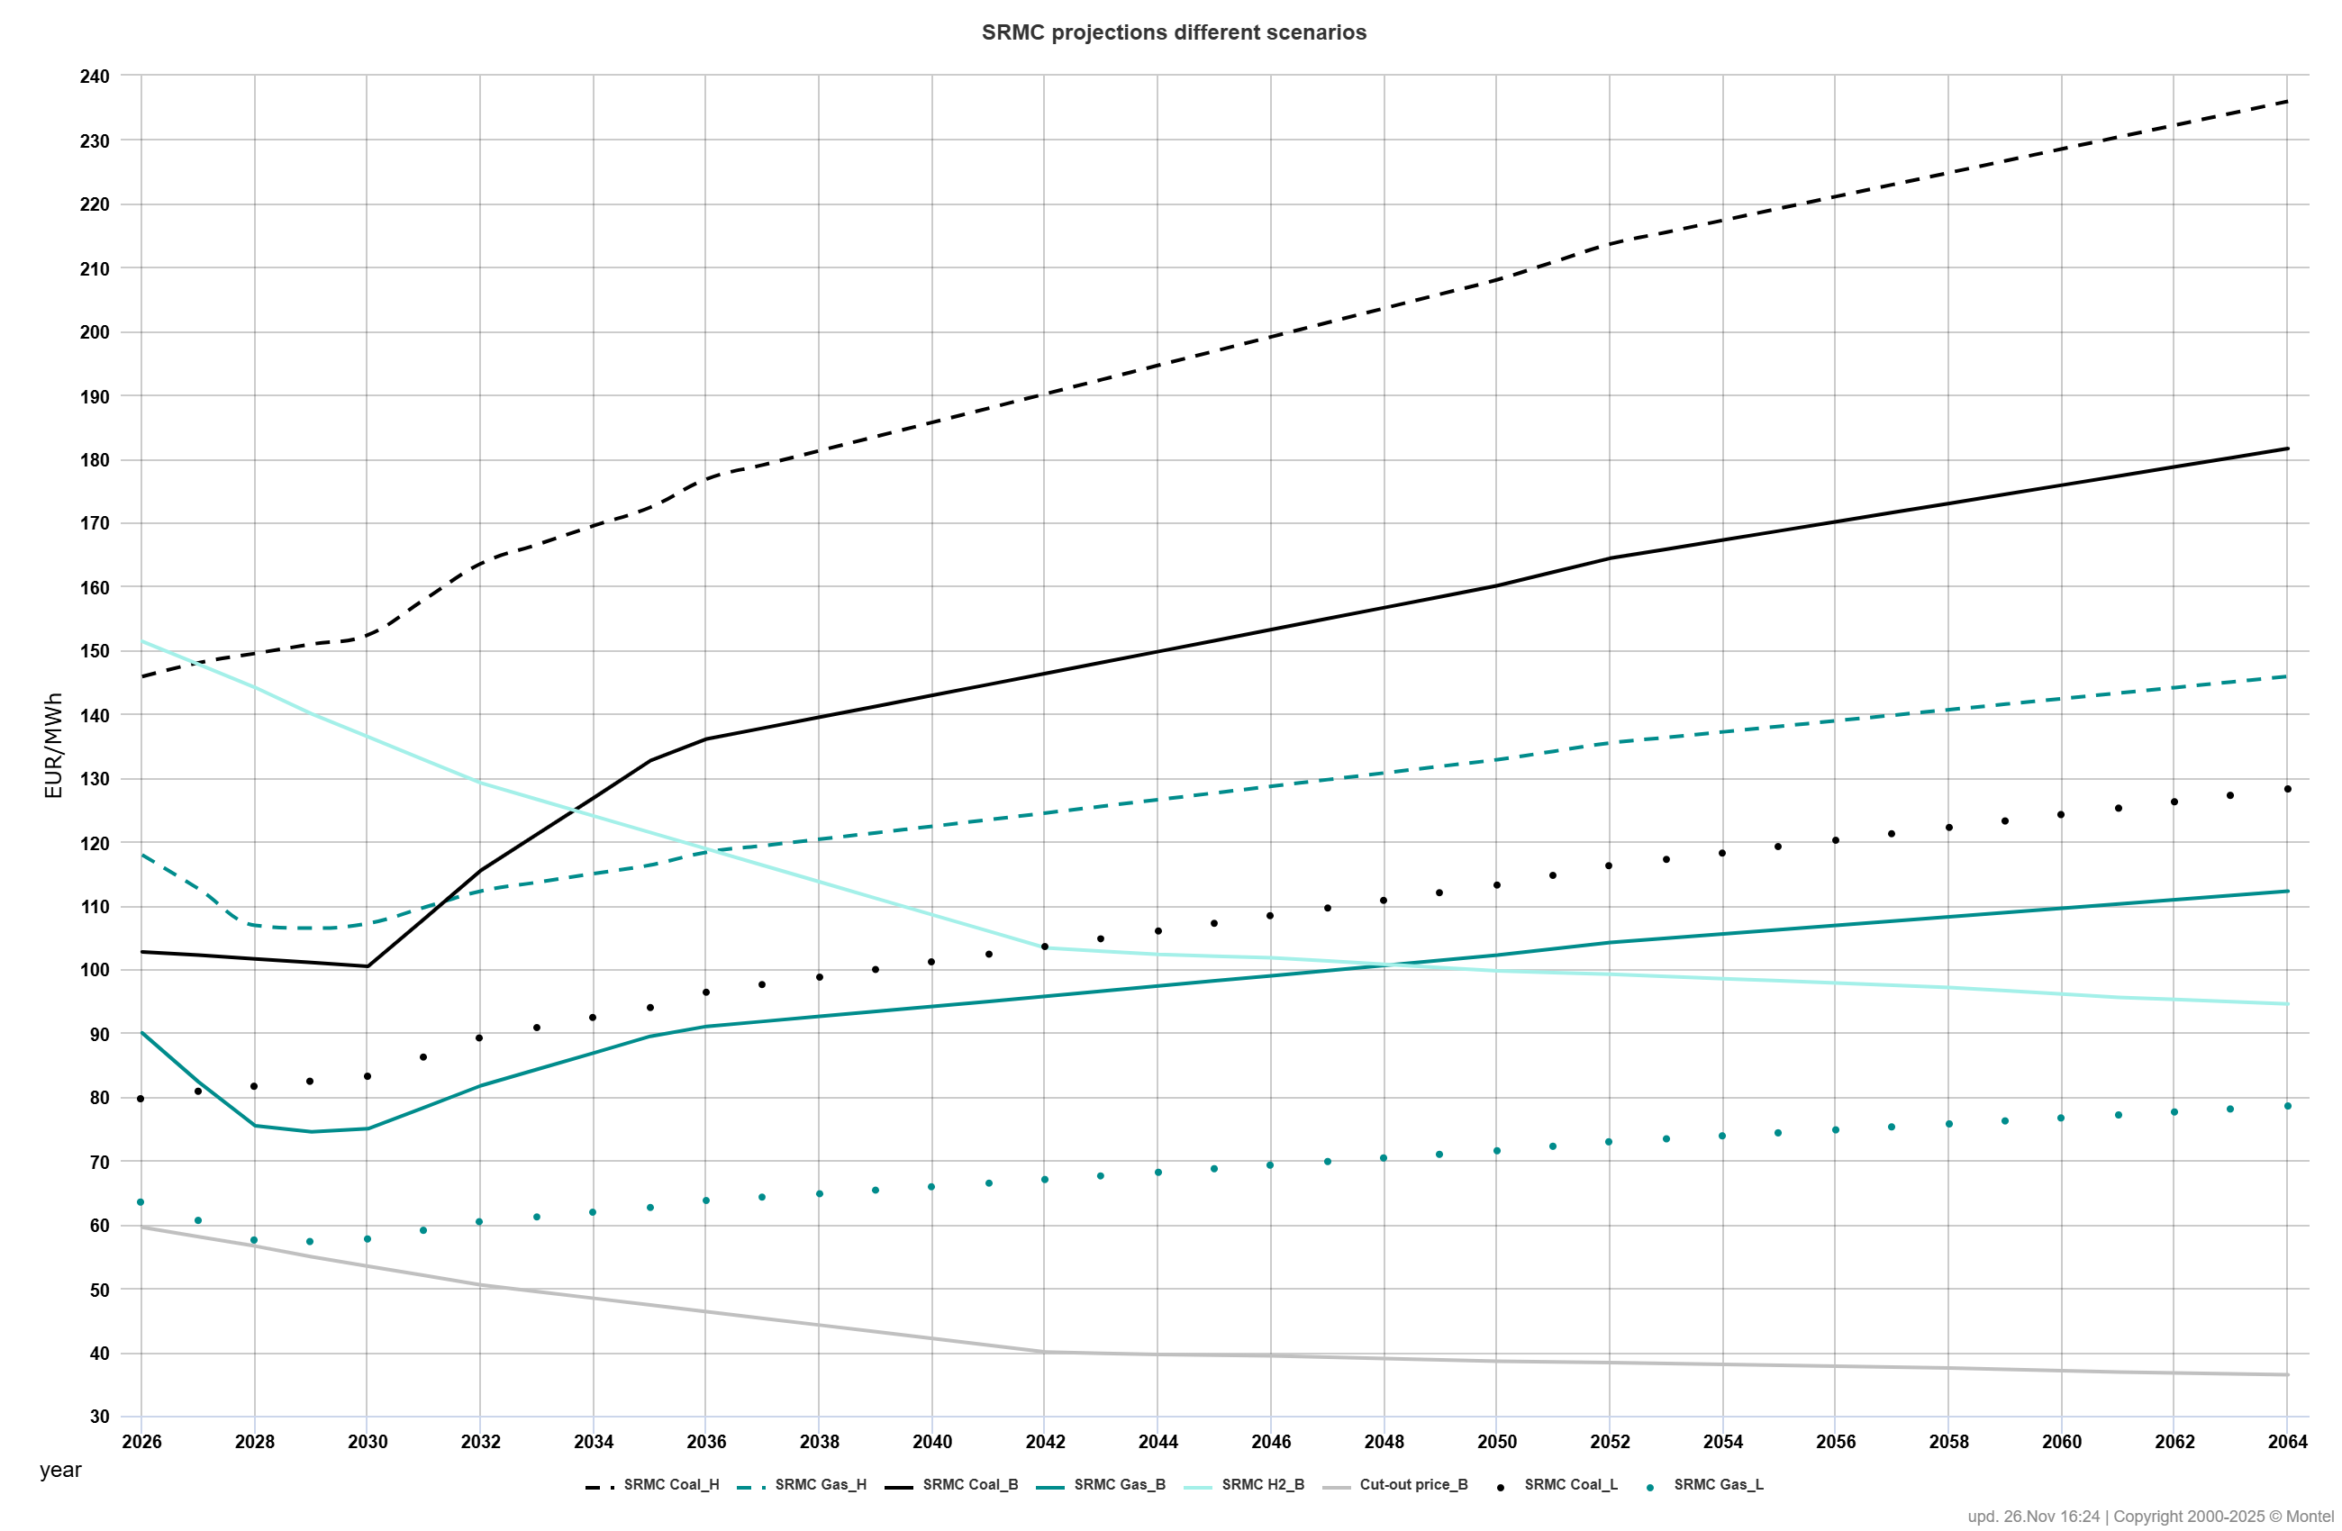
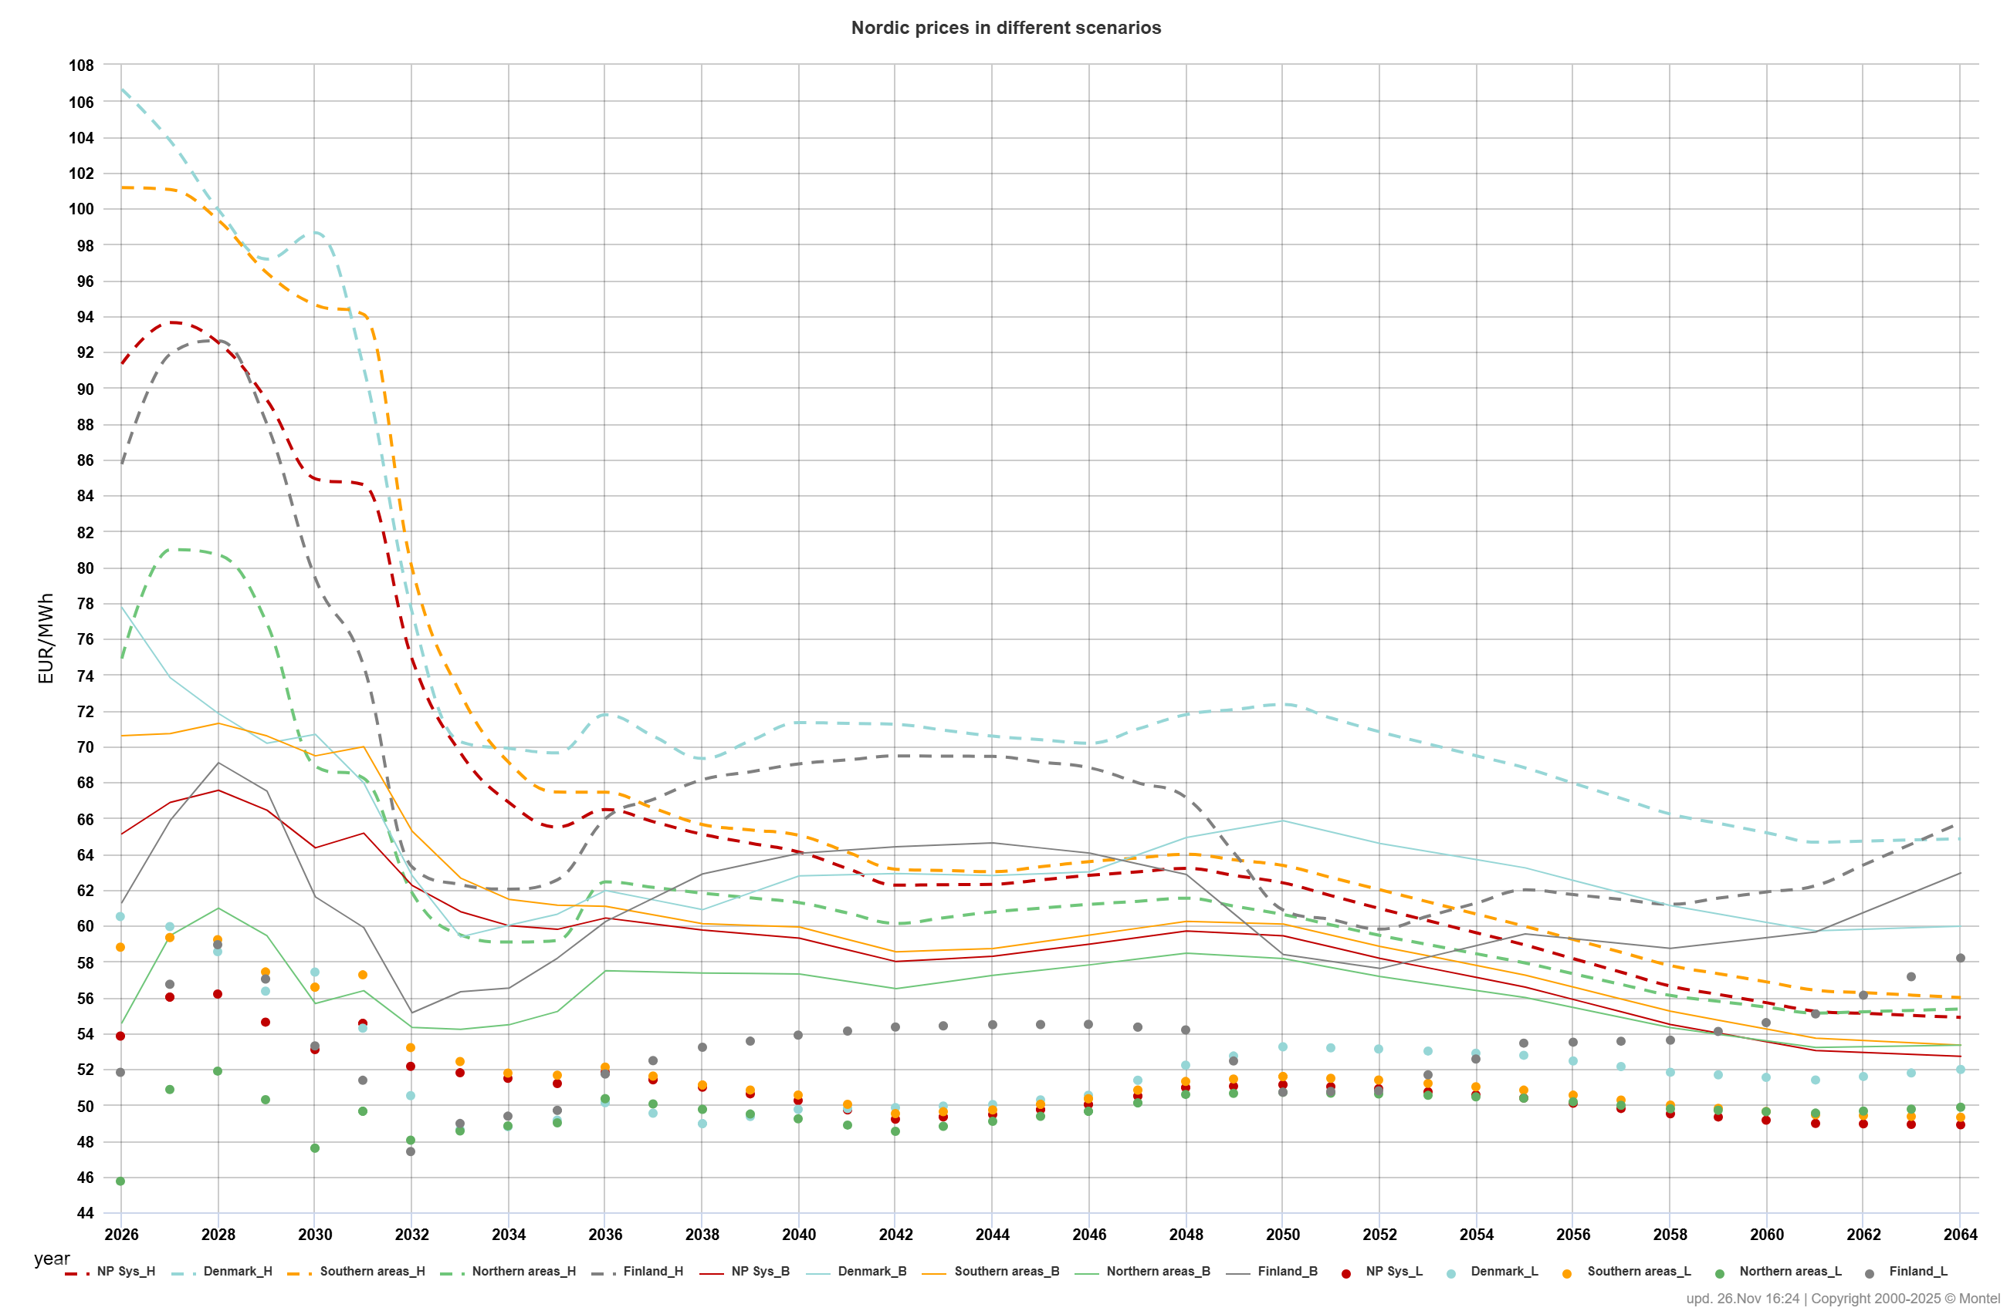
Price development sensitivities
Until 2030-2035, carbon and thermal prices still have a major impact on power price development through the SRMC costs of the remaining thermal generation.
Our sensitivity scenarios assume a 30% decrease/increase in thermal SRMC costs
A strong SRMC increase could lead to a radical impact on southern areas prices, resulting in significant price differences and triggering investment in renewable generation.
An increased commodity price level improves RES profitability and lead to further growth, initiating a sharp price decline afterward.
Lower power price level will have a major impact on commercial offshore wind construction, making it unprofitable and reducing the penetration of hydrogen
Extending the lifetime of the nuclear fleet or the construction of Small Modular Reactors (SMR) in Sweden and Finland will be challenging with lower prices, resulting in a significant reduction in nuclear production by the 2040s.
From 2035, the H2 price will be the main decisive factor for power price settlement and renewable construction and future development of it will be crucial

Slide 12
Other risks
European strategy to reduce dependency on Russian energy and transition to a carbon-neutral power system
Political commitment for decarbonization and expected increase in renewable capacity
General economic development and growth
The rate of decline in renewable investment costs
Development of imbalancing costs
Development of required flexible capacities across all areas to facilitate renewable growth
The phase-out of remaining thermal capacity and the construction of additional flexibility generation utilizing green hydrogen
Development of new and extending the lifetime of existing nuclear capacity
Cost development for green hydrogen production and utilization as the main driver for prices after 2035
The speed of green hydrogen technology penetration across power markets on both the demand and power generation sides
Consumption growth, the rate of electrification, and electrolyze consumption
Reinforcement of internal transmission capacities and construction of new interconnectors abroad
Global climate changes
Hydrological and weather situation as the major source of volatility in a shorter perspective
Market and PPA liquidity

Slide 13
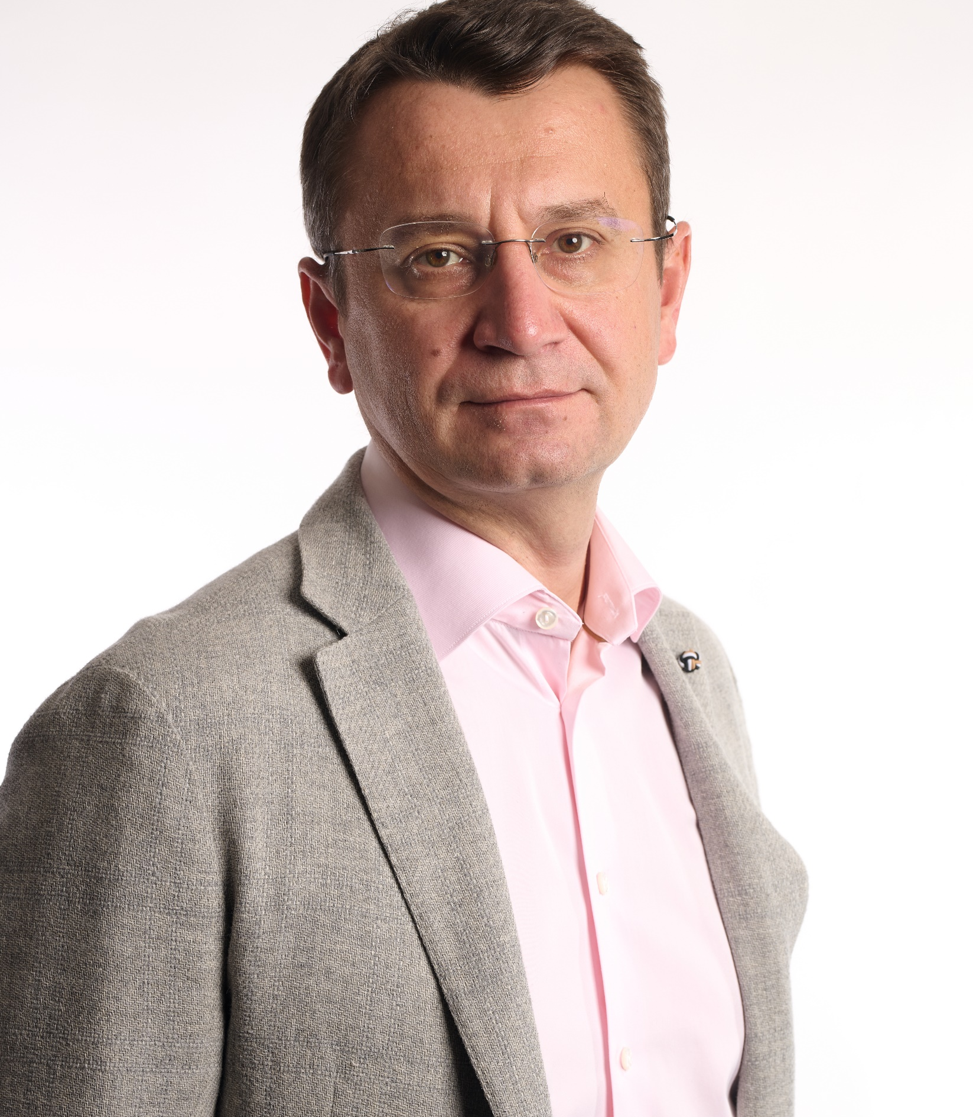



Any questions welcomed!
Viktor Bayberdin – Senior Director Montel SysPower
viktor.balyberdin@montel.energy
+47 73 80 58 00
www.montel.no

