Slide 1
Decarbonising the UK: Challenges and Options for the Incoming Government.

Slide 2
Decarbonising the UK: Challenges and Options for the Incoming Government
Generation Build Out
Targets in the Manifesto
Double Onshore Wind (15 to 30 GW)
Triple Solar (17GW to 51GW)
Quadruple Offshore Wind (13 GW to 54GW)
Invest in CCS, Hydrogen, Marine Energy, Long Term Energy Storage
Extending Existing Nuclear, build Sizewell C and SMRs
Notes:
These

Slide 3
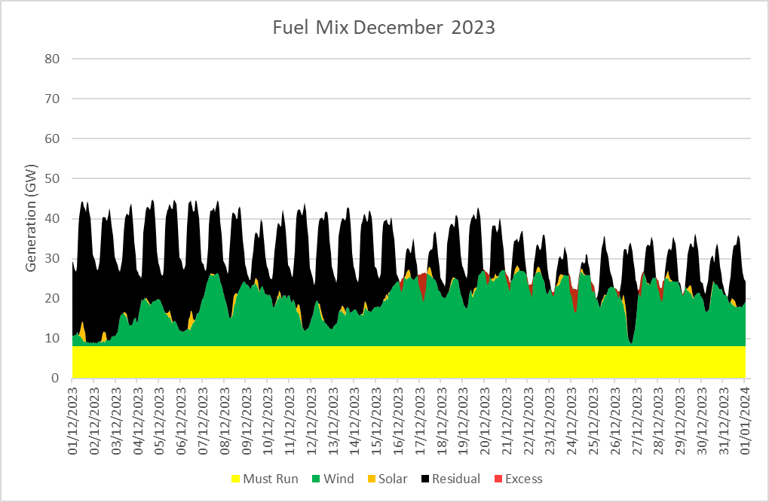
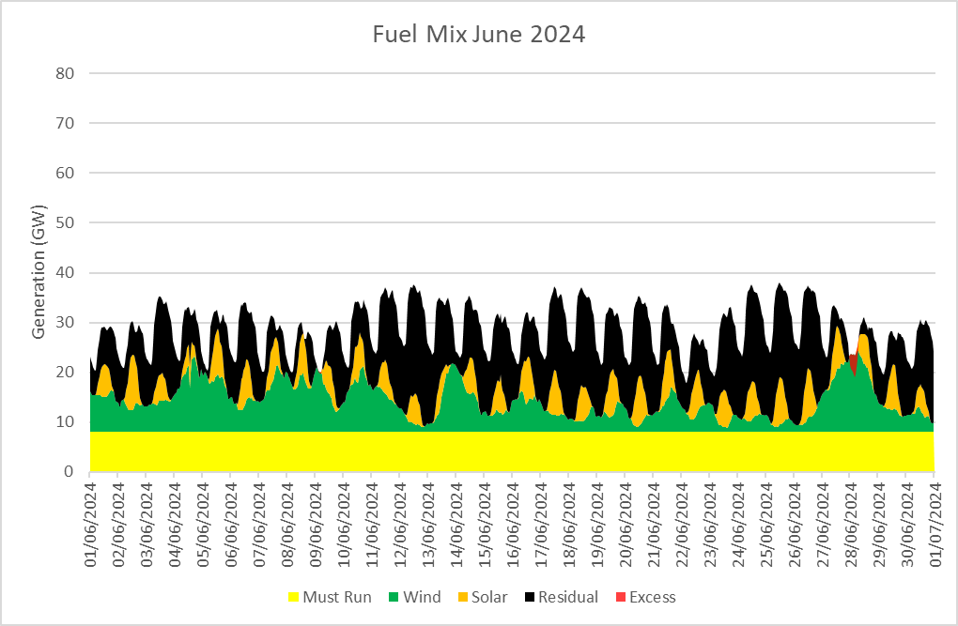
Decarbonising the UK: Challenges and Options for the Incoming Government
Renewable Penetration Now
Source : Montel Analytics
Notes:
This is the current state of the grid, it is a simple model using a fixed must run component of Nuclear, Gas fired CHP and industrial load that creates electricity and biomass. The wind combines onshore and offshore and embedded generation from Elexon / National Grid, solar is from Sheffield Uni data. Then we use indicative demand data from National Grid to get a residual the needs to be met by fossil generation or storage or interconnection. You can see the off occasional period of excess generation, this may be exported or curtailed.
Data is for December, 2023 and June 2024
You can see in these charts the weekly and daily patterns of consumption and the intermittency of wind and solar with lots of space for fossil thermal generation.

Slide 4
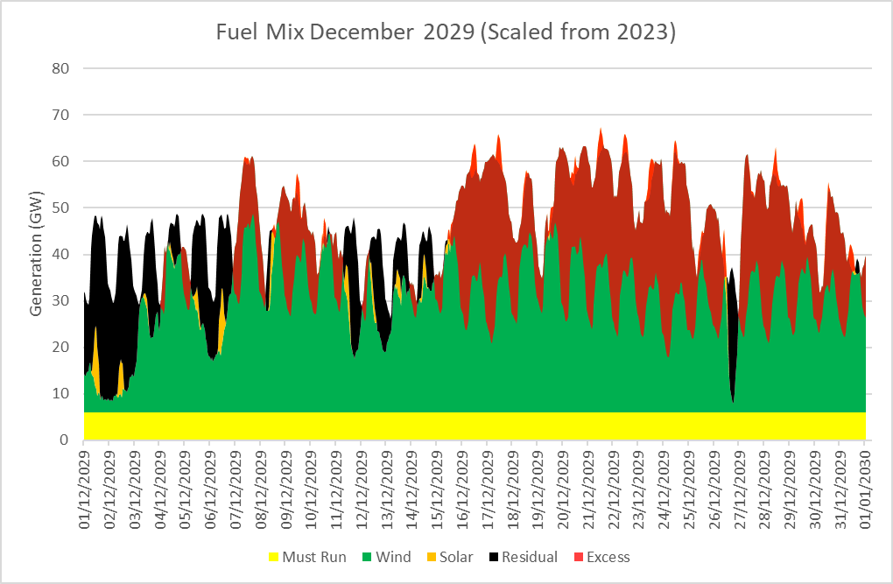
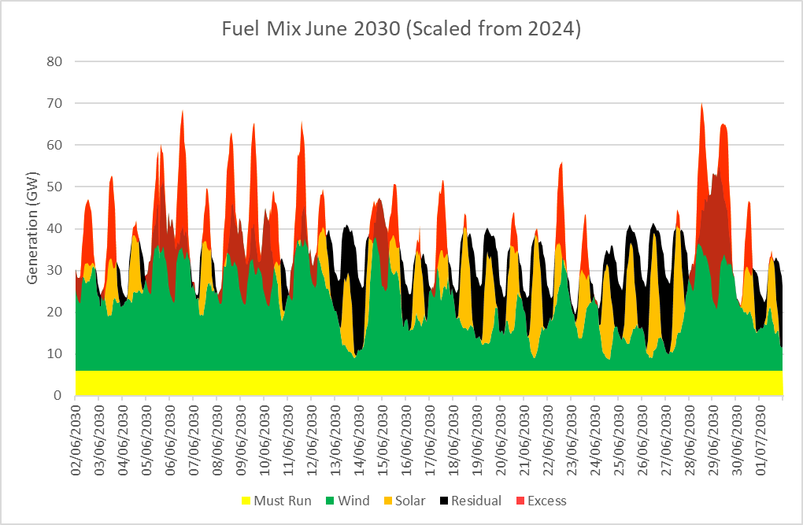
Decarbonising the UK: Challenges and Options for the Incoming Government
Renewable Penetration 2029/2030
Source : Montel Analytics
Notes:
If we apply the scaling of tripling solar and tripling wind we get the following charts. We also have to increase demand so I have used assumptions in the National Grid FES and increased the demand by 9%.
You can see here that there is a lot of excess generation. This is a totally different market. With a lack of grid build out then some of this maybe curtailed or exported but generally we have a market that is heavily oversupplied.
Interconnection capacity will only grow from 10 GW to 12 GW so a fair amount of generation will be wasted and wholesale prices will be less than zero. You can anticipate no build out of hydrogen electrolysers at scale or additional nuclear build out or new pumped storage.
This is very much a supply side revolution, everything else which have to keep up.

Slide 5
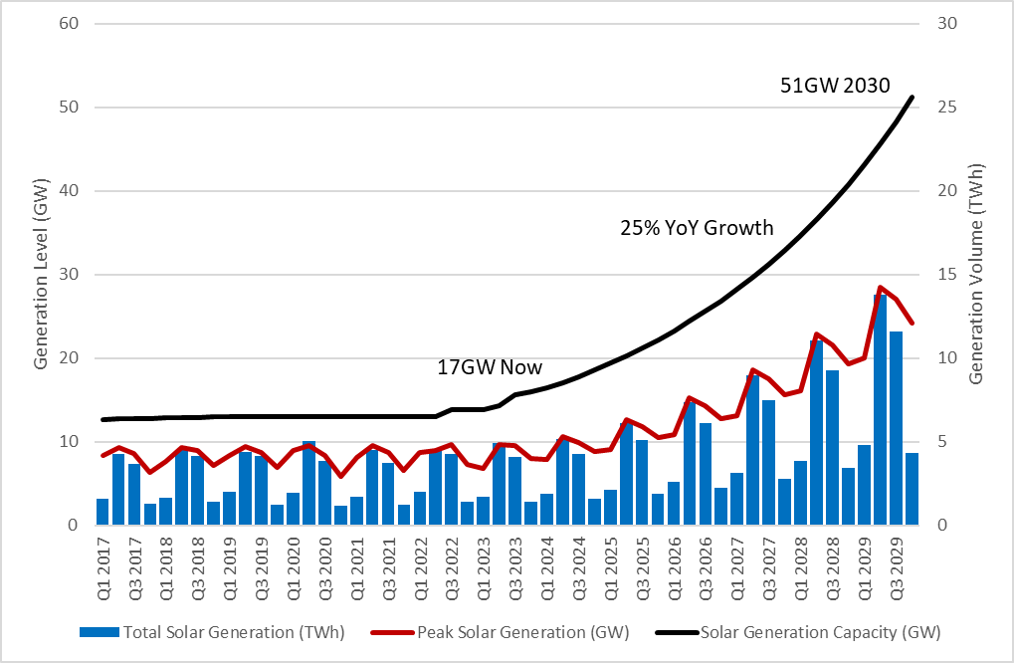
Decarbonising the UK: Challenges and Options for the Incoming Government
Solar Build Out
Source : Montel Analytics
Notes:
Solar has been building without subsidy for a couple of years after stalling at the end of the FIT/ROC regime. Current year on year capacity growth has been around 15 to 20%. To build triple solar requires a build out rate of 25% a year which does not seem unreasonable but you can see the volume of power at peak (just breached 10GW) will be significant on some days.
With this build out of solar NG ESO will need to have the facility to curtail the farms and suppliers will need time of use tariffs on generation to prevent being exposed to negative imbalance prices.

Slide 6
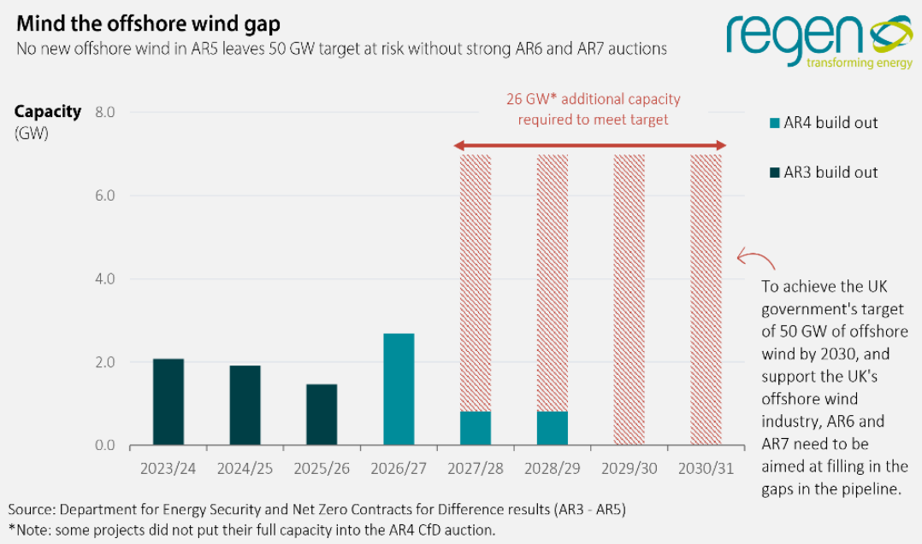
Decarbonising the UK: Challenges and Options for the Incoming Government
Offshore Wind Build Out
Built and Pipeline is 97GW
Currently 13GW operational
8GW building
More with CfD not building
AR-5 Failed
AR-6 3 to 5GW – Push Budget?
AR-7?
Source : Regen Analysis
Notes:
Wind build out is more problematic, the offshore wind pipeline according to renewable UK is almost 100GW built, building and planned. This chart from Regen against the existing 50GW target shows that the 4x offshore wind is a challenging target. Currently slightly more than 13GW is operational and 8GW is building, more with a CfD but yet to start. However, AR5 failed to deliver any capacity, AR6 is only going to bring on between 3 and 5GW unless the new government gets the billpayers cheque book out. Realistically windfarms getting contracts in AR7 will potentially build in time for 2030 but AR8 onwards are unlikely to be around

Slide 7
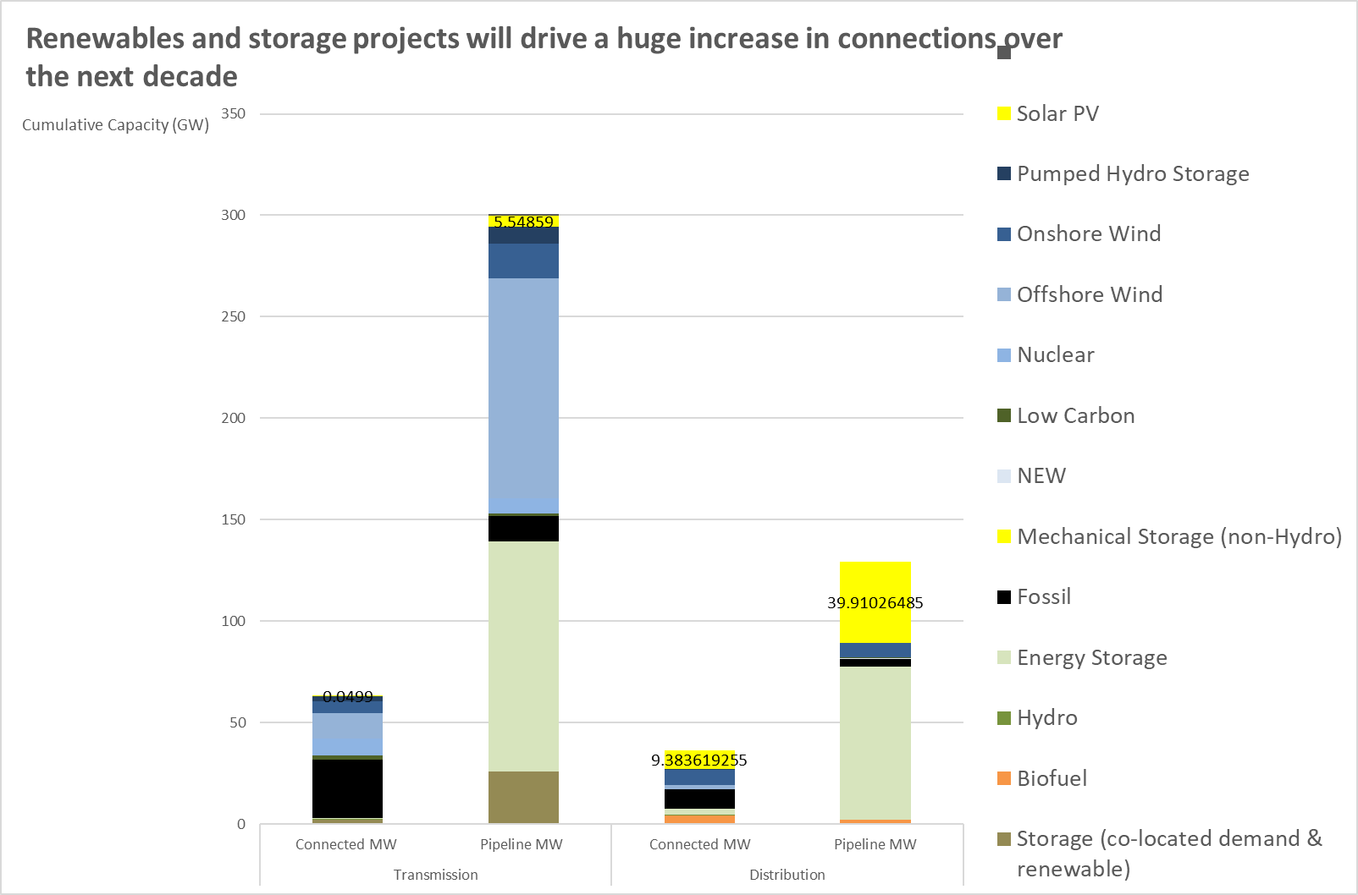
Decarbonising the UK: Challenges and Options for the Incoming Government
Wind Build Out
Projects already in the queue
Planning Reform - Done
Unsubsidised?
Source : Regen Analysis
Notes:
Onshore wind has a healthy grid connection queue and potentially could build quickly but it is likely these plants would be unsubsidized. This means they will be price reactive which as explained in the first slides will be

Slide 8
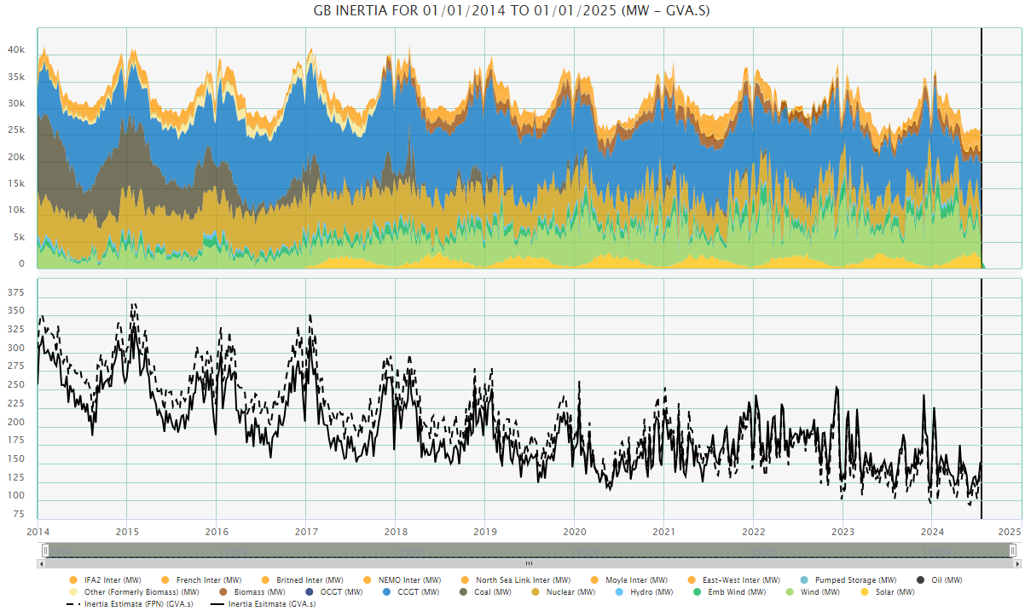
Decarbonising the UK: Challenges and Options for the Incoming Government
Barriers
Planning
Grid
Supply Chains
Stability
Source : Montel Analytics
Notes:
What are the barriers to build out.
Planning, the onshore ban has gone but NIBMYs will still try and stop onshore wind and overhead transmission
Grid, the grid needs to reprioritize the queue to build those who can and investment in copper needs to happen quickly to prevent constraints. First Ready, First Served
Supply chains will need to scale to build out the generation capacity
There needs to be heavy investment in stability services like inertia support, voltage control and reactive power. All the stuff that will be built will be DC.
The current interconnection queue to the continent probably needs to be revisted after all but one project was not approved by Ofgem
GB energy needs to come up with money for infrastructure and innovation

