Slide 1
The EU Energy Outlook - Update Q4-2024
Notes:
Welcome to this webinar, welcome to our perspective on the future of power prices in Europe.
This is the EU Energy Outlook, the Update for Q4-2024.
My name is Matthis, I work for the new Montel, which is well known as a provider of energy news and data. But Montel nowadays comprises of several analytics entities, therefore Montel offers also enhanced data, modelling and plenty of consultancy services.
Energy Brainpool is one of these analytics entities that has joined Montel in January this year.
I have had the priveledge to work with talented colleagues within Energy Brainpool for the last five years – now I have many more wonderful colleagues in Montel.
Some of you may know the EU Energy Outlook from the time when we were operating under the company name „Energy Brainpool“. Some of you will see our report for the first time.
I would like to welcome all of you.

Slide 2
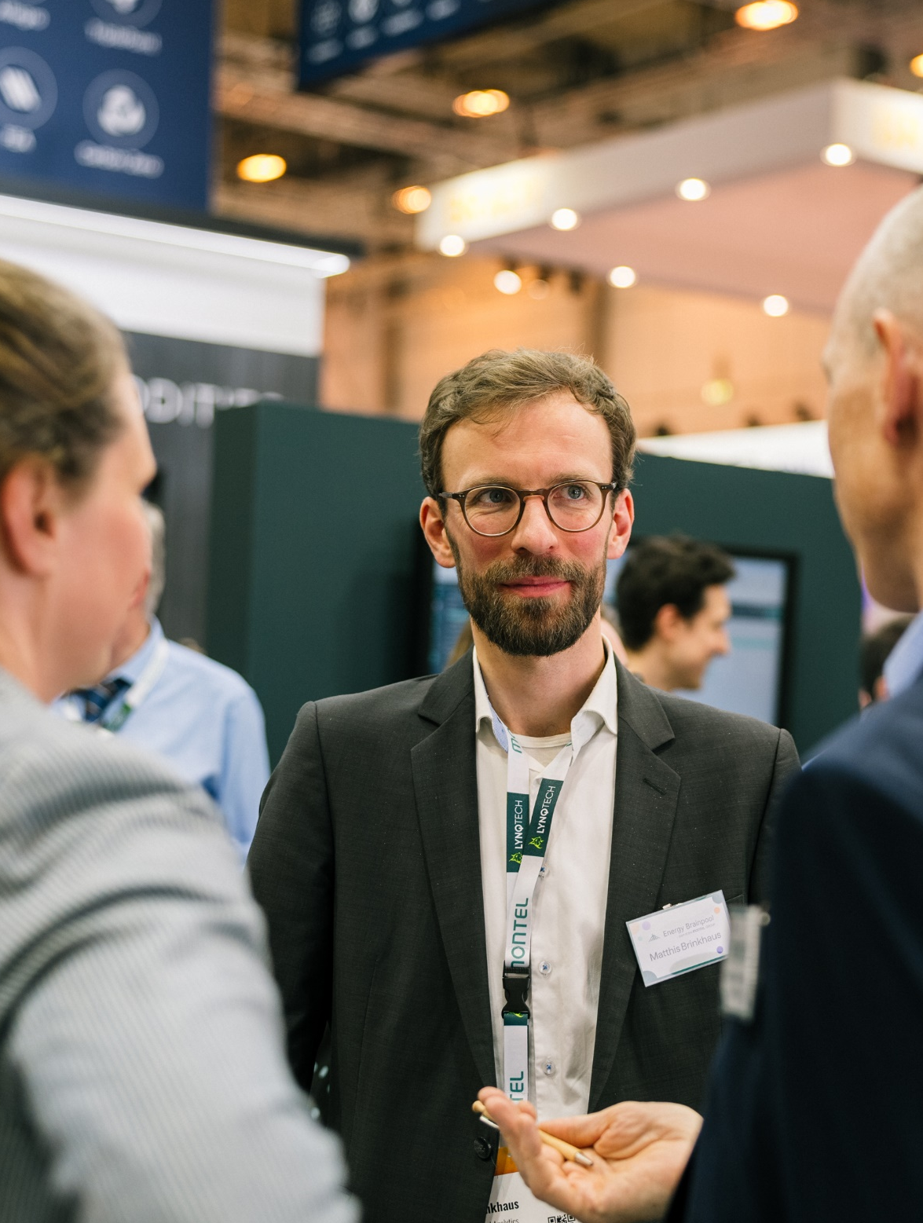
Webinar
Introduction to fundamental modelling and power price scenarios
Scenarios in the BrainReports: The stories behind Central, Tensions, GoHydrogen
Updates from the World Energy Outlook & Adaptation of commodity prices for our scenarios
Updates on further scenario assumptions and input parameters
Results: European power prices until 2060
Q&A
Agenda
December 5th, 2024
Matthis Brinkhaus
Senior Analyst
matthis.brinkhaus@montel.energy
Notes:
Today we will speak about power price forecasts for the long run, for the next decades.
First, I will introduce to you what fundamental modelling actually is.
Then I will explain our scenarios – that is which storylines did we select to look into the future
Afterwards I will explain what we have changed in our modelling since the last update and why
And finally I will share some results for the average European power prices as well as capture prices
With regards to housekeeping rules:
Ask questions through the „Question“ tab next to the „chat“, I will get back to them at the end of the presentation
Unanswered questions will be answered in a follow-up email for sure
Interact with me and the rest of the group through Mentimeter:
Question 1: Have you seen a power price scenario before?

Slide 3


Energy Brainpool is now part of Montel
Montel Analytics – Experts for energy markets across Europe
Analyses and scenarios
Training and simulation games
Individual consulting
Workshops
Studies
All-commodity data platform
News platform for the European energy sector
Analyses of short-term and long-term markets
Price forecasts from seconds to decades
Notes:
One more word about who is Energy Brainpool and who is Montel:
Energy Brainpool is a Berlin Based company, we own and operate our own fundamental Model for more than 17 years now.
We use it to create our own power price scenarios, to calculate fair values for PPAs, to analyse the impact of political measures, and much much more.

Slide 4
Introduction & overview

Slide 5
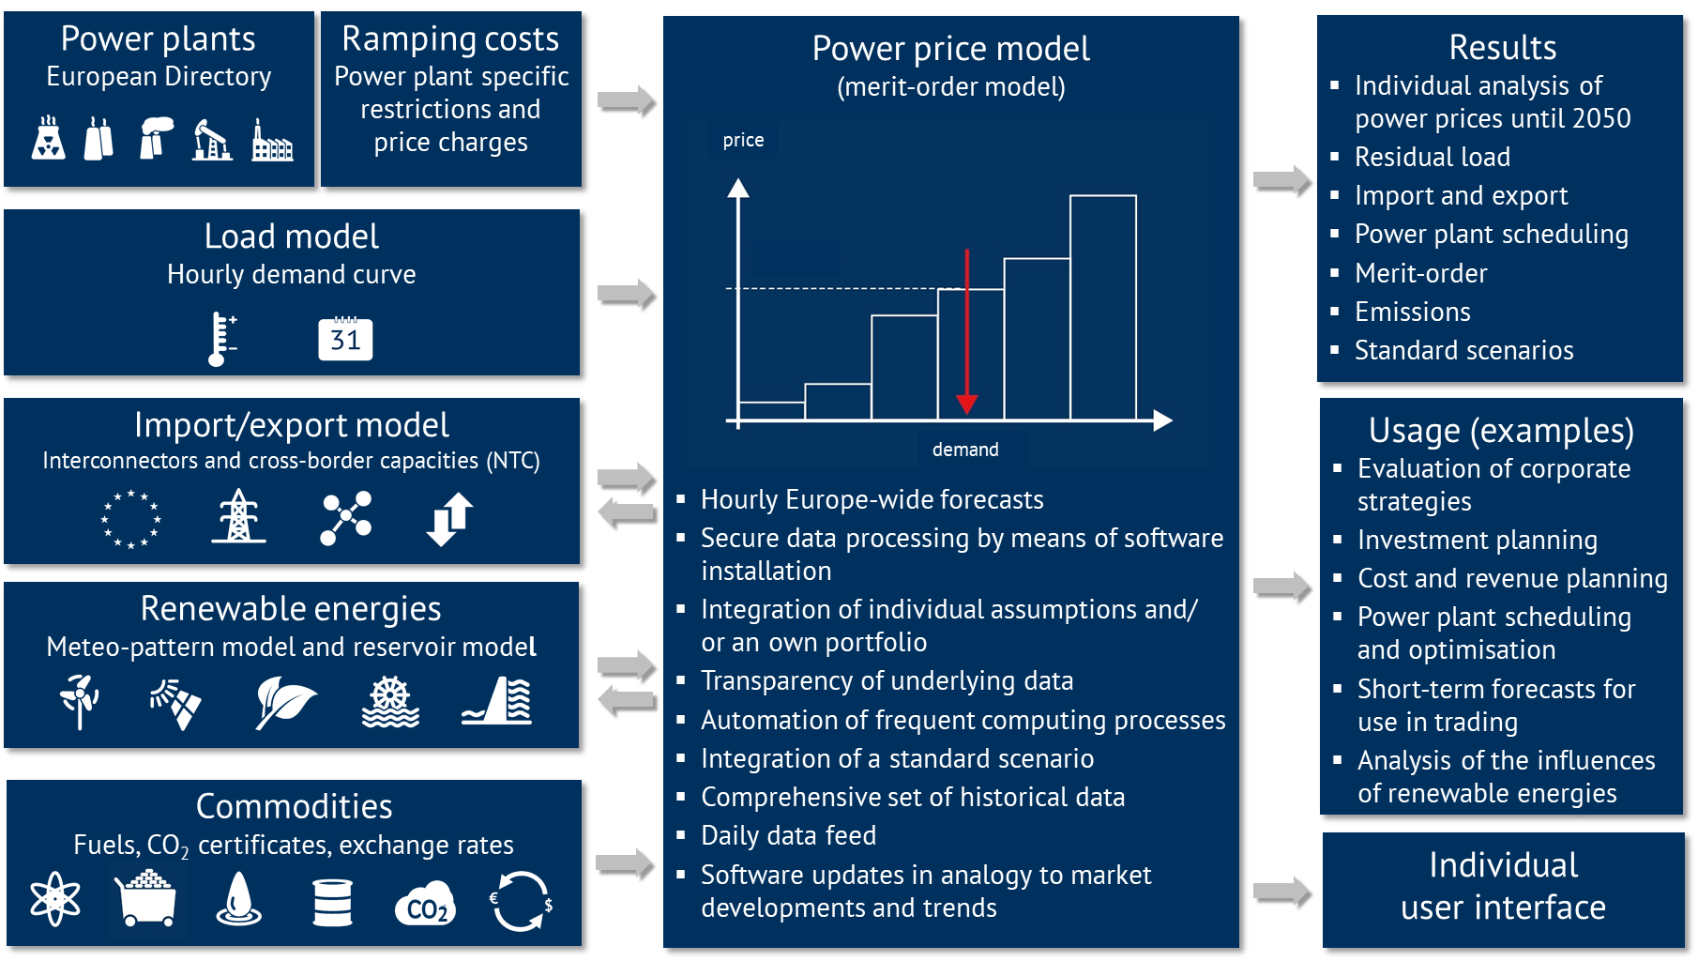
Model structure & functionality
Introduction & overview
Modelling of the energy-only market with import/export
Careful selection of input parameters and backtesting
Hourly prices until 2060
Quarterly updates

Slide 6
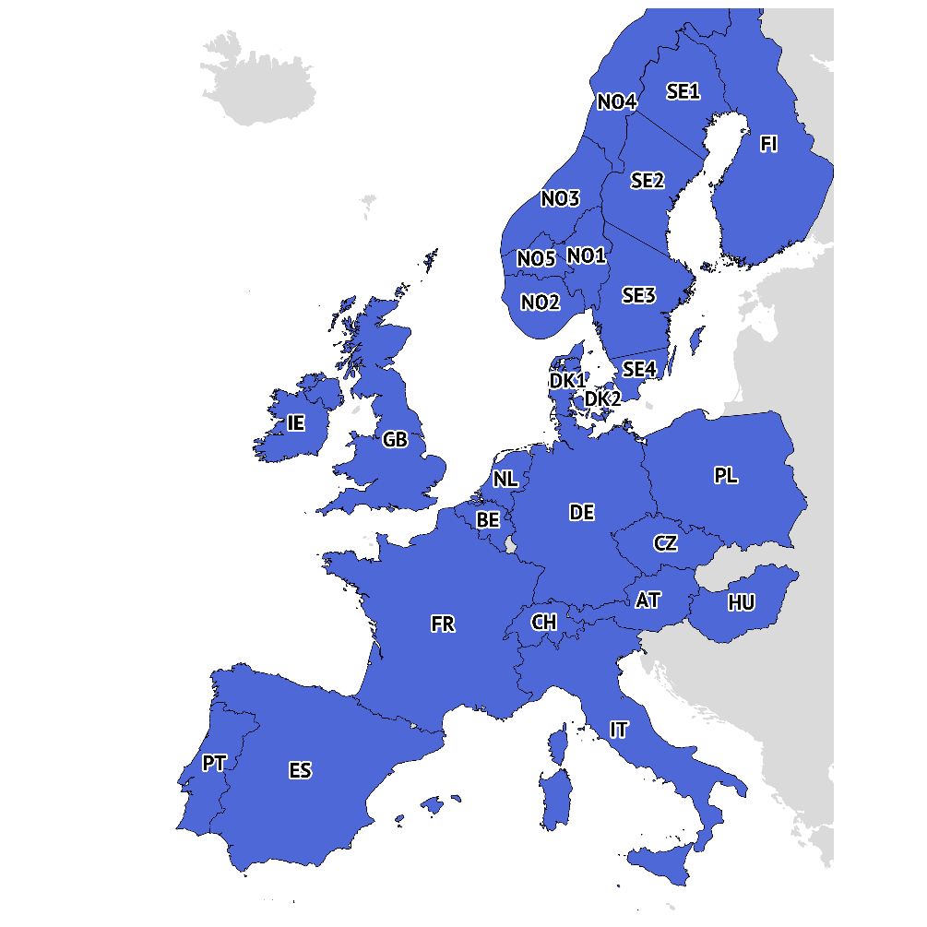
Country coverage
Introduction & overview
The fundamental model Power2Sim covers 30 countries: the EU27 plus the GB, Norway and Switzerland.
We offer ‘BrainReports’ for 18 countries in Europe, each with three scenarios: „Central“, „Tensions“ & „GoHydrogen“
AT (Austria)
HU (Hungary)
BE (Belgium)
IT (Italy)
CH (Switzerland)
IE (Ireland) / SEM
CZ (Czech Rep.)
NL (Netherlands)
DE (Germany)
NO (Norway)
DK (Denmark)
PL (Poland)
ES (Spain)
PT (Portugal)
FI (Finland)
SE (Sweden)
FR (France)
GB (Great Britain)
Since Q3-2024, we have been modelling the Nordic electricity price zones separately so that assumptions and results are displayed in the reports for each zone.
Notes:
Mentimeter: pin on image

Slide 7
Scenario overview
Introduction & overview
Electricity price scenarios take into account a variety of developments in Europe. Each scenario forms a consistent storyline. We offer 3 scenarios and one sensitivity.
Scenario | Renewable energies | Commodity prices | CO₂ prices | Nuclear power stations | Coal fired power stations | E-mobility and PV-storage systems
„Central“
„Tensions“
„GoHydrogen“
Strong increase
Stable, moderate increase
Increase
Decrease, strong decrease

Slide 8

Description of the scenarios
Introduction & overview
Scenario 1 – „Central“
prices for hard coal, oil and EUAs are based on the „Announced Pledges“ scenario of the „World Energy Outlook 2024“
imports of Russian pipeline gas will stop 2027 at the latest
As a consequence, the price of natural gas in Europe is determined by the world market price for LNG
strongly decentralized energy system in the future with a considerable expansion of renewables
increase in the flexible demand for electricity
Scenario 2 – „Tensions“
problems around the implementation of the energy transition
imports of Russian pipeline gas stops as early as possible
As a consequence, the price of natural gas in Europe is determined by the world market price for LNG, competition with Asia
Geopolitical and domestic tensions over the production of natural gas and transport bottlenecks
Commodity prices are based on „Stated Policies“ (coal and oil) and „Net Zero Emissions“ (EUAs) scenarios of the WEO24
Slower expansion of renewables
Share of power generation in 2050 (2060) EU27 plus GB, CH and NO
Emission-free 94 % (100 %)
Renewables 76 % (77 %)
Share of power generation in 2050 (2060) EU27 plus GB, CH and NO
Emission-free 90 % (94 %)
Renewables 74 % (75 %)
Notes:
Tensions:
- Die CO₂-Preise steigen stark an, sowohl um zusätzliche Einnahmen zur Refinanzierung von Staatsschulden zu generieren, als auch um die technologische Entwicklung beim Einsatz von Wasserstoff zu fördern.
- In einzelnen Ländern geht der Ausbau von Erneuerbaren u. a. durch Fachkräftemangel und unzureichende politische Förderung langsamer voran als im „Central“-Szenario.

Slide 9
Description of the scenarios
Introduction & overview
Scenario 3 – „GoHydrogen“
Goal of EU Green Deal: climate neutrality by 2050 in Europe
use of green hydrogen as one of the main energy carriers in industry, transport and buildings
demand for electricity will increase greatly due to electrification and electrolysis, covered by the expansion of renewables
continuously rising price for CO2 emission certificates, after 2050 this price will be kept at a high level
Fossil natural gas is gradually replaced by hydrogen between 2030 and 2040, so that the gas price after 2040 is related to the world market price for green hydrogen.
Oil and coal play a minor role, falling prices according to „Net Zero Emissions“ scenario of the „World Energy Outlook 2024 “
Sensitivity on Scenario 1 – „Delayed EEG“
same assumptions for commodity prices as for „Central“​
For Germany:
  reduced government support for renewable energy in the short to medium term in comparison with the “Central” scenario, hence a slow down in the expansion of renewable
  delayed expansion of gas capacity and a later phase-out of coal-fired generation
For the remaining countries, the assumptions on installed capacity, demand development and interconnection capacities are the same as in the “Central” scenario
Share of power generation in 2050 (2060) EU27 plus GB, CH and NO
Emission-free 100 % (100 %)
Renewables 82 % (82 %)
Share of power generation in 2050 (2060) EU27 plus GB, CH and NO
Emission-free 94 % (100 %)
Renewables 76 % (77 %)
Anteil an Stromerzeugung 2050 (2060) EU 27 plus UK, CH und NO
emissionsfrei 94 % (100 %)
Erneuerbare 76 % (77 %)
Notes:
Question 2: Which scenario would you select, if I would give you one for free?

Slide 10
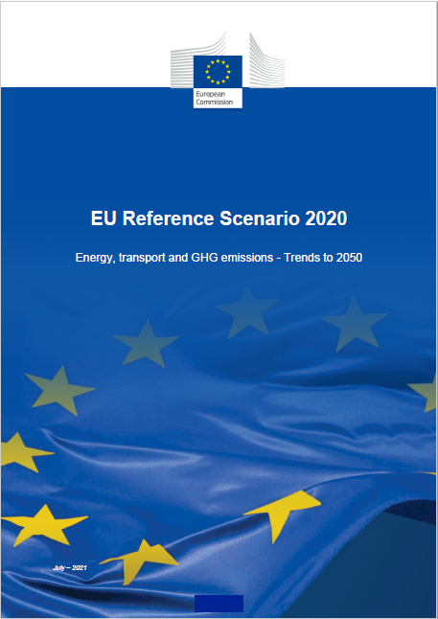


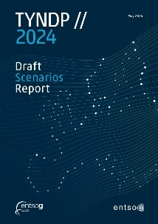


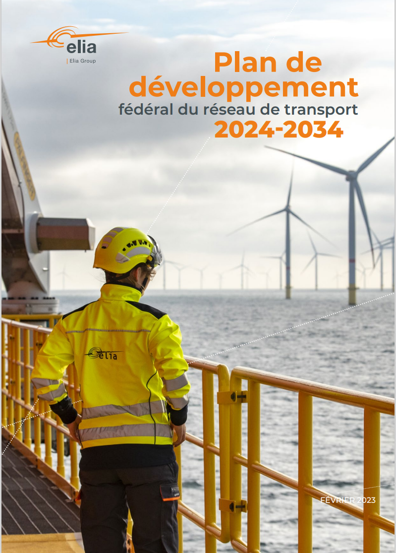

Data sources
Introduction & overview
Assumptions are based on publicly available documents:
Policy documents, laws, strategy papers (e.g. NECP)
grid development plans, adequacy studies, etc.
Supplemented by own analyses and interpretations
EU Reference Scenario 2020
Energy, Transport and GHG Emissions - Trends to 2050
Energy Brainpool
Experts
World Energy Outlook 2024
ENTSO-E – Ten Year Network Development Plan 2024
EU 27
Europe
Europe
Europe
ENTSO-E – Ten Year Network Development Plan 2022
National Grid – Future Energy Scenarios 2024
Elia – Plan de Développement Fédéral du réseau de transport 2023
RTE – Futurs énergétiques 2050 (2021)
Europe
UK
BE
FR
Notes:
Mentimeter: which scenario would you chose?

Slide 11
Updates for Q4-2024

Slide 12
Updates on content
The BrainReports are updated on a quarterly basis.
Here are the changes compared to the last quarterly update.
Incorporation of new assumptions on commodity price trends and inflation:
Based on the “World Energy Outlook 2024”, we have updated the assumptions on price trends for oil, coal, gas and emissions allowances.
We updated assumptions on inflation to provide a more realistic assessment of the current economic environment and expectations for economic development in the coming years as well as their impact on the energy market.
Country-specific updates to the assumptions in Spain, Belgium, the Netherlands and Poland:
In Spain and Poland, new National Energy and Climate Plans (NECP; (Poland: draft) highlight new policy objectives and challenges for future energy supply, providing important impetus for the energy transition.
In the Netherlands and Belgium, we used the adequacy studies of the transmission system operators Tennet (NL) and Elia (BE) to validate and update the current assumptions.
More transparent presentation of flexible demand and battery capacities:
We now provide a more detailed presentation of the different components of flexible demand as well as the large-scale battery capacities.
We have made adjustments to the reports (PPT and Excel) to enable a more precise analysis of these key technologies and provide our customers with a better basis for analysis.
Notes:
Der „World Energy Outlook 2024“ stellt eine langfristige Prognose zur Entwicklung der Rohstoffpreise auf, die über die kommenden Jahrzehnte die zukünftigen Marktdynamiken widerspiegelt.

Slide 13
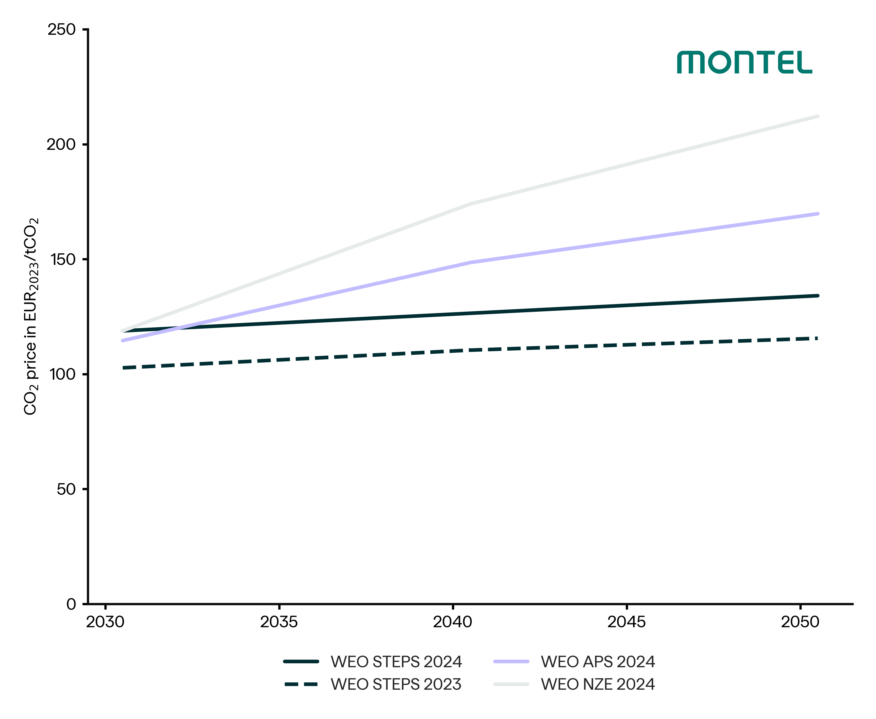
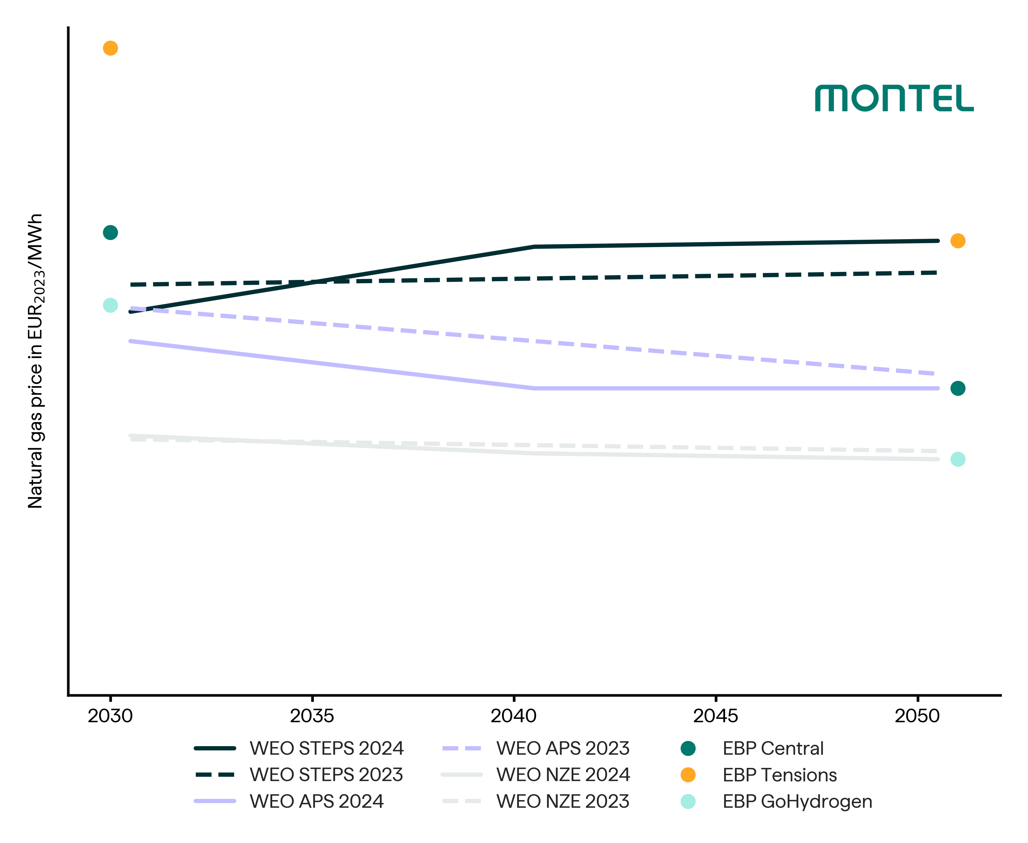
Commodity prices
Prices from futures markets for the short end of commodity prices
Scenario results of the World Energy Outlook for the long end
Own analysis results for the medium term
Notes:
Bis 2040: LNG Preise

Slide 14
Expansion of large-scale batteries
Capacity of large-scale battery storage systems
Total across all 18 BrainReport countries
Explanation
The expansion of large-scale battery storage is based on the European Resource Adequacy Assessment (ERAA 2023) and Ten Year Network Development Plan (TYNDP 2022&2024 Draft) studies.
Only the storage capacities that utilise the price fluctuations on the day-ahead market to generate arbitrage revenue is taken into account.
Storage capacities that operate on the ancilliary service market, that function as grid boosters and that are used to optimise the self-consumption of large industrial and commercial consumers are explicitly excluded.
The C-rate at the end of the simulation period is set to 0.5, which means that a 1 MW battery storage system will have an average capacity of 2 MWh.

Slide 15
Adjustments
Demand E-Mobility
Adjustments
Demand Electrolysis
Adjustments
Demand Heatpumps
Notes:
DE: interne Komm: CEN / GHY -> neue Zahlen von TYNDP -> CEN immer im Mittelfeld, GHY immer der niedrigste Preis
Externe Komm: Nachfrage überarbeitet
NL/BE: interne Komm: Zahlen der EE-Kapazitäten Richtung EAS bewegen (deren Zahlen waren höher), um Preise im Rahmen zu halten, wurden die Flex-Demand erhöht
Adequacy Studien herangezogen (Elia, Tennet)
NL – Emob
BE - Ely
PL: es gibt ein neues NECP Draft, das wurde bereits übernommen für Szenarien (auch wenn noch nicht final), HardCoal Abbau schneller, WiOn Zubau schneller, Gas-Kapazität niedriger weil weniger auf H2 gesetzt wird, um Preisergebnisse vergleichbar zu halten -> FlexDemand angepasst
ES: PNIEC (entspricht NECP bis 2030), größte Änderung ist verstärkter Ausbau von PV, (intern: das führt zu starkem Abfall der PV-CapturePreise)

Slide 16
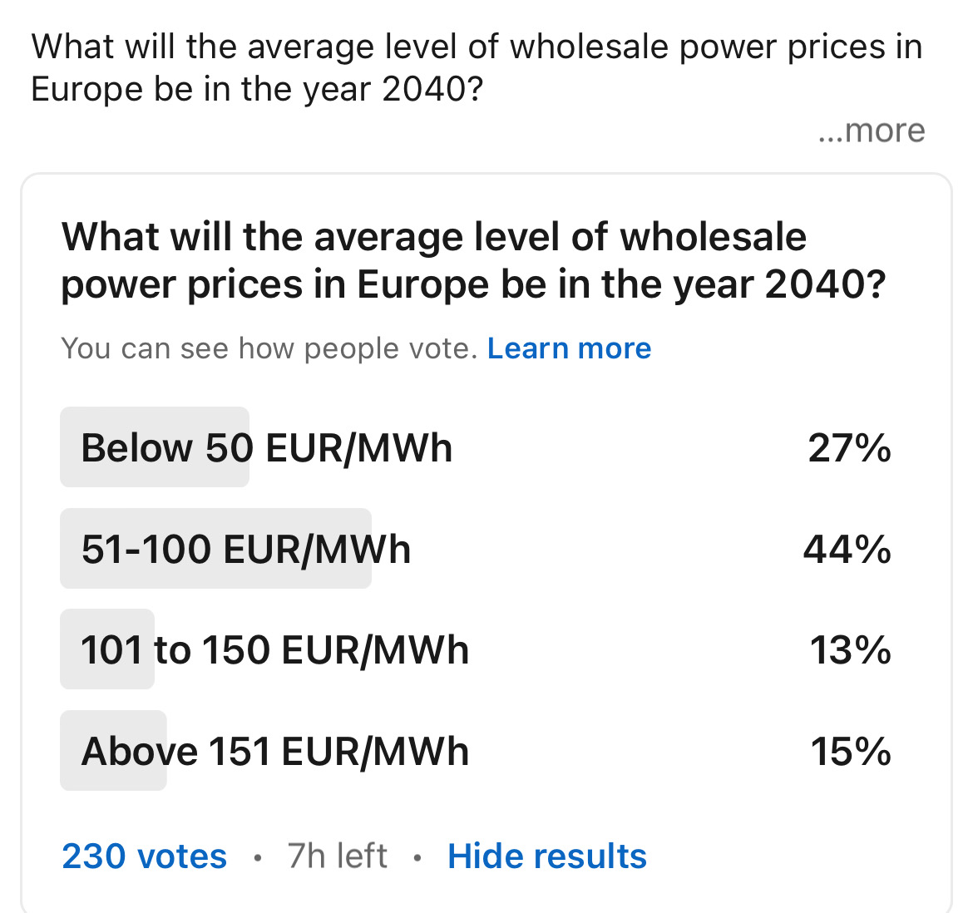
Results

Slide 17
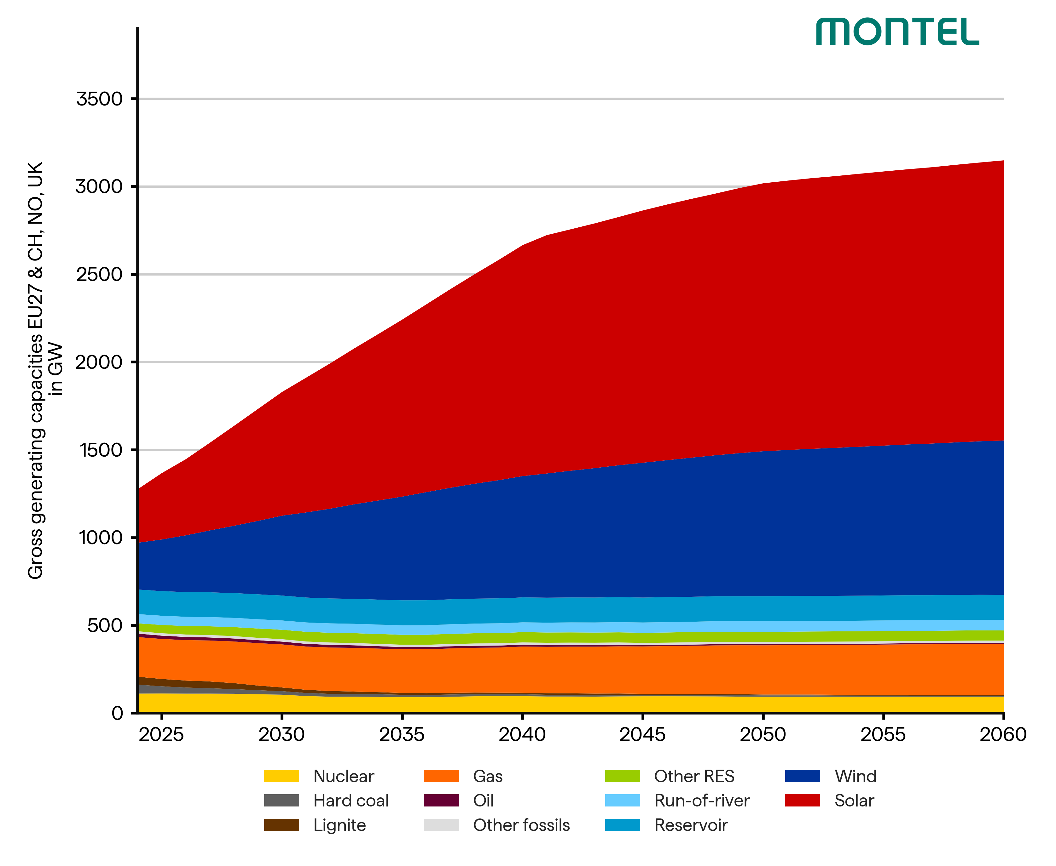
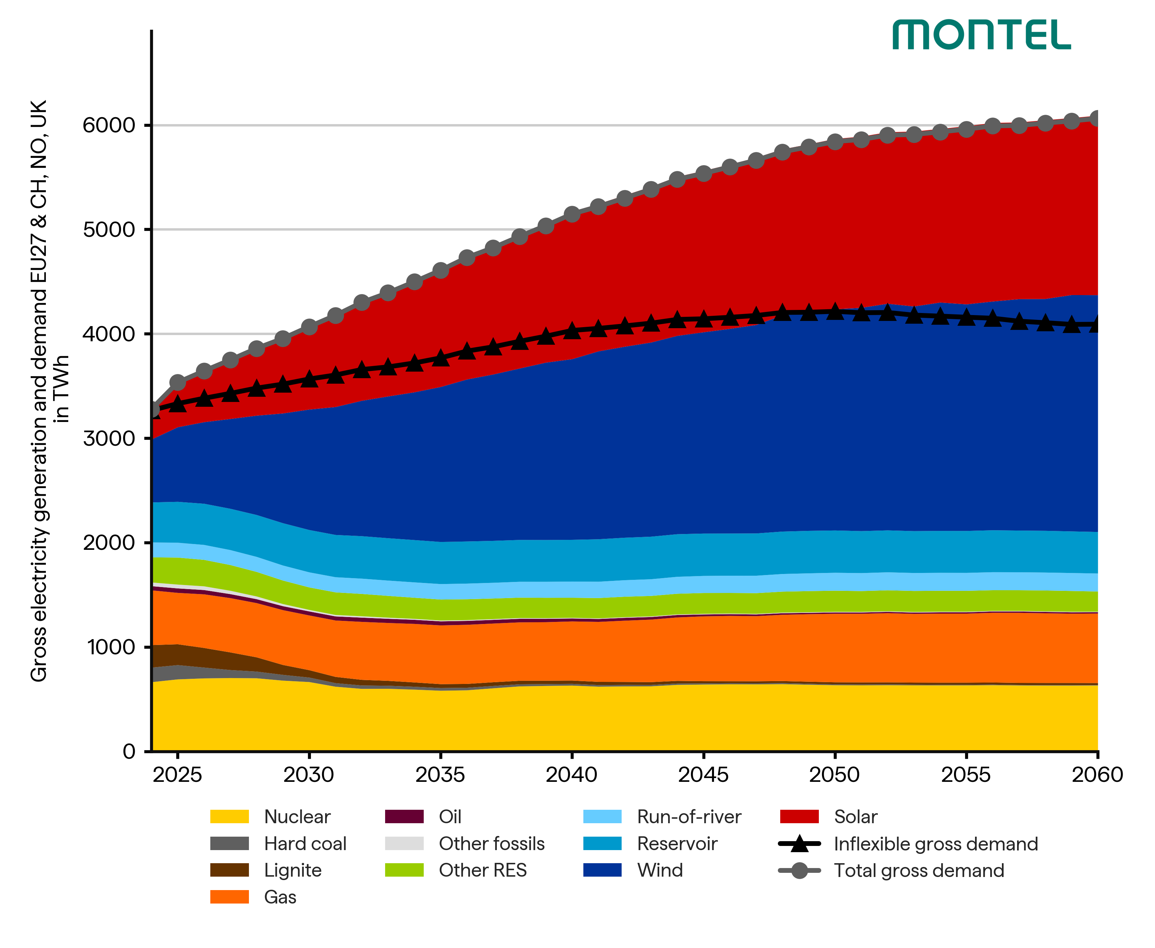
Power generation
The power plant fleet expands significantly, particularly through PV and wind energy, gas-fired power plants to a lesser extent
Demand is rising steadily, the share of flexible demand increases up to one third in the 2050s
CEN
CEN

Slide 18
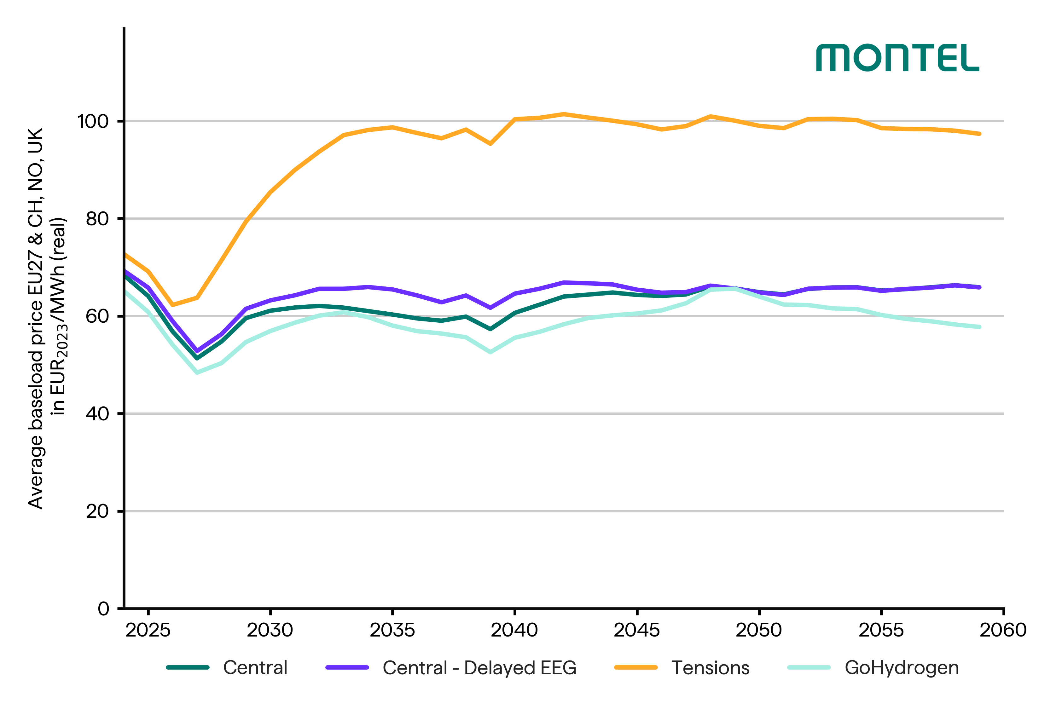
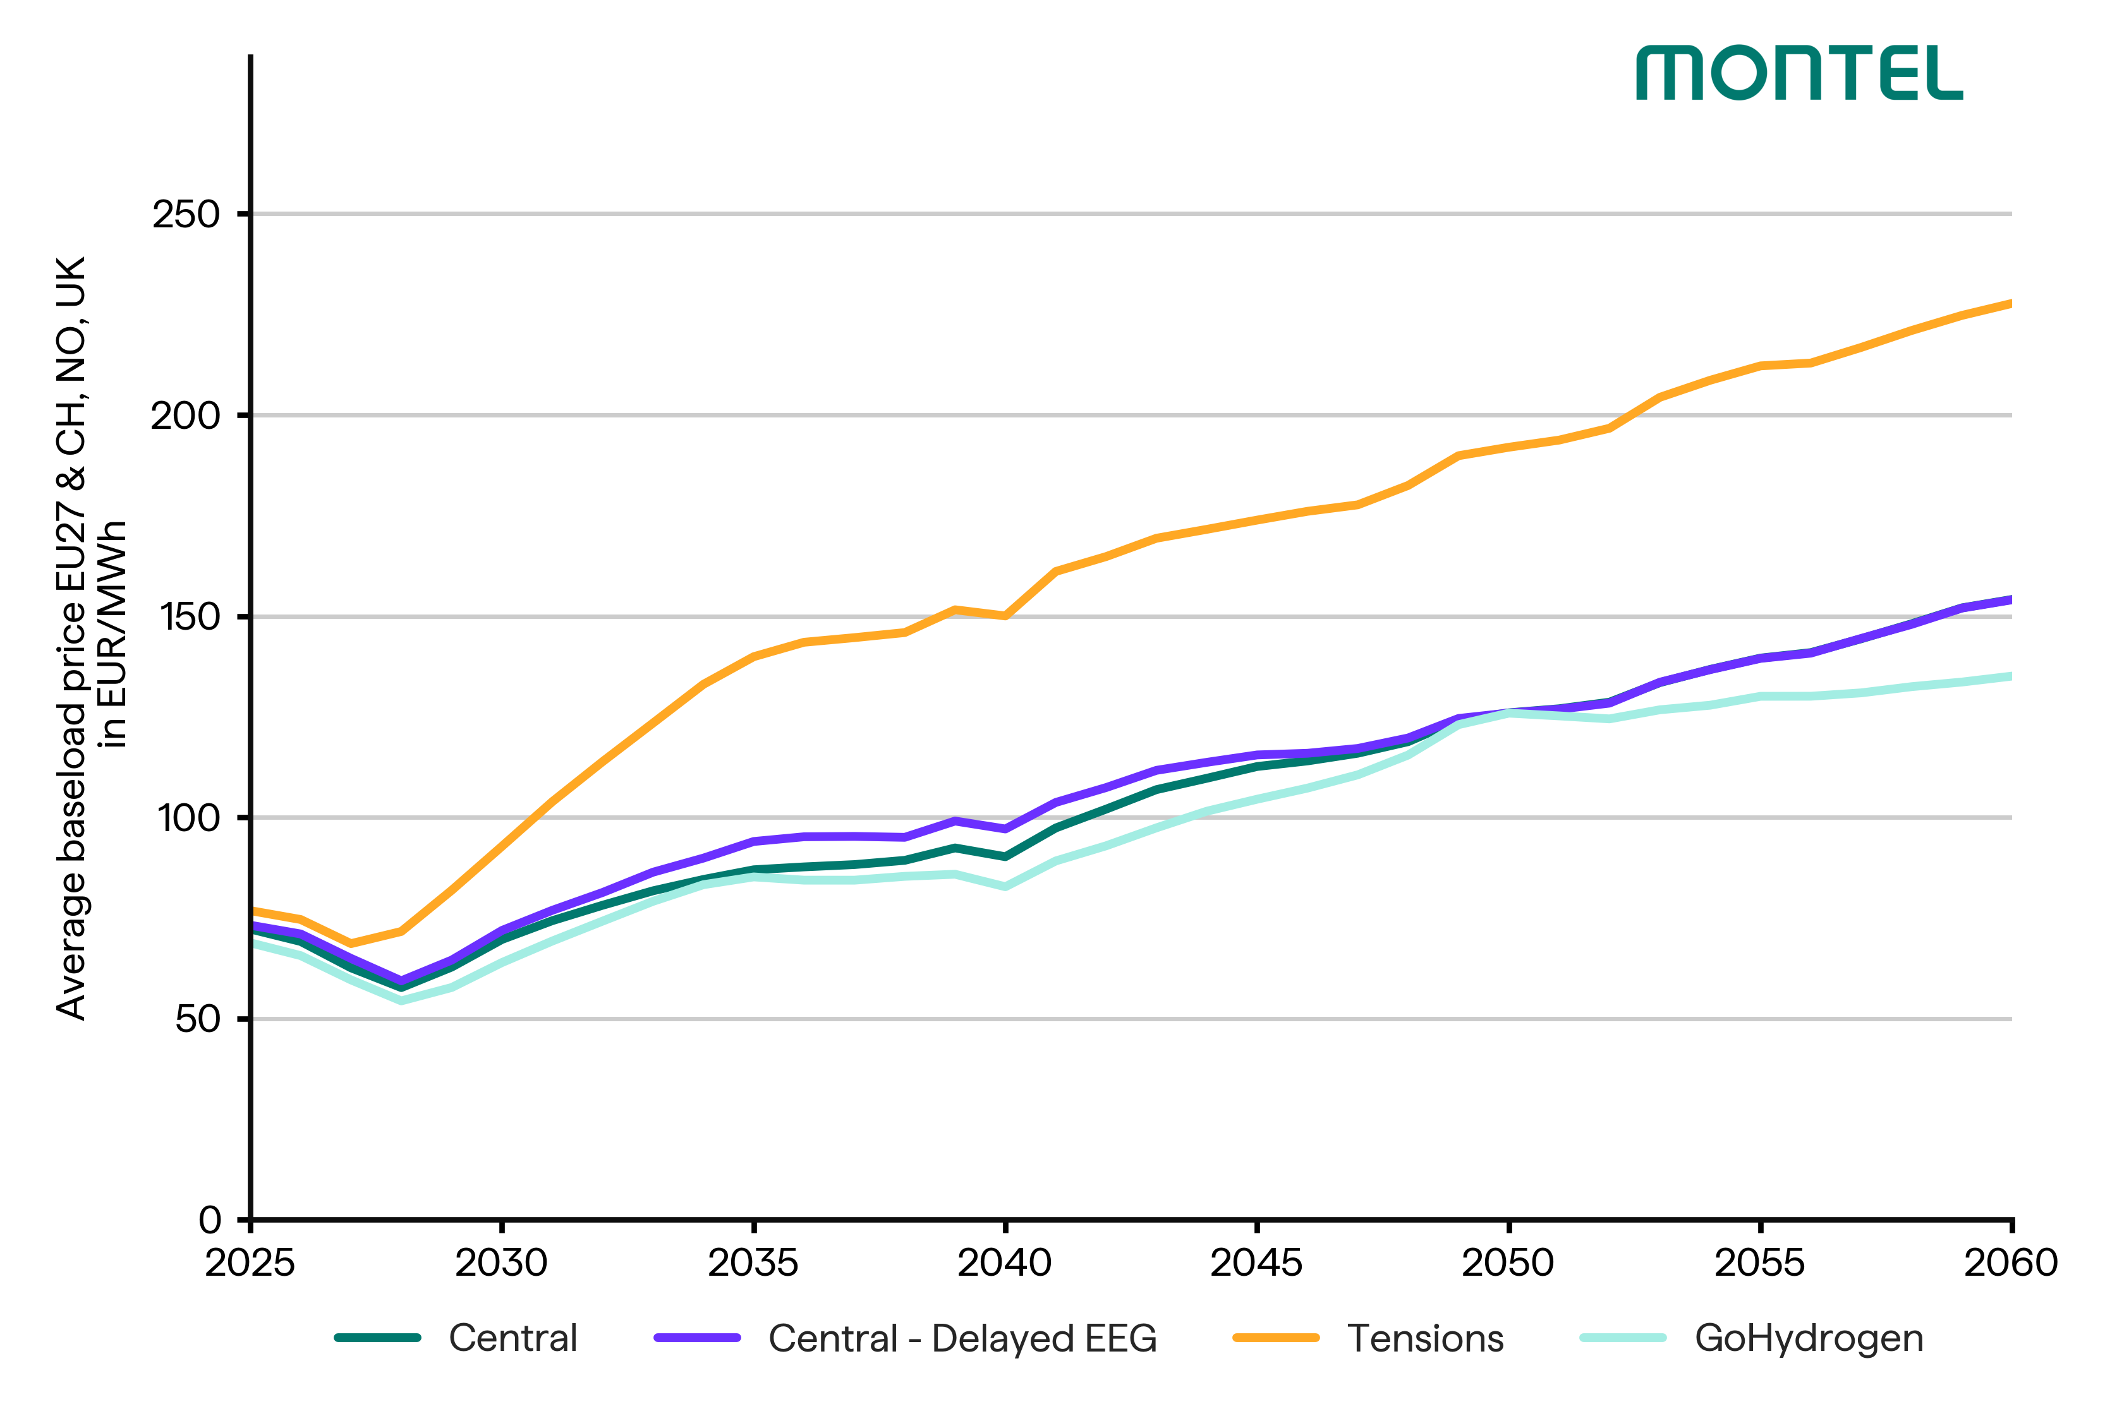
Price development
The annual average prices differ depending on the scenario.
Real prices stabilise at different levels depending on the scenario.
Nominal prices rise continuously due to the inflation rate.

Slide 19
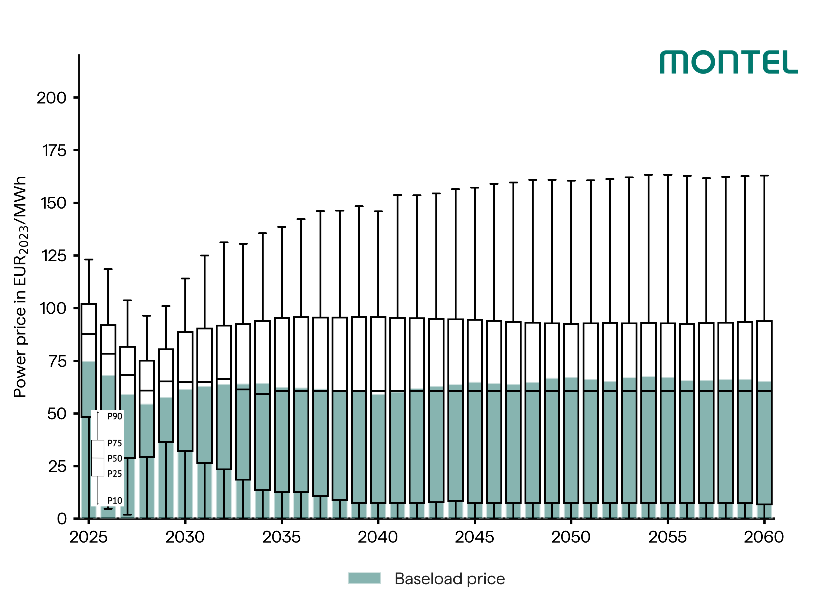
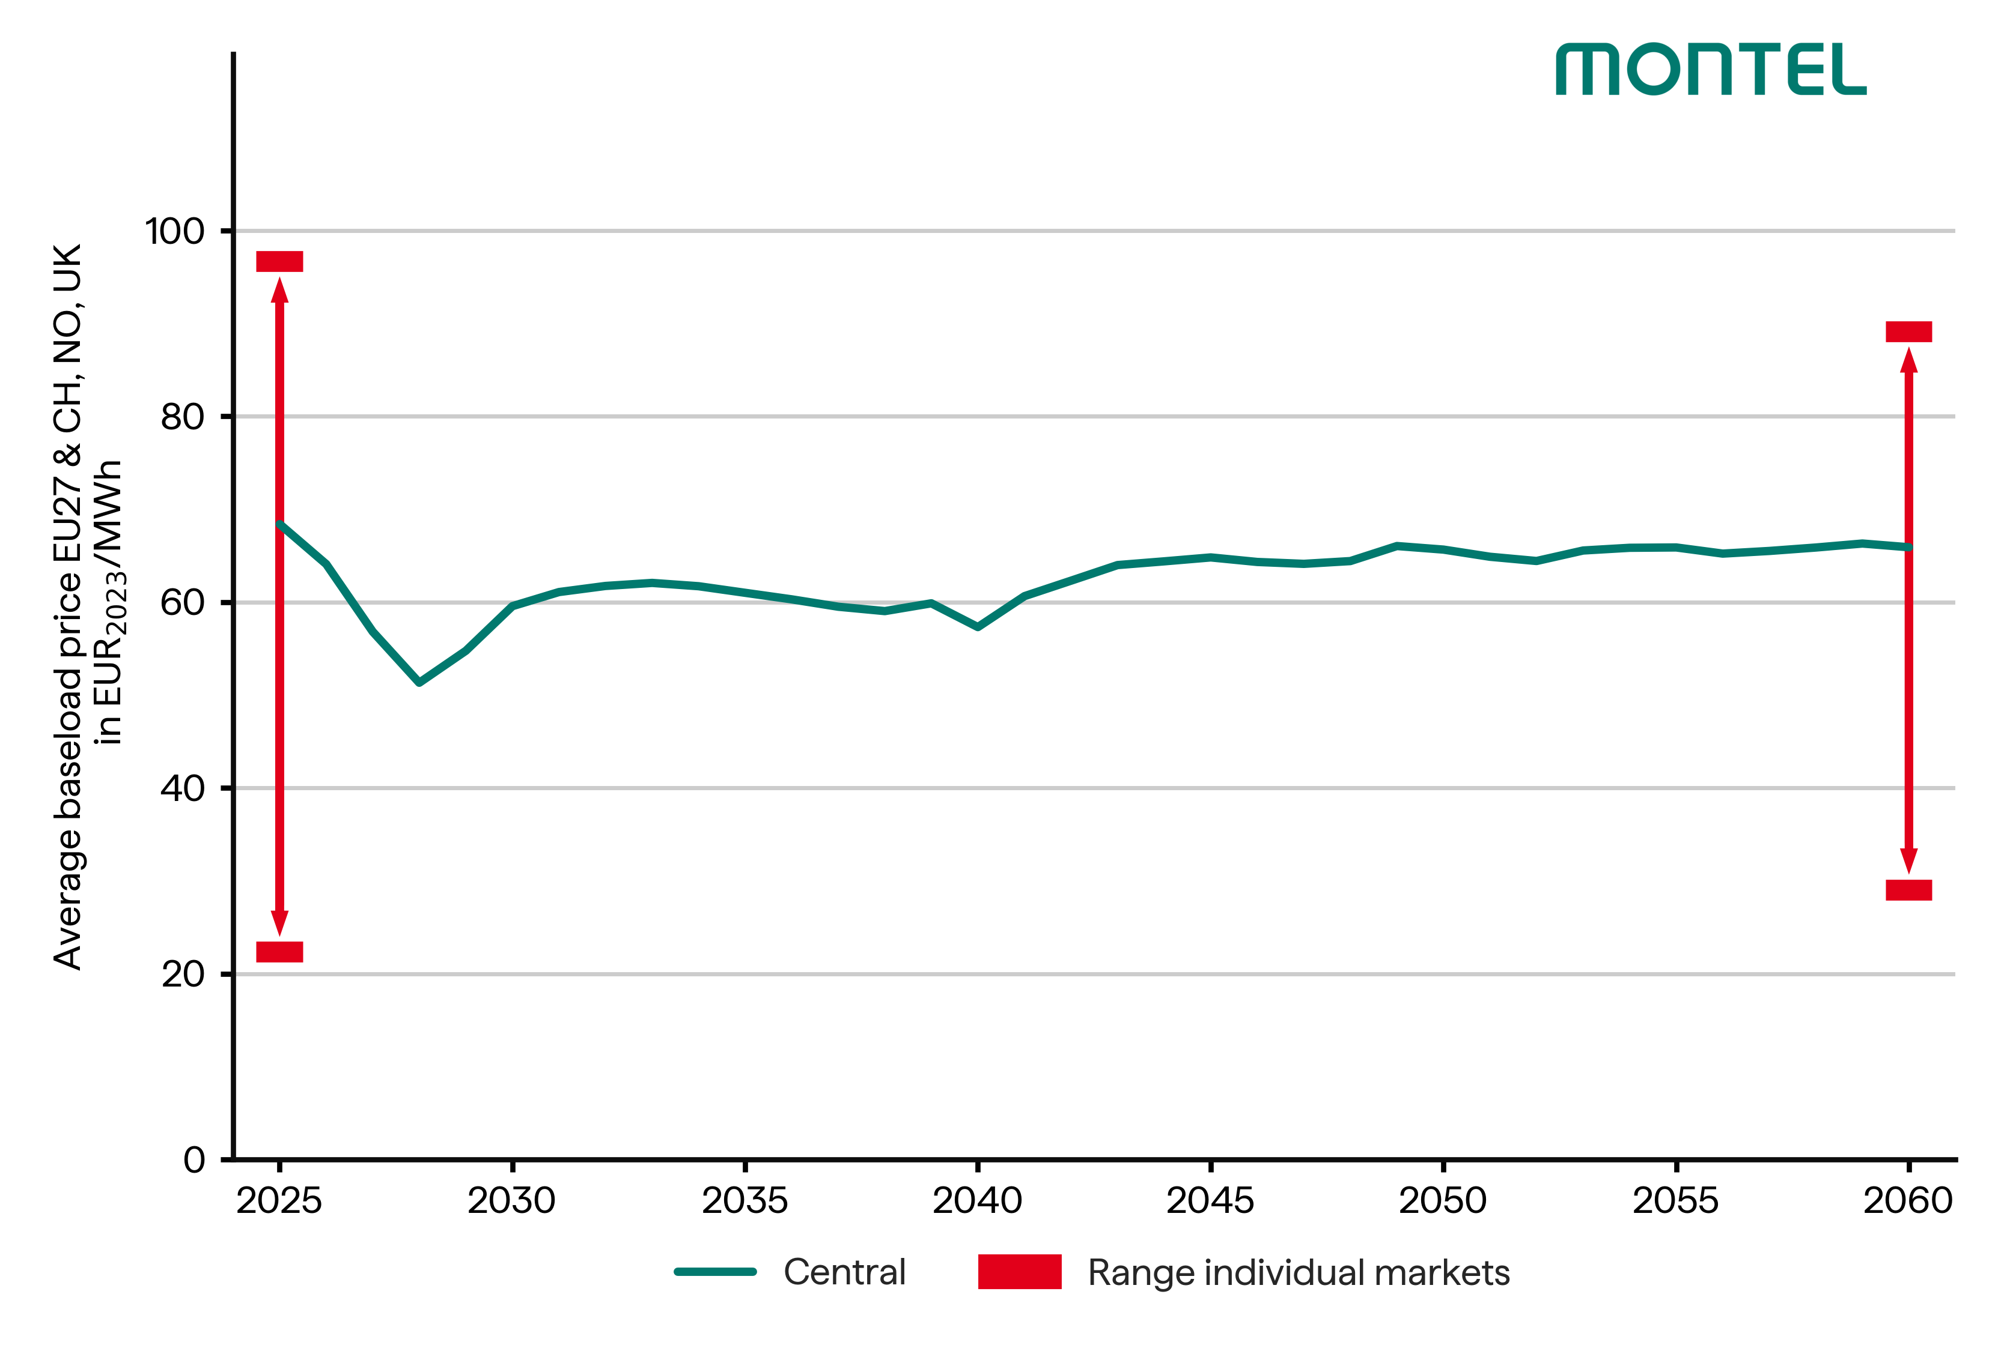
Volatility
Power prices vary greatly from country to country and depend on many factors (power plant fleet, geographical conditions, ...)
The volatility of hourly power prices increases in the medium term, extremely low prices occur more often, extremely high prices become higher.
CEN
CEN

Slide 20
Extremely low prices
The number of hours with extremely low prices will increase.
The number of hours with negative prices will decrease in most countries.
The chart shows the development of hours with prices below and equal to zero EUR/MWh in the European markets.
CEN

Slide 21
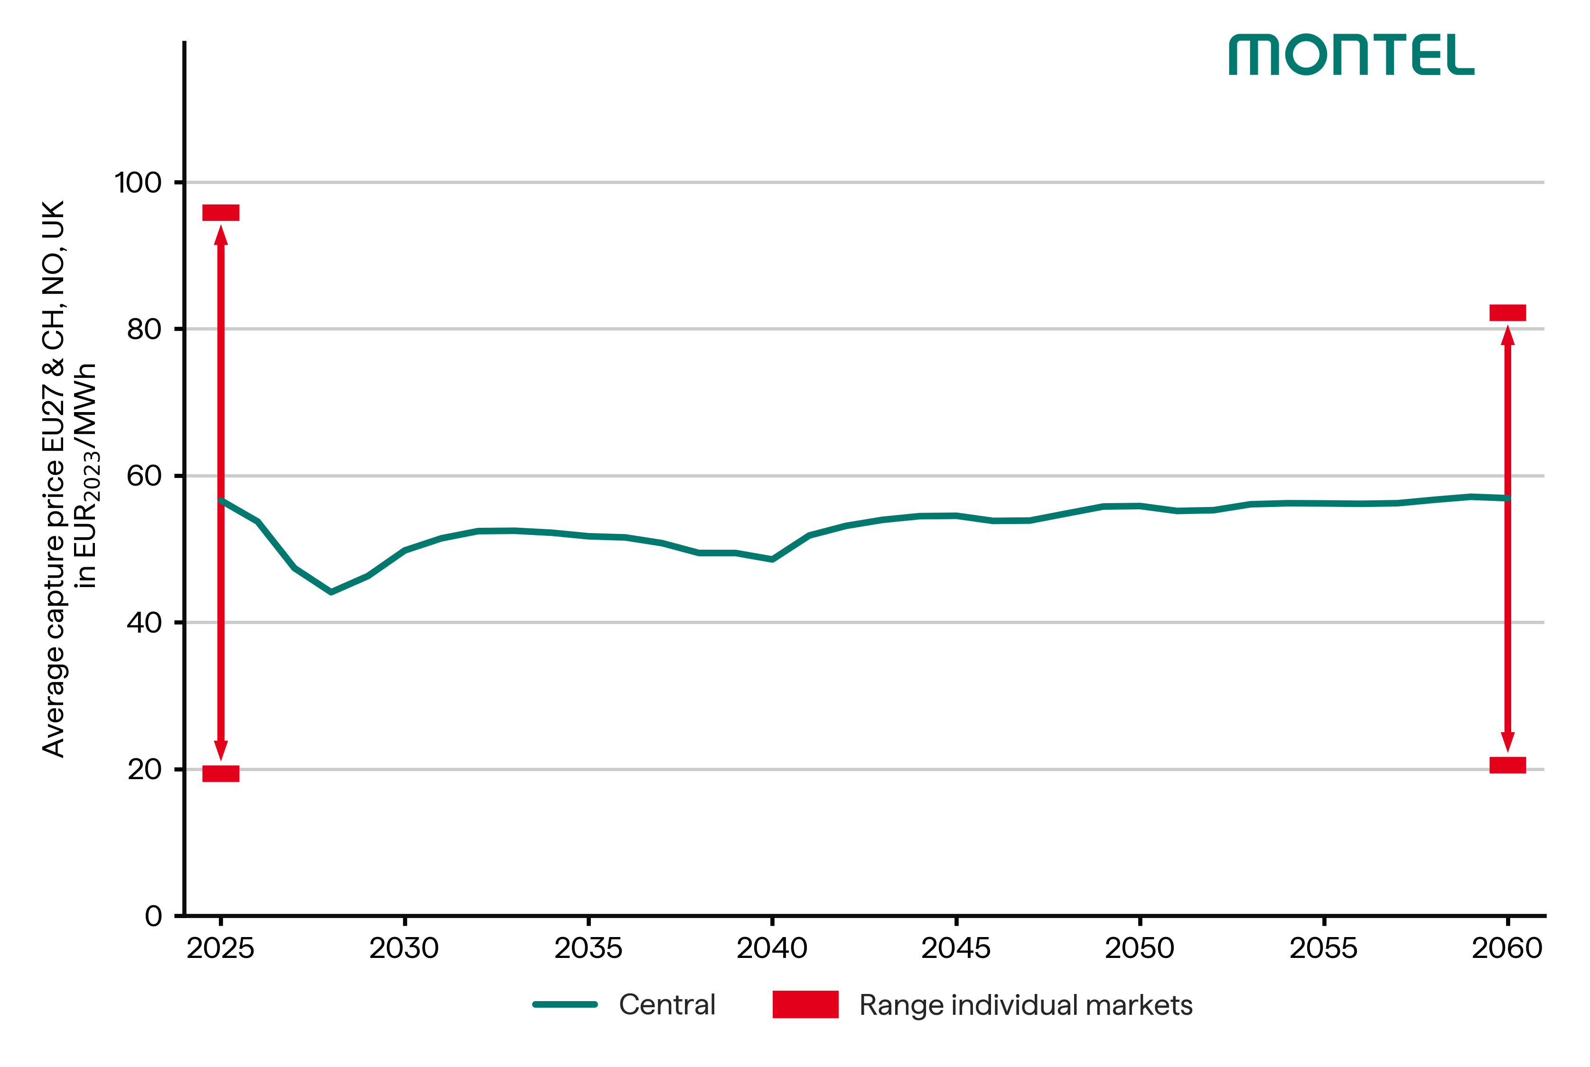
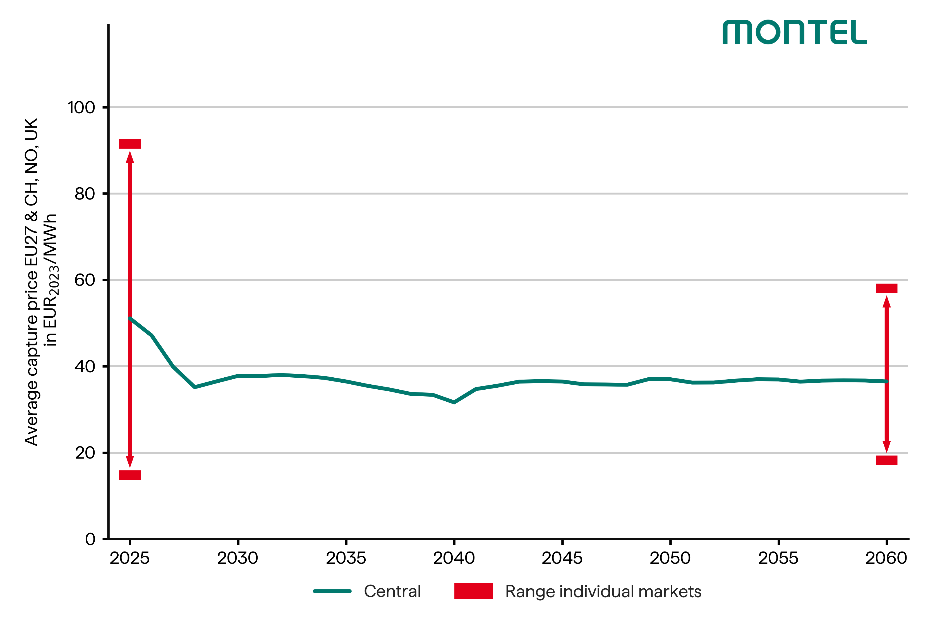
Capture Prices for Renewables
Capture prices take into account the revenue from electricity feed-in at positive market prices (day-ahead auction).
Due to the simultaneity of the RE plants, a cannibalisation effect occurs, which reduces the average revenue.
CEN
CEN
Wind onshore
Solar PV

Slide 22
Thank you!
Questions and comments to:
matthis.brinkhaus@montel.energy

