Slide 1
Corporate Social Responsibility (CSR) in the Energy Sector
Laura Malinen, Market Manager Montel Match
Juan Cordero, European Sales Executive Montel Analytics
Josephine Steppat, Analyst Montel Analytics
31. October 2024
Notes:
Pre-Austrian Energy Day: How Corporates can go green?
10:40 – 11:30

Slide 2
Agenda
A
Introduction
B
Corporate Social Responsibility regulation in Europe
C
Importance of the CSR regulation for the purchase of electricity by companies through PPAs
D
The role of Guarantees of Origin (GOs) in CSR regulation
E
Case studies of successful corporate use of GOs in the electricity-intensive industry

Slide 3

Corporate Social Responsibility regulation in Europe
Importance of CSR
CSR = ethical obligation of businesses to contribute positively to society and the environment
Key principles of CSR:
  Ethical behavior: conducting business with integrity and transparency
  Stakeholder engagement: involving employees, customers, suppliers, and the community in decision-making processes.
  Sustainability: balancing economic growth with environmental protection and social equity.

Slide 4



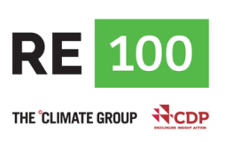

Corporate Social Responsibility regulation in Europe
Global CSR standards and frameworks
Mandating regulation:
  Corporate Sustainability Reporting Directive (CSRD)
Voluntary standards and initiatives:
  United Nations global compact
  ISO 26000
  Global Reporting Initiative (GRI)
  The RE-100 initiative

Slide 5
Corporate Social Responsibility regulation in Europe
Corporate Sustainability Reporting Directive (CSRD) (1/2)
Aims to improve and standardise corporate sustainability reporting
Replaces the previous Non-Financial Reporting Directive (NFRD)
Stricter requirements regarding the disclosure of ESG data
European Sustainability Reporting Standards (ESRS) are a set of standards developed as part of the CSRD:
  ESRS for large, small and medium-sized enterprises (SMEs)
ESRS for small and micro enterprises (VSMEs)

Slide 6
Corporate Social Responsibility regulation in Europe
Corporate Sustainability Reporting Directive (CSRD) (2/2)
CSRD in relation to electricity procurement:
  Disclosure of energy consumption and the share of renewable energy
Targets and measures to increase the share of renewable energy
CO2 emissions and reduction targets
Risks and opportunities related to climate change
The CSRD aims to improve and standardise sustainability reporting in order to provide clear and comparable information and to promote sustainability and the transition to a green economy.

Slide 7
Corporate Social Responsibility regulation in Europe
United Nations Global Compact (UNGC)
Consists of ten principles addressing issues such as human rights, labor, environment, and anti-corruption.
Standards in relation to electricity procurement:
  Renewable energy sources
  Energy efficiency
  Sustainable practices
  Transparency
  Climate protection measures
  Investing in sustainable energy
  Reporting on environmental performance

Slide 8
Corporate Social Responsibility regulation in Europe
RE-100 initative
Global initiative supported by some of the world’s most influential companies and launched by the nonprofit Climate Group in collaboration with the Carbon Disclosure Project (CDP)
Standards in relation to “green” energies:
  Commitment to 100% renewable energy
  Transparent reporting
  Definition of renewable energy
  Credible evidence
  Strategic planning
  Global approach
RE-100 initiative ensures that ist members not only make symbolic commitments, but take concrete, verifiable steps towards achieving a sustainable and renewable energy future.

Slide 9




Importance of the CSR regulation for the purchase of electricity by companies through PPAs
Types of green PPAs
Residual load
on-site
Utility
Utility
production schedule for balancing group
Who?
Utility/Aggregator
as service provider
Corporate
physical
How?
Residual load
Agreed PPA-price
virtual
Physical vs virtual PPA: Main difference is balancing group management!
Compensation ( spot / PPA)

Slide 10
Importance of the CSR regulation for the purchase of electricity by companies through PPAs
CSRD standards in context of PPAs
Quantitative and qualitative information: companies must provide both quantitative data (e.g. amount of renewable energy purchased in MWh) and qualitative information (e.g. type of renewable energy source). The impact of PPAs on the reduction of greenhouse gas emissions should also be clearly presented.
Risk and opportunity assessment: companies should assess the risks and opportunities associated with the use of PPAs for renewable energy and present them in their reports.
Traceability and certification: the energy purchased through PPAs must be clearly identifiable and traceable as renewable energy. Companies must provide GOs or certificates that confirm the sustainability and renewability of the energy.

Slide 11
Importance of the CSR regulation for the purchase of electricity by companies through PPAs
UNGC standards in context of PPAs (1/2)
Promotion of renewable energies: UNGC encourages companies to reduce environmental impacts and promote sustainable environmental practices
Energy efficiency and environmental sustainability: by using PPAs companies can reduce the environmental footprint of their electricity consumption. This is in line with the principle of minimising environmental impact.
Sustainable energy practices: the UNGC emphasises the need to pursue environmentally friendly practices and the conclusion of PPAs is a concrete measure that companies can take to fulfill their environmental responsibilities.
Transparency and responsibility: Companies that use PPAs can report transparently on their contracts and their impact on their environmental performance to comply with the principles of the UNGC.

Slide 12
Importance of the CSR regulation for the purchase of electricity by companies through PPAs
UNGC standards in context of PPAs (2/2)
Climate protection and investments: PPAs are an opportunity for companies to invest directly in projects that contribute to reducing carbon emissions.
Stakeholder engagement: The conclusion of PPAs can be a positive aspect of a company’s environmental strategy that is valued by stakeholders.
Reporting on progress: transparent reporting on the use of PPAs and their impact on environmental performance helps companies to document and publicise their progress

Slide 13
Importance of the CSR regulation for the purchase of electricity by companies through PPAs
RE-100 standards in context of PPAs
Long-term commitments: PPAs should be set up for the long term over a period of approximately 10 to 20 years.
Additionality: PPAs must contribute to the additional generation of renewable energy. The RE-100 criteria require corporate buyers’ procurement of renewable electricity to observe a fifteen-year commissioning or re-powering date limit.
Renewable energy sources: the energy must come from recognised renewable sources, such as solar, wind, hydro or biomass energy.
Traceability and certification: the electricity generated must be clearly identifiable and traceable as renewable energy by GOs.
Direct supply relationships: On-site or physical PPAs. Virtual PPAs can be recognised only when the virtual PPA is used to make claims to use of renewable electricity which observes market boundaries.

Slide 14
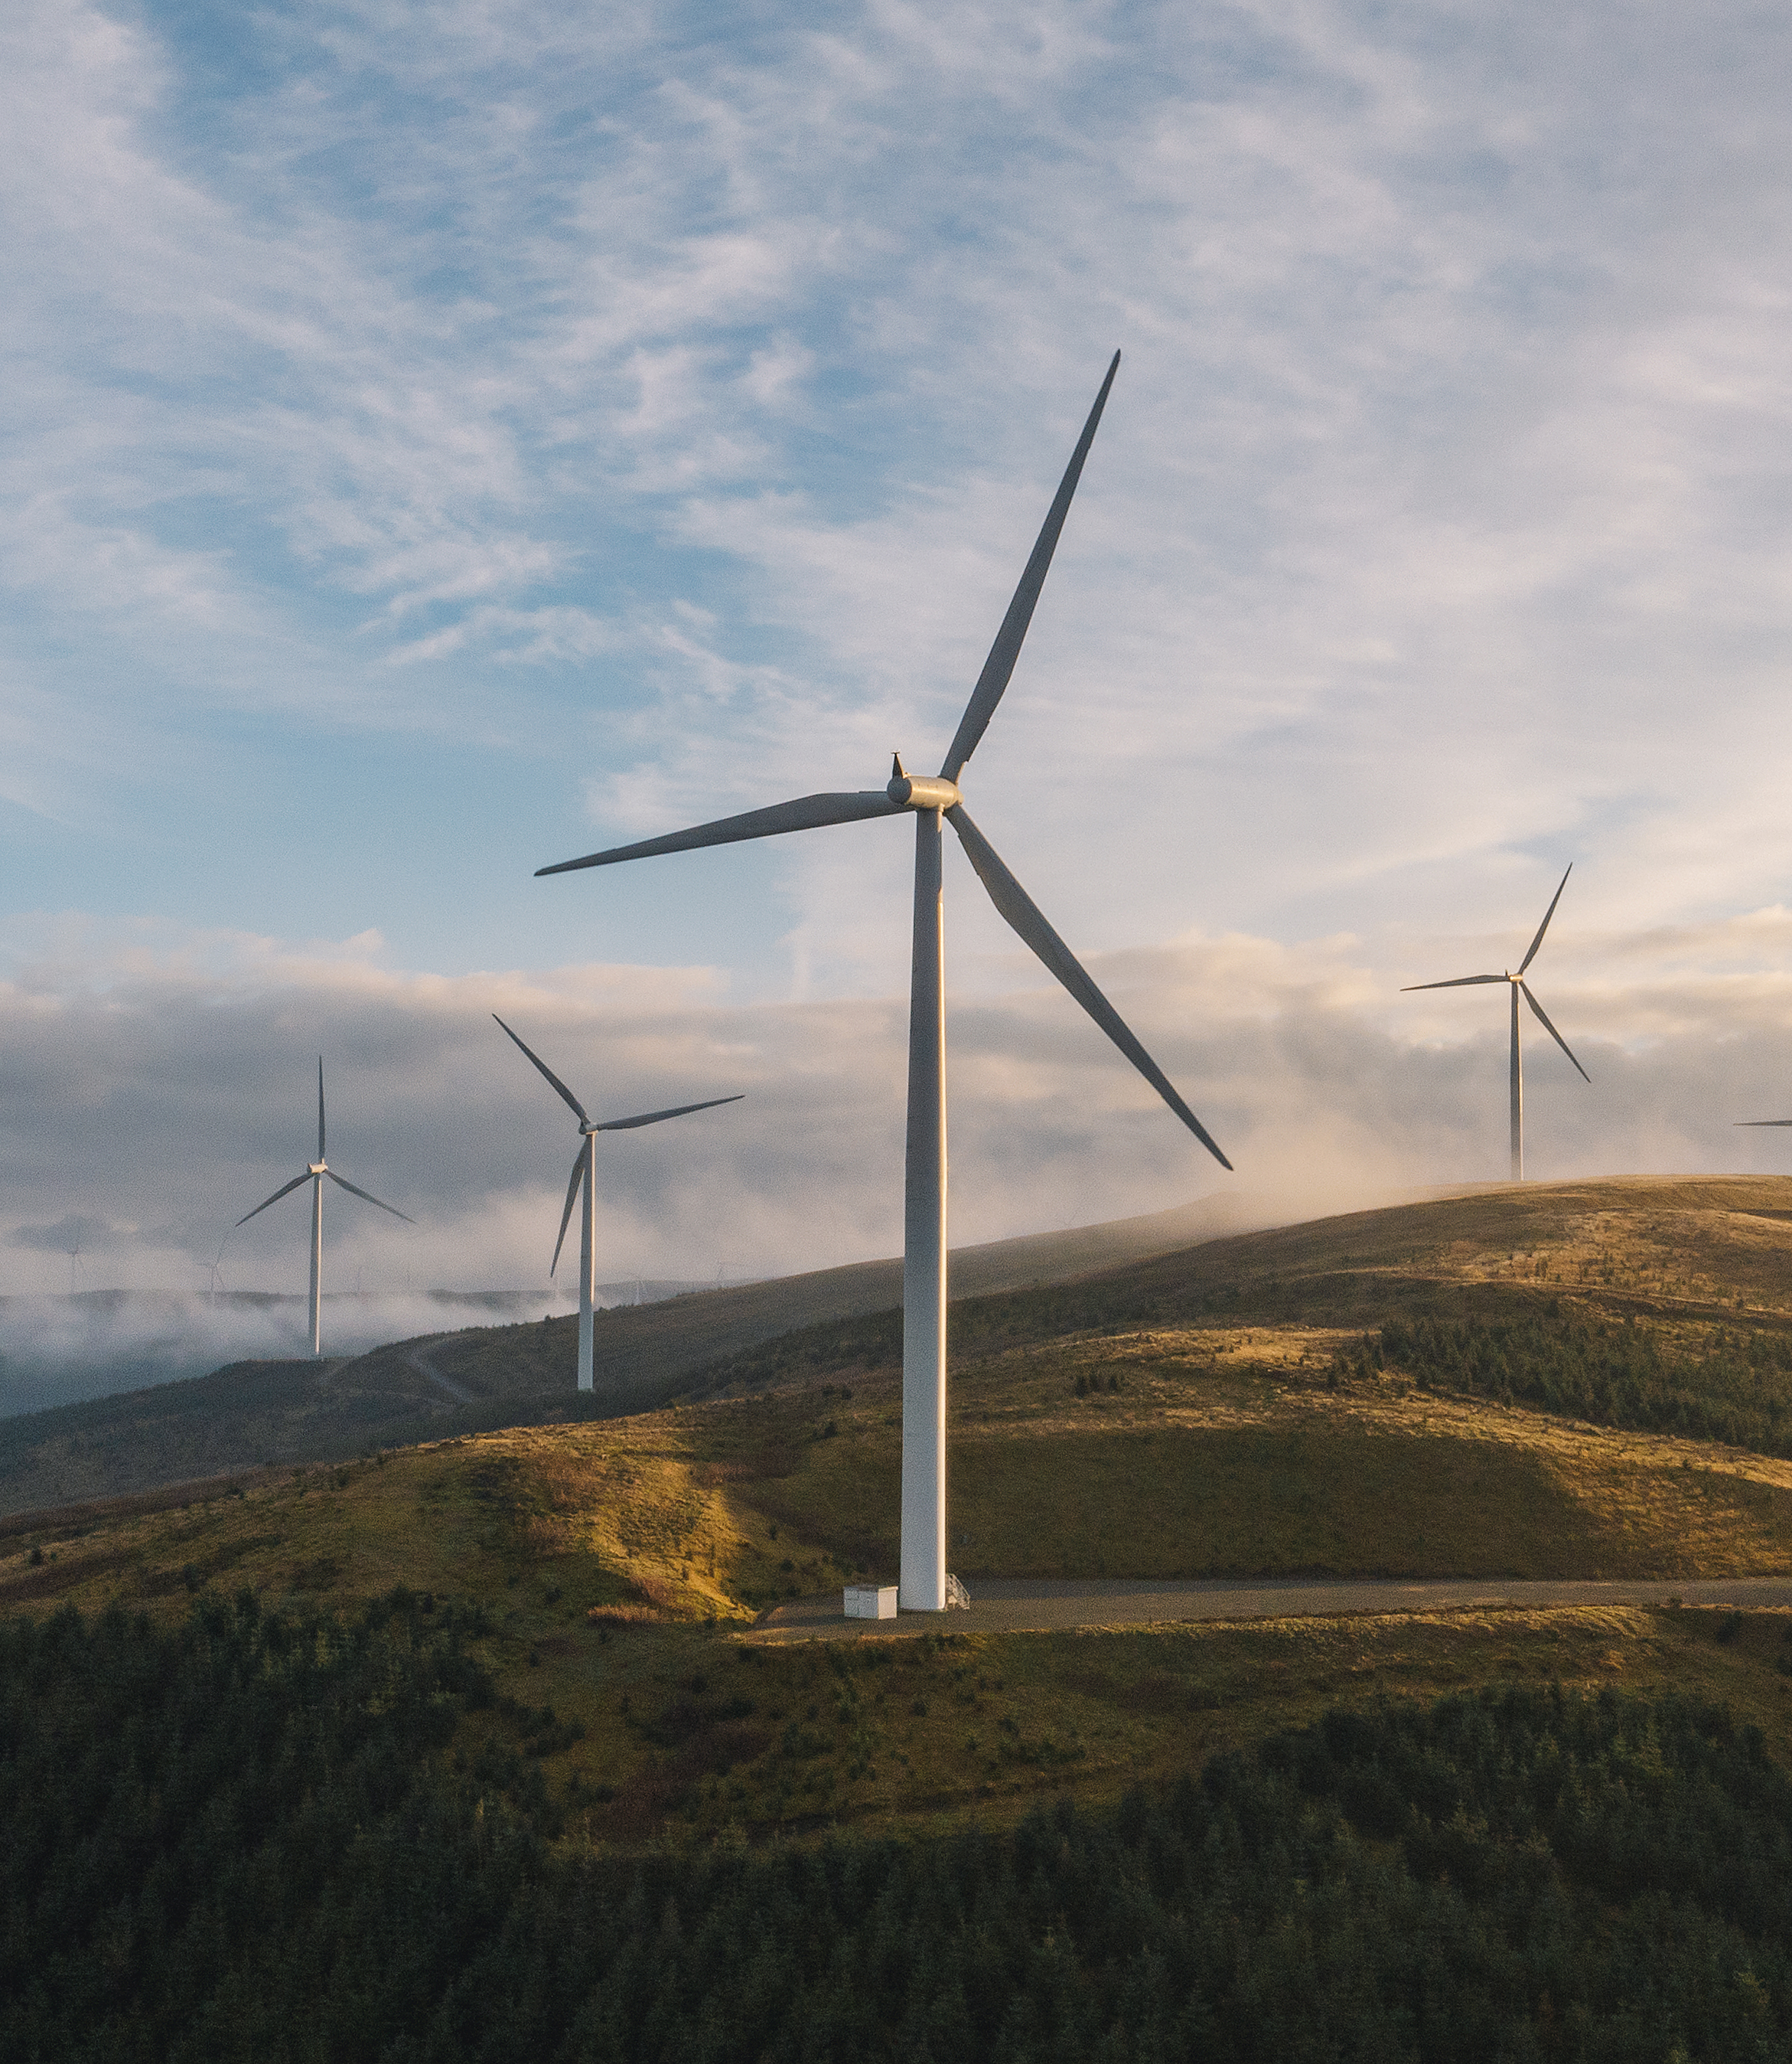
Guarantees of Origin in sustainability reporting
Laura Malinen
Market Manager, Guarantees of Origin
Montel Match
Notes:
Thank people for joining.
Introduce yourself and the Marketplace.
Today we will cover the key concepts and regulatory developments around GO and dig into how those will impact supply and demand.

Slide 15

A market based instrument for green transition
The only way to make renewable claims in the EEA
Book and claim system
Subject to European and national regulation
  Renewable Energy Directive III
  Renewable Fuels of Non-Biological Origin (RFNBO)
Traded
  Mostly Over The Counter
  Also primary and secondary auctions
Notes:
GO is a book and claim system, where the physical attribute of power is separated from the renewable attribute. These renewable attributes are called Guarantees of Origin or GO.
1 MWh=1GO
Red3:
GO for power, biogas, hydrogen as well as heating and cooling
Possibility for hourly matching
More accessible PPAs

Slide 16
Life of a GO according to REDIII
Issuance
Transfers /
Trading
Cancellation or
Expiry
(Trading)
12 months
6 months
Notes:
Traded also as forwards, OTC
Issued against actual production figures by government appointed issuing bodies.
12+6 for transfers and trading, both OTC and in auctions
Cancelled for a specific purpose or expiry.

Slide 17

Not as voluntary as it used to be
Increased pressure for use of GO for corporate actors
  CSRD and ESRS
  Green Claims Directive
  Taxonomy
CSRD only recognizes market based mechanisms for claiming renewable energy consumption
Market based instruments can also be used to report reduced Scope 2 GHG emissions
Notes:
The document also requires companies to “apply the location-based AND market-based methods to calculate Scope 2 GHG emissions” (you can read more about the methods here). When disclosing market-based emissions, businesses can report “emissions linked to purchased electricity bundled with instruments such as Guarantees of Origin or Renewable Energy Certificates.” In other words, GOs allow organisations to report reduced carbon intensity.

Slide 18
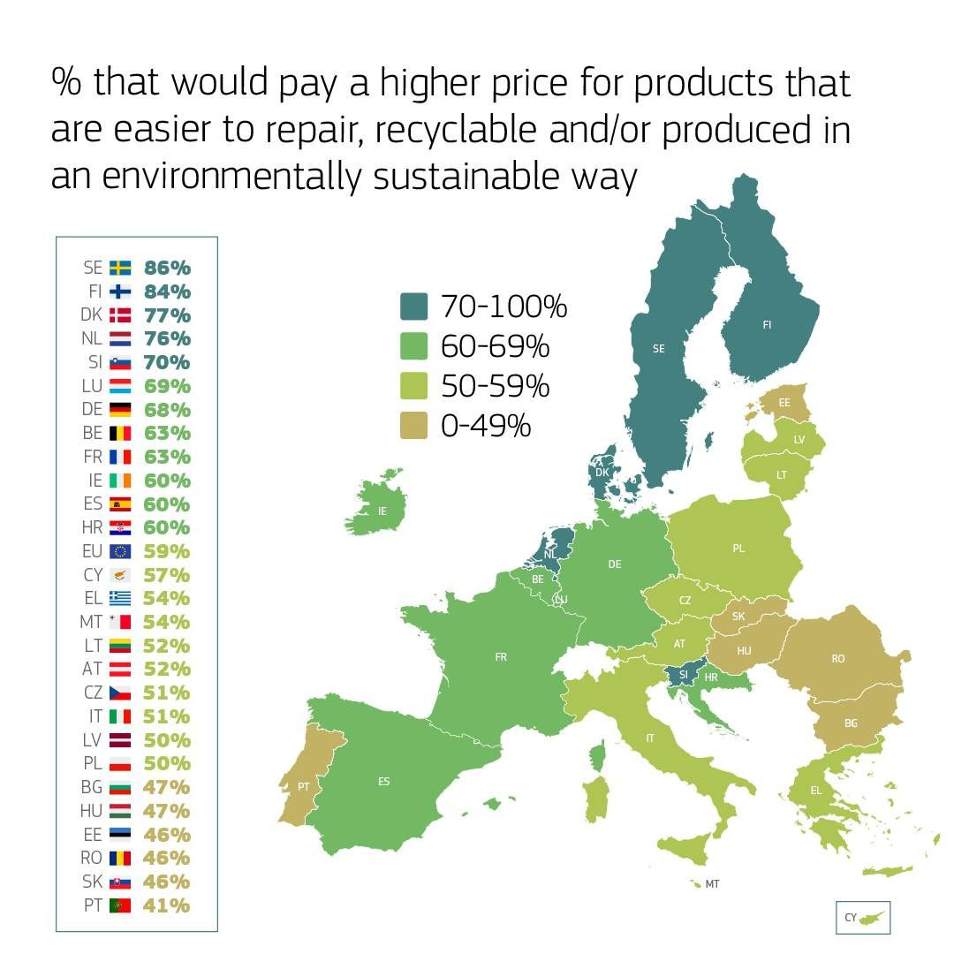
Consumer driven demand
Regulation and demand driven market
ESRS and EU taxonomy bring Guarantees of Origin to the core of decision making
  European Investment Bank guidelines
Demand drivers:
  Willingness to make green claims
  Sustainability reporting requirements and increased transparency
  Demands from voluntary initiatives like RE100 or Science Based Targets Initiative
Source: Eurobarometer 2024: Attitudes of Europeans towards the environment

Slide 19
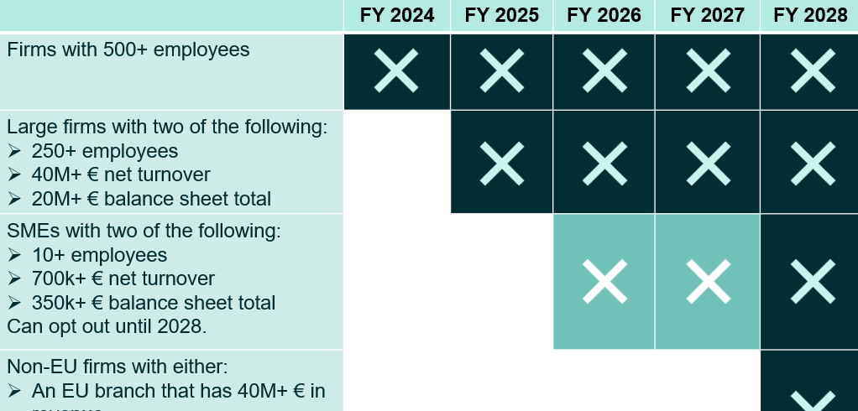

Slide 20
Source: Montel Analytics
Notes:
We can see the demand from traditional industries consistantly increase in the coming years. Naturally the electrification of processes will heighten the demand, but even with all the energy efficiency measures taken, their power demand will only increase in the coming years. Majority of these companies is subject to CSRD reporting, so we can expect this increase in power demand to be also reflected on GO demand, either bundled or unbundled.

Slide 21
AIB statistics, cutting point 07/24
Notes:
While the supply of GO is constantly increasing, it will be interesting to see how the demand generated by both current and new developments will impact the supply-demand-balance.

Slide 22
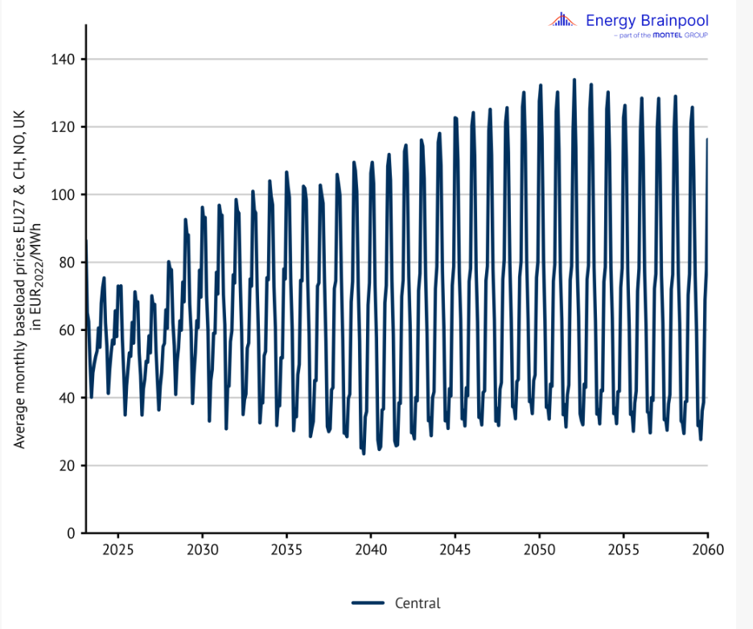
MONTHLY PRICE DEVELOPMENTS FORECAST
Notes:
Hedging through the more readily available PPAs?

Slide 23
Market development
Notes:
Market has moved from backwardation to contango in the past 1,5 years and the prices have fallen.
The shift has been driven by weather conditions suitable for renewables production, oversupply on current vintages and the regulatory developments.
We can see the market is expecting prices to rise in the coming years – this could be driven by increasing demand fueled by green claims directive and CSRD. The prices could peak even more dramatically in a case of for instance a drought, as they did in 2022 when they went from 1,5 euros to 10 euros in 8 months. Additionally, looking at the long term trends, we can only expect the demand to increase. The reporting requirements are calling for more transparency and taxonomy is reframing this transparency to something beyond a PR matter. This means that the increasing electrification of the society and new technologies like electrolyzers (estimated new demand over 1000 TWh by the end of 2040) will directly reflect either on the supply or demand side of the market.

Slide 24

Case studies of successful corporate use of GOs in the electricity-intensive industry

Slide 25




Heidelberg Materials is one of the world’s largest building materials companies
Case studies of successful corporate use of GOs in the electricity-intensive industry
51,000
employees ​
on 5 continents​
3,000
locations ​
worldwide
Leading positions in cement, aggregates, and ready-mixed concrete
10/31/2024

Slide 26
Bringing Down CO2 Emissions: The Key Challenge for the Cement Industry
Case studies of successful corporate use of GOs in the electricity-intensive industry
The cement industry is responsible for approximately 8% of global CO₂ emissions¹
Electricity emissions in cement industry make up ~0.4% of global CO₂ emissions
Emission type | Share Cement | Share Global emissions | Mitigation measurse
Scope 1 (process) | 44% | 3.5% | Carbon Capture (no alternative)
Scope 1 (fuel) | 23% | 1.8% | Carbon Capture, low/no carbon fuels
Scope 2 (electricity) | 5% | 0.4% | Green electricity (focus today)
Scope 3 (other) | 28% | 2.3% | Various measures
Total | 100% | 8%
Agriculture
Transportation
Electricity
Commercial & Residential
Cement industry
Other Industry
10/31/2024
1) Source: PSCI Princeton University

Slide 27





Electricity: Portfolio of CO₂ emission reduction levers is available increasing complexity in sustainability reporting. In case electricity is not generated on-site, Gos are needed to claim green electricity.
Case studies of successful corporate use of GOs in the electricity-intensive industry
Various measures are available to reduce CO₂ which come with different characteristics and risks
Challenge: Elaborate company specific strategy for identified measures mostly based on:
Examplary measures | (1) | (2) | (3) | (4)
On-site PPA¹
Off-site PPA¹
Own investment (on-site)
Virtual PPA¹
GOs
Grid Greening
Efficiency measures
External factors
Competitor Benchmark
Expectation from external stakeholders
Subsidies
Company Strategy
Company sustainability targets
Possibility to engage into long term commitments
Available resources in-house
Electricity consumption pattern / seasonality
Overall electricity consumption
Internal economic requirements
Willingness to pay premiums for green electricity
Cash availability and payback / NPV requirements
……
Electricity delivery GOs Investment needed Long term commitment
1) Power Purchase Agreement

Slide 28
Maximizing Benefits and Navigating Challenges of GOs for Electricity Offtakers
Case studies of successful corporate use of GOs in the electricity-intensive industry
Benefits
Sustainability Targets: Achieve sustainability goals with sufficient supply available (price-dependent).
Low Decarbonization Effort: Easily decarbonize portfolios by purchasing GOs without needing PPA contracts or investments.
Cost Efficiency: GOs are still relatively low-cost compared to other electricity bill components.
Flexibility: High flexibility for offtakers; purchase GOs after determining actual electricity demand.
Cross-Border Transferability: GOs can be transferred across borders or sold if consumption patterns shift.
Challenges
Price Volatility: High price volatility due to fluctuating supply and demand.
Strategic Planning: Need to define a strategy for GOs (hedging, quality).
Cost Pass-Through: Limited ability to pass on GO costs to customers.
Reputation risk: E.g. GOs without additionality might be subject to “greenwashing” discussions.

Slide 29
Thank you!
Questions?

