Slide 1
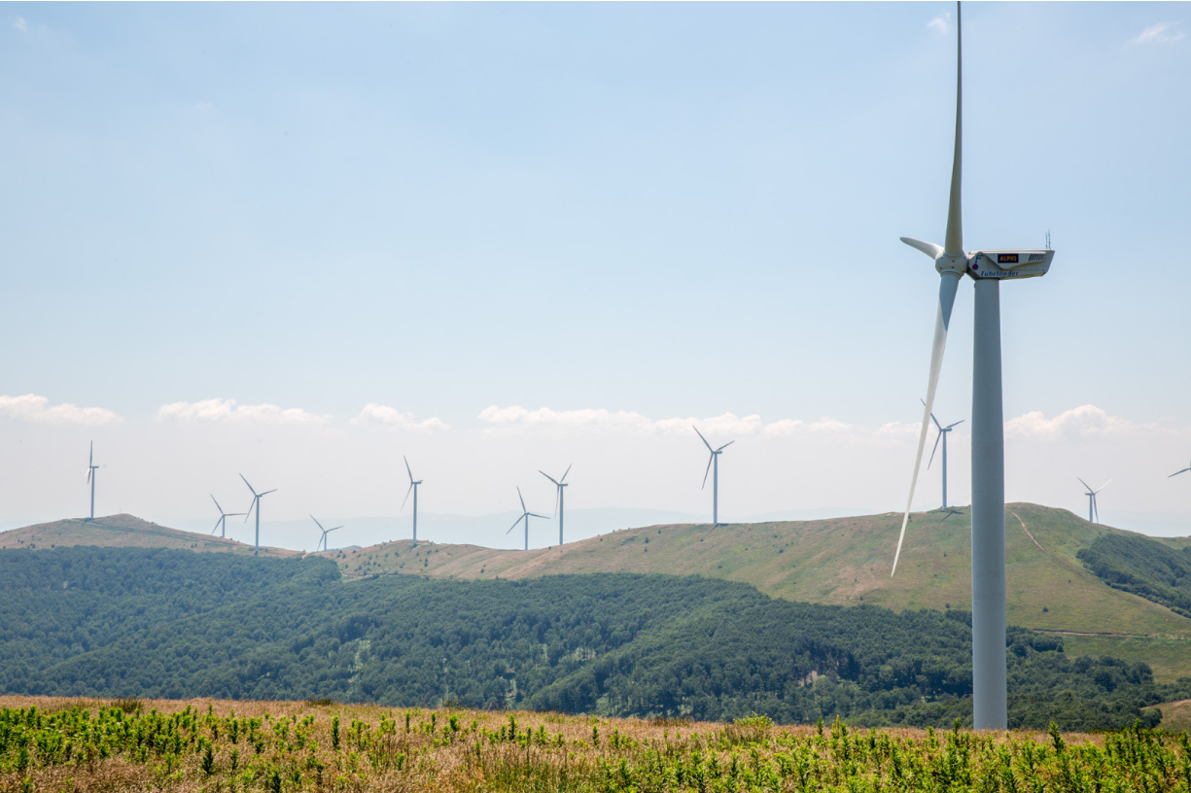

PPA Price Developments in Finland and the Baltic Region
Matti Ahtosalo, Head of North West Europe
13 June 2024

Slide 2
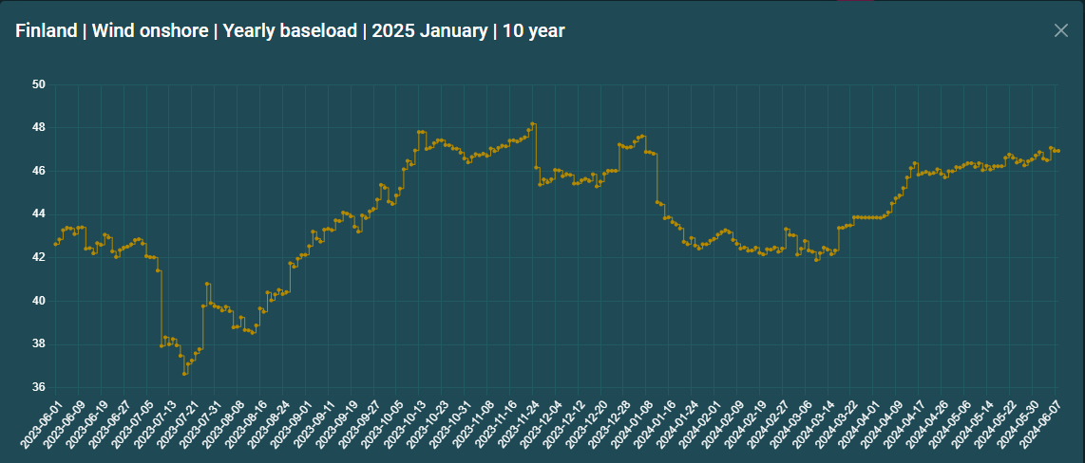
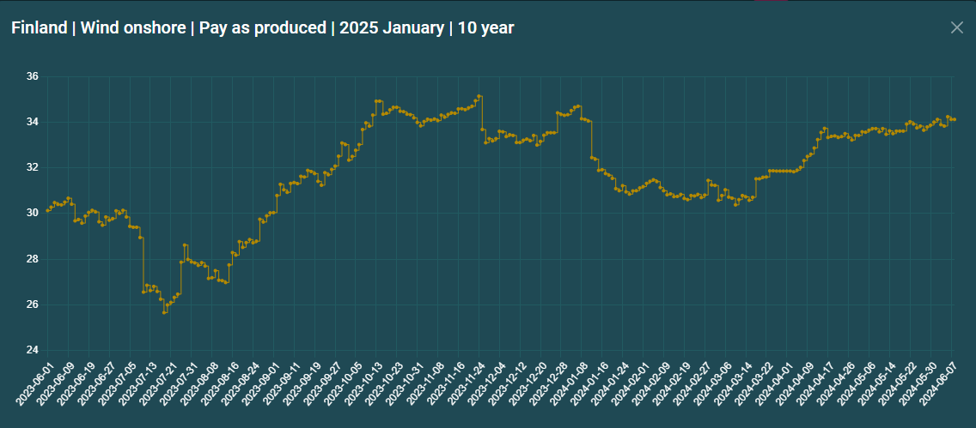
Pay-as-produced structures come with a large discount

Slide 3
Capture rates remains volatile and uncertain
Monthly Capture Rates, Onshore Wind - FI
Source: SKM Market Predictor

Slide 4
Renewable generation is reshping the regulating market in Finland
Regulating Market, Finland
Notes:
Instances with very high balancing costs
15 minute from Q1-2025.
Discussions on max/min price in balancing market from existing +/- 9,999€/MWh to 99,999€/MWh
TSO fees that wind power producer faces.
aFRR and mFRR
Icing events

Slide 5
Different buyers have different requirements
Seasonality
Seasonality
Seasonality
Seasonality
Profiled
Baseload
Volume Risk
Volume Risk
Volume Risk
Baseload
Profile Cost
Profile Cost
Profile Cost
Pay as
Nominated
Balancing Cost
Balancing Cost
Pay as
Produced
Unknown operating costs
Direct
Investment
Wind offtake driven categories
Wind production driven categories
Offtaker have certainty of the outcome
Offtaker carries uncertainty of the outcome
  Buy monthly fixed volume fitted to consumption at fixed energy price.
  Buy fixed flat volume for with fixed energy price.
  Buy uncertain volume with uncertain timing at fixed energy price.
  Buy uncertain volume with uncertain timing, with uncertain balancing cost at fixed energy price.
  Pay Investment related costs in addition to market related variables.

Slide 6
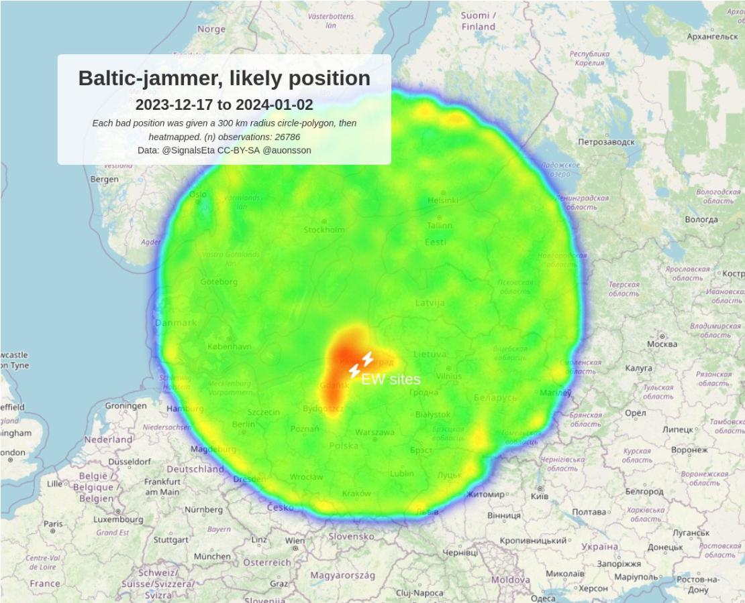
Geopolitical risk remain in the region

Slide 7
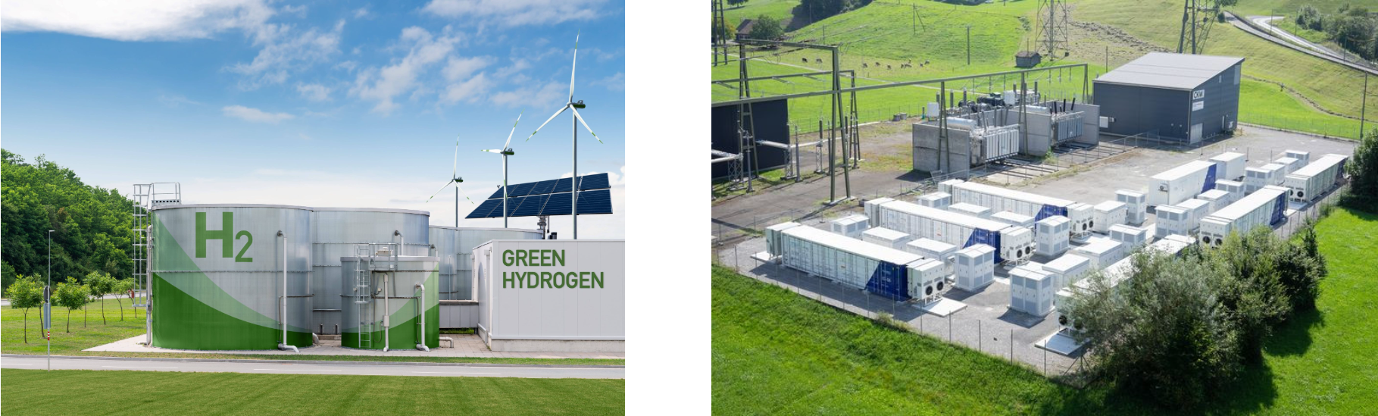
The future is flexible

