Slide 1
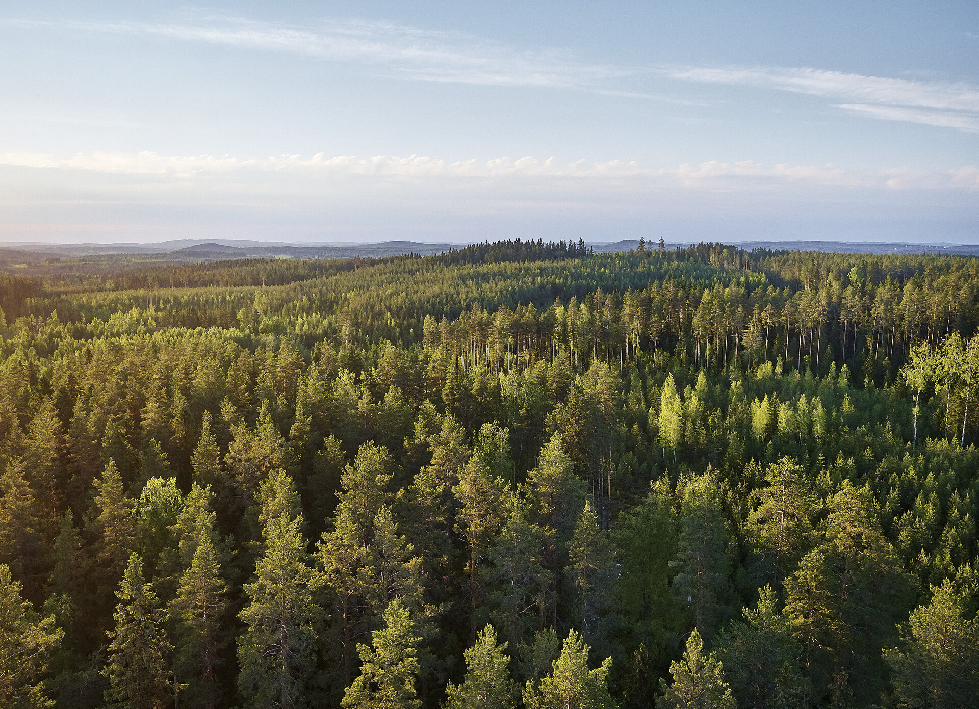
Guarantees of Origin market:
Industrial user case
Metsä Group · Maria Kataikko
13.6.2024
Notes:
Biotaloudessa jalostetaan uusiutuvia luonnonvaroja tuotteiksi, jotka korvaavat fossiilisten raaka-aineiden käyttöä.

Slide 2


Introduction
Metsä Group in brief
Principles of GoO calculations
Drivers behind the GoO’s
Approaching the targets 2030
PROFILE
Maria Kataikko
M.Sc. Engineering
Metsä Group Services, technology
Development manager
- Environmental calculations and reporting
- Chemical safety; REACH

Slide 3





* 2023, internal sales excluded
** Shares listed on the Nasdaq Helsinki
***the amount of biofuels produced
Metsä Group Sales* EUR 6.1 billion Personnel 9,500 Renewable energy*** 26,9 TWh
Metsäliitto Cooperative | The Group’s parent company | Owned by over 90,000 Finnish forest owners
Metsä Forest
Metsä Wood
Metsä Fibre
Metsä Board**
Metsä Tissue
Wood supply and forest services
Sales:
EUR 2.2 billion
Personnel:
700
Wood products
Sales:
EUR 0.6 billion
Personnel:
1,550
Pulp and
sawn timber
Sales:
EUR 2.5 billion
Personnel:
1,600
Paperboard
Sales:
EUR 1.9 billion
Personnel:
2,250
Tissue and grease-
proof papers
Sales:
EUR 1.3 billion
Personnel:
2,500
Metsä Spring | Innovation company

Slide 4

We mitigate climate change.
Measures for the 2030 targets
We only use fossil free fuels and purchase fossil free electricity and heat
We only use fossil free raw materials and packaging materials
We increase forest management
We recommend continuous cover forestry in peatlands
We increase the production of wood products that store carbon for a long time
Indicators
0 t fossil-based carbon dioxide emissions,
scope 1 and 2
100% fossil free raw materials and packaging materials
+30% forest regeneration and young stand management*
+50% forest fertilisation*
+30% share of continuous cover forestry
in peatland forests
+30% amount of carbon stored in wood products**
We reduce fossil-based carbon dioxide emissions and the use of fossil-based raw materials and packaging materials. We ensure that carbon is stored in forests and wood products.
* hectares, compared to 2018
** CO₂ equivalent compared to 2018

Slide 5
Principles behind use of GoO’s
Guarantees of Origin (GoO’s) are used for tracking and verifying the attributes of a given megawatt-hour (MWh) of renewable/fossil free energy from production to consumption.
With the GoO’s the customer can be assured of the origin of the energy. It also benefits the producer by having a reliable chain for the fossil free energy production
As GoO’s are transferable and can be traded separately from the electricity market, customer can choose the quality of the GoO’s
Guarantee of Origin applies to following:
  electricity produced with renewable energy sources, nuclear power and efficient co-production
  renewable gas and hydrogen produced with renewable energy sources
  heat and cooling produced with renewable energy sources and waste heat and cold.
https://energiavirasto.fi/en/guarantee-of-origin

Slide 6
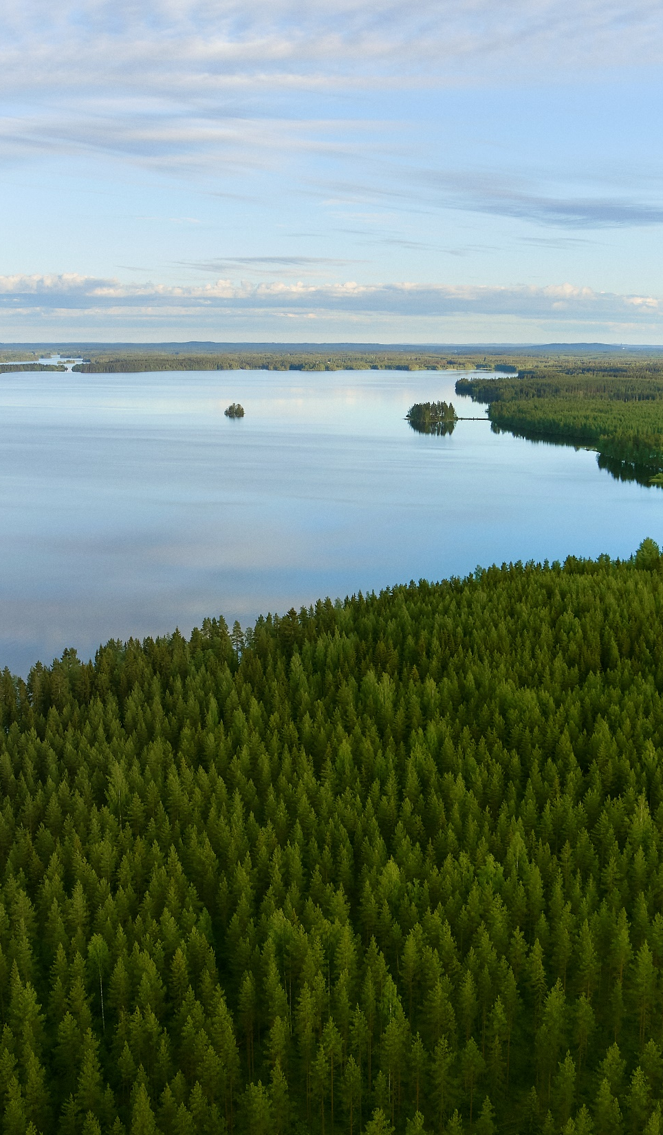
Calculations for electricity
All purchased electricity packages are calculated in total with the division of different attributes;
  fossil fuels
  hydro, wind, solar and geothermal power
  biomass-based electricity
  nuclear
GoO’s are added into the mix to replace unspecified electricity purchases from the grid thus acting as a factor to decrease the Scope 2 CO₂ emissions.
Metsä Group as a utilizer of GoO’s needs to have the verification documents to prove the purchase
Metsä Group Treasury handles the trading of Guarantees of origin and Energy team takes care of the balance needed

Slide 7

Practical measures for Metsä Group
Reduction of specific energy consumption based on more effective production
Production of own energy with renewable fuels (Scope 1)
  Applying for the GoO’s as producer of renewable electricity
  Cancelling used amount of GoO’s for own consumption
Purchasing electricity with PPA from a supplier (Scope 2 market-based)
  Supplier gives information about the origin of the electricity
  Supplier cancels the GoO’s for the benefit of Metsä Group
  GoO’s can be negotiated to be fully or partially covered.
Purchasing market electricity and separately purchasing the GoO’s from the market (Scope 2 market-based)
  Purchasing electricity from the grid with attributes described in the residual mix
  Purchasing the decided amount of GoO’s to cover the electricity use - in total or partially - and to be cancelled for own benefit

Slide 8

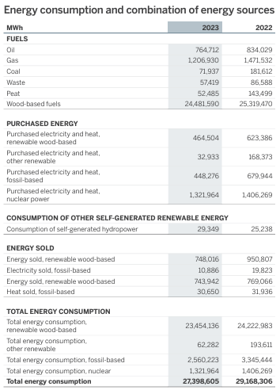
ESRS and Green Claims regulation
Metsä Group annual report 2023
Sustainability reporting to be a part of financial reporting starting 2024
  Metsä carried out the sustainability reporting as a part of financial reporting for year 2023
  According to ESRS, many energy related parameters needed to be calculated more precisely being split in smaller fractions
  Target setting must be open for public; Scope 1 and 2 targets for Metsä Group
Directive of green claims under development
  will enter into force in beginning of 2025 (estimate) and becomes applicable in Member States in 2027
  If companies make environmental claims, they must comply with minimum requirements related to substantiation and communication: the roles of solid (LCA) data and 3rd party verification are highlighted
  Claims must be specific; no generalization is allowed, and existing environmental labels will also have to be verified
  Recommended maximum sanction for unfounded claims is up to 4% of a company’s turnover

Slide 9





Handling and value of GoO’s
GoO’s are valued differently depending on how the attributes of the specific GO are viewed/appreciated in the market.
  Type of different renewables or nuclear
  Specific country
Market situation; decrease due to more fossil free production –increase due to increased demand.
GoO’s are a key tool in the transition towards a more sustainable and renewable energy future and play a crucial role in promoting renewable energy sources and providing transparency to consumers.

Slide 10

By the end of 2030
Estimated emissions’ status of MetsäBoard Classic FBB from Simpele Mill
Metsä Board’s roadmap 2030 enables reduction of Scope 1 & 2 emissions to zero
Scope 3 emissions’ reductions depend on our suppliers’ emission reduction activities (e.g. raw materials, logistics) and we work actively together with them to encourage them in their work towards 2030 and beyond
Notes:
Few product specific examples on emissions development with our roadmap
- -50 % since 2018 – 2023
- -70 % by end of 2030 (vs. 2018)
If/when using our Classic – you have been able to reduce your packaging material emissions accordingly

Slide 11
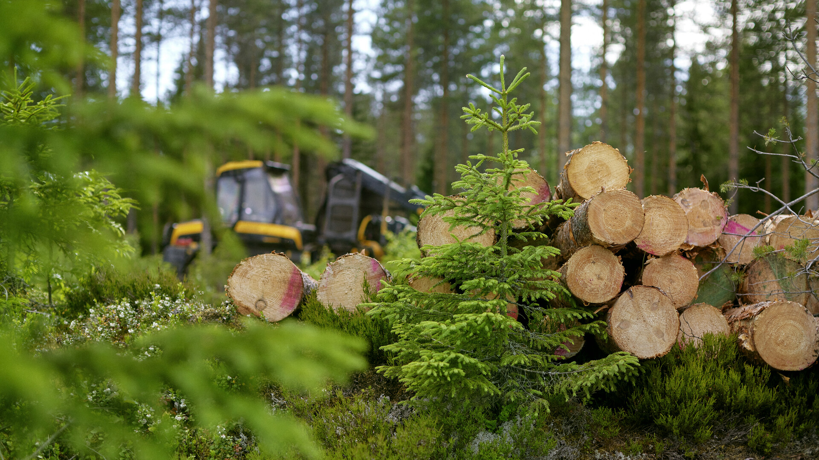
THANK YOU

