Slide 1



Volt Power Analytics
Nordic Power Price Outlook
Montel Finnish Energy Day 2024. Helsinki
Olav Johan Botnen
13th June 2024

Slide 2







A Leading Team With A Thorough Industry Experience
Katinka Bogaard, Managing Director and Co-Founder
Master's degree in Industrial Economics, NTNU 2017.
Expertise in European power market analysis and modelling.
Previous work experience: Volue, EnBW, Refinitiv.
Olav Johan Botnen, Power Market Expert and Co-Founder
Master's degree in Electrical Power Engineering, NTNU 1986.
One of the leading Nordic power market experts.
Expert in European power market analysis and modelling.
Previous work experience: Markedskraft, Wattsight, Volue, Sintef Energy Research.
Eivind Samseth, Lead Continental Analyst and CSO
Master's degree in Industrial Economics, NTNU. 2012.
Expert in European power market analysis and modelling.
Previous work experience: McKinsey & Company.
Børge Bogaard, CCO and Co-Founder
MBA from Stanford 1994.
Start-up expert with over 30 years of experience building up companies. Previous guest lecturer on start-ups at Harvard Business School. Previous work experience: CEO of US operation for a Norsk Hydro company, C- roles in startups.
Odd Gunnar Jakobsen, Senior Nordic Market Analyst
Over 15 years of Nordic power market analysis experience.
Previous work experience: Markedskraft, Wattsight, Volue.
William Bjønness, Power Market Analyst
Dual master's degree in Energy Systems and Markets, NTNU/TU Berlin 2022.
Expertise in power market modelling and data analysis.
Previous work experience: Fraunhofer ISE, NTNU.
Tom Donnelly, Head of Marketing
Master's degree in Renewable Energy from the University of Hull
Expertise in building and developing SaaS businesses and marketing.
Previous work experience: Fugro Satellite Positioning,
Wattsight, Volue.

Slide 3
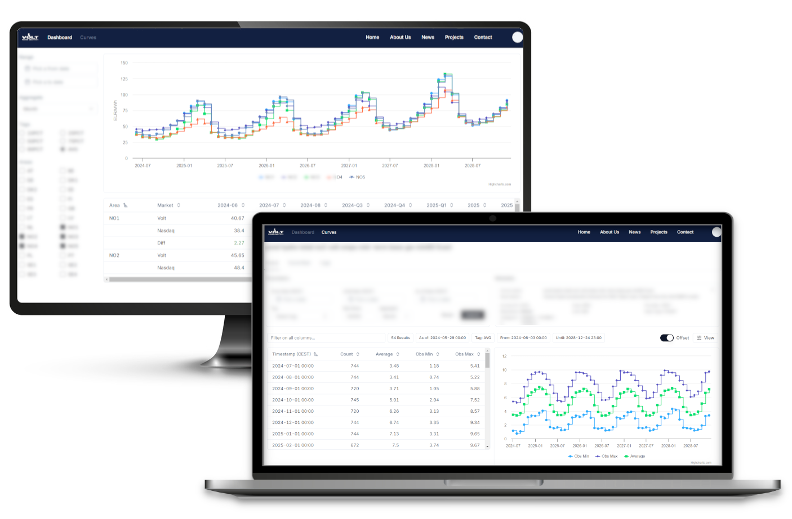

Volt Power Analytics’ New Client Portal
The Volt Power Analytics Portal is Live
Nordic forward, based on hourly model simulations, updated every working day with free API access
Portal Access Available to early adopters now
Long Term Outlooks
Released our Nordic 2035 Outlook using Hourly Resolution Simulations
Long-term power price outlook until 2050 on its way
Early Portal
Adopters
Welcome!

Slide 4
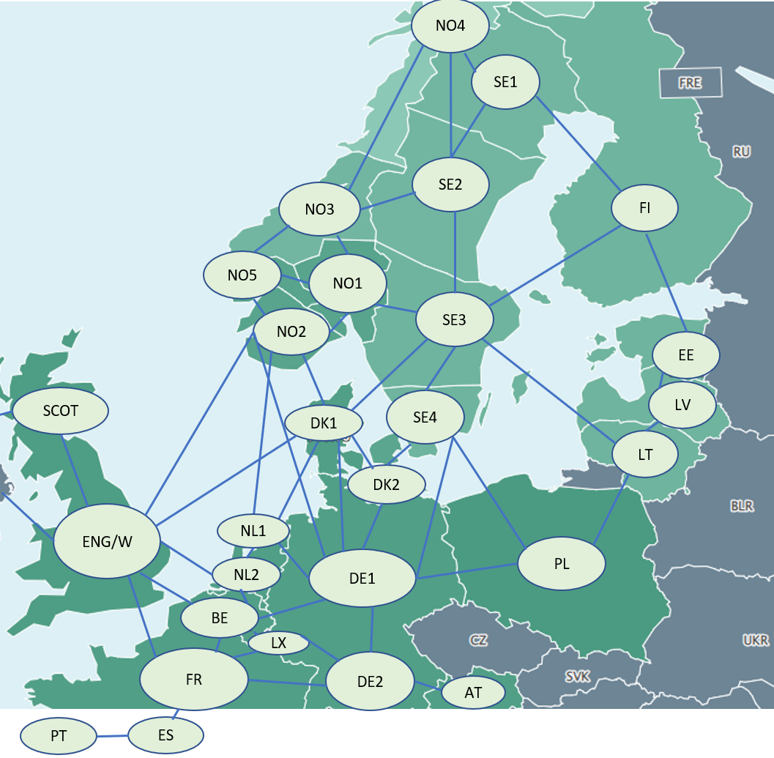
Volt’s EMPS Model For Hourly Price Simulations
  Detailed modelling of hydropower plants in Norway and Sweden, incl. 30 years of inflow series
  Modelling of thermal power plants in European countries
  Forecasts for development of generation sources and power consumption included
  Hourly time series for onshore/offshore wind and solar power, power consumption
  Hourly simulations for forward/long-term horizon (2024-2050) in latest EMPS software (API/Python version)
  Calculation of capture prices for renewable investments, utilization of electrolysers

Slide 5
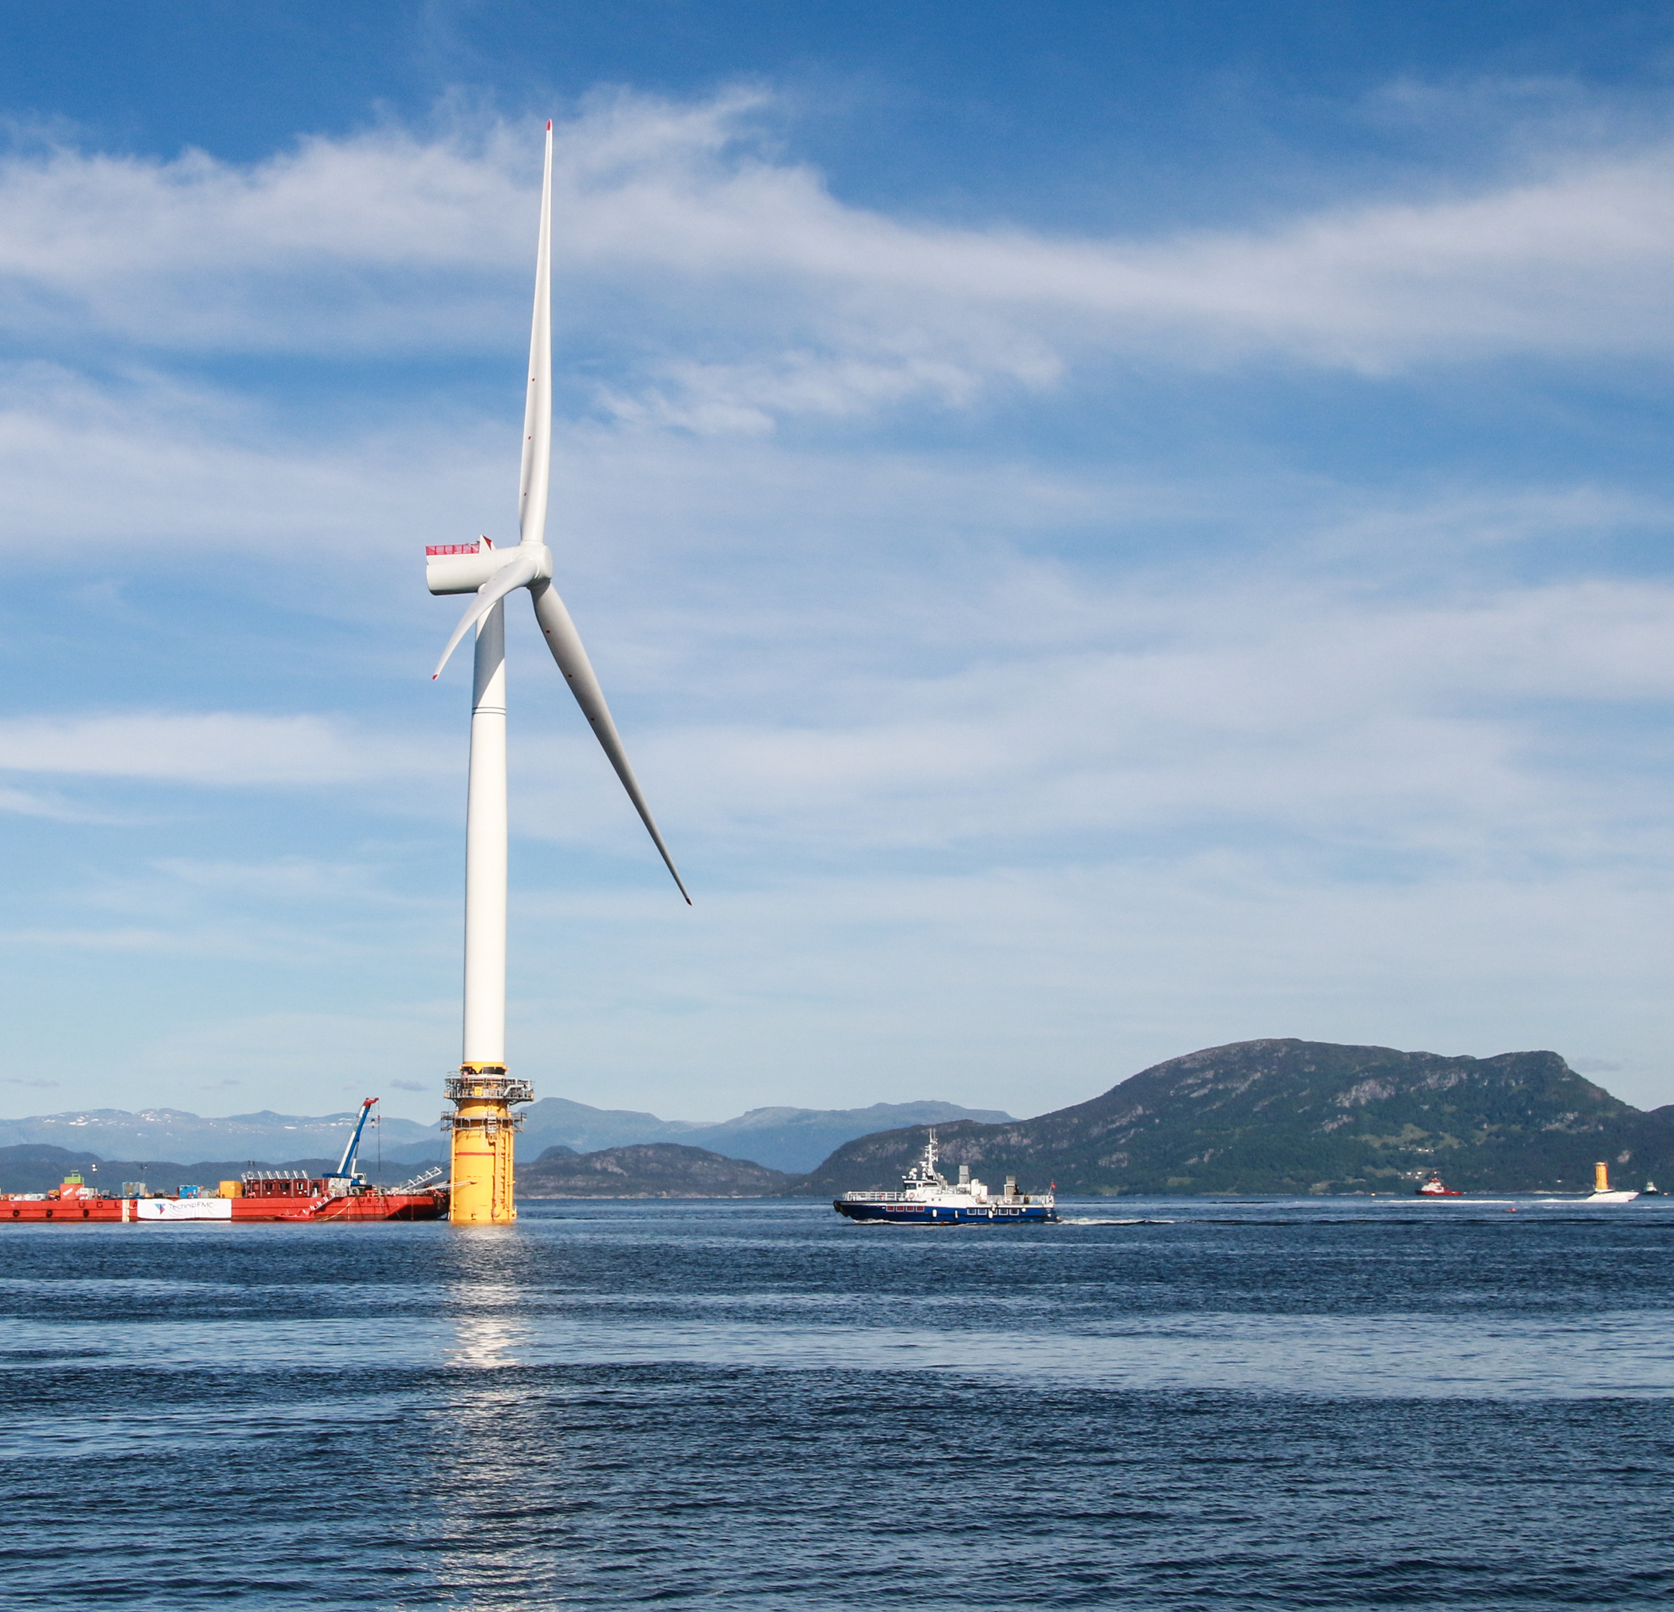
New Landscape For Renewable Investments
Strong inflation rate, increased interest rates, bottlenecks in supply chains: 30-40% increase of CAPEX
Onshore wind projects: Licensing processes slower/more difficult, high taxes (Norway)
Offshore wind projects: Some investment decisions cancelled/on hold/delayed: more subsidies needed
Solar projects: Healthy progress recently, weakening capture prices observed. Batteries a solution?
Grid projects: Slow licensing/progress, hindering some large-scale renewable/industrial projects. Split to price zones?
Electrolyser projects: Strong need for subsidies, slow progress, difficult to find long-term off-take agreements

Slide 6
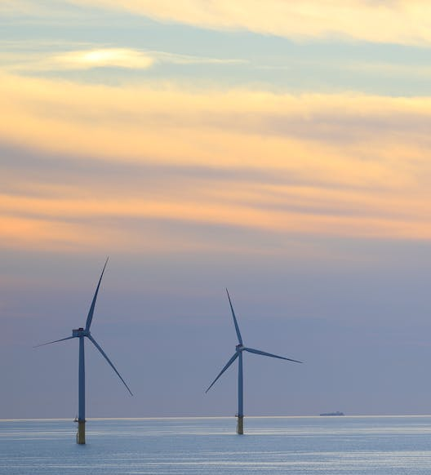
Offshore Wind Projects – Delayed/Scaled Down In Long-term Analysis
Slower development of offshore wind in European supply over late 2020s/early 2030s. Higher speed expected over mid 2030s, assuming falling LCOE’s
Companies announced plans to scale back their green transitions recently: Orsted, Iberdrola, ENEL, EDP (Portugal). Statkraft now reviewing its green targets
Norwegian projects: deep sea, high grid costs, high need for subsidies – significantly delayed/cancelled?

Slide 7
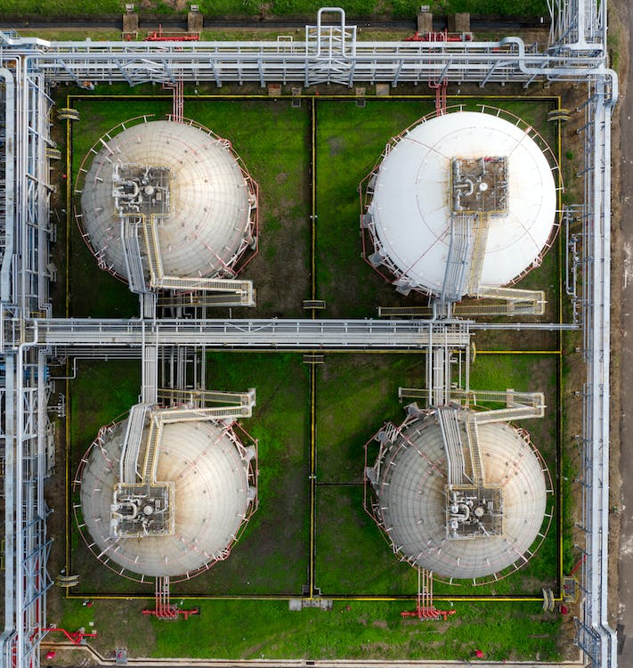
Higher Costs Stall Development Of Green Hydrogen
More than 50% cost increase for electrolysers over recent 2 years - delays in FIDs
No significant progress worldwide
The challenge: Finding long-term offtake agreements to secure cash flow for banks to be able to finance
The EU not on track to reach its 40 GW target by 2030
EU’s Hydrogen Bank provided €720 million to 7 renewable hydrogen projects in Europe in April 2024 (ES, PT, FI, NO)
Large-scale industrial electrolyser projects in Sweden/Finland: developed by 2026-2028?

Slide 8
Development of Electrolysis in ‘Optimistic’ Scenario
Assumed Power Consumption from electrolysers in Europe (TWh/a)
Region | 2025 | 2030 | 2035
Nordic | 4 | 65 | 89
Rest of Europe | 5 | 40 | 80
Total Europe | 9 | 105 | 169
Assumed electrolyser capacity in Europe (GW)
Region | 2025 | 2030 | 2035
Nordic | 1 | 13 | 18
Rest of Europe | 1 | 10 | 20
Total Europe | 2 | 23 | 38
* assuming utilisation of 5000 h/a in Nordic and 4000 h/a for rest of Europe
Weak performance over front years 2024-2026
Stronger performance over 2027-2030 to a level of 23 GW, compared with EU target of 40 GW
Rather strong performance over early 2030s

Slide 9


Finnish Power Balance Development (In TWh)
 |  |  | Power Balance of Finland
Year | Hydro | Onshore | Offshore | Solar | Nuclear | Thermal | CHP | Total production | Consumption | Balance
2022 | 14 | 12 | 0 | 0 | 24 | 4 | 16 | 70 | 82 | -12
2025 | 14 | 23 | 0 | 2 | 35 | 3 | 15 | 92 | 84 | 8
2030 | 14 | 28 | 3 | 4 | 35 | 1 | 13 | 97 | 106 | -9
2035 | 14 | 31 | 10 | 5 | 35 | 1 | 13 | 109 | 109 | 0
Healthy development of renewables and consumption
Onshore wind licenses available
Large wind projects under construction work or with (potential) FID’s

Slide 10
Finnish Consumption Development 2022-2026 (In TWh)
2022-2026:
Datacenters 1.7 TWh
Transport: 2 TWh
Hydrogen 0.4 TWh
Battery manufacturing: 0.5 TWh
Heat pumps: 1.2 TWh
Total: 5.8 TWh
2022-2030:
Datacenters 3.3 TWh
Transport: 3.4 TWh
Hydrogen 2.4 TWh
Battery manufacturing: 2.5 TWh
Heat pumps: 2.4 TWh
Green Steel: 11.0
Total: 25.0

Slide 11
Our Indications: Finland Base Long-term Scenario
Falling with more supply
Climbing with weaker power balances
* Capture prices will normally be 7-20 €/MWh lower than base-load prices for wind/solar projects

Slide 12
Swedish Power Balance Development (In TWh)
 |  |  | Power Balance South of Sweden (SE3 and SE4)
Year | Hydro | Onshore | Offshore | Solar | Nuclear | CHP | Total production | Consumption | Balance
2022 | 8 | 14 | 0 | 2 | 50 | 12 | 86 | 110 | -24
2025 | 8 | 18 | 0 | 5 | 52 | 12 | 95 | 112 | -17
2030 | 8 | 21 | 3 | 7 | 52 | 12 | 103 | 125 | -22
2035 | 8 | 21 | 18 | 9 | 60 | 12 | 128 | 130 | -2
Healthy development of renewables, later also nukes
Offshore wind in south post 2030
New nukes by mid 2030s
More development of new consumption than new supply in north
Industrial demand in north to go potentially higher?
 |  |  | Power Balance North of Sweden (SE1 and SE2)
Year | Hydro | Onshore | Offshore | CHP | Total production | Consumption | Balance
2022 | 61 | 18 | 0 | 4 | 83 | 27 | 56
2025 | 58 | 25 | 0 | 4 | 87 | 30 | 57
2030 | 58 | 33 | 5 | 4 | 101 | 62 | 39
2035 | 58 | 41 | 8 | 4 | 112 | 65 | 46

Slide 13
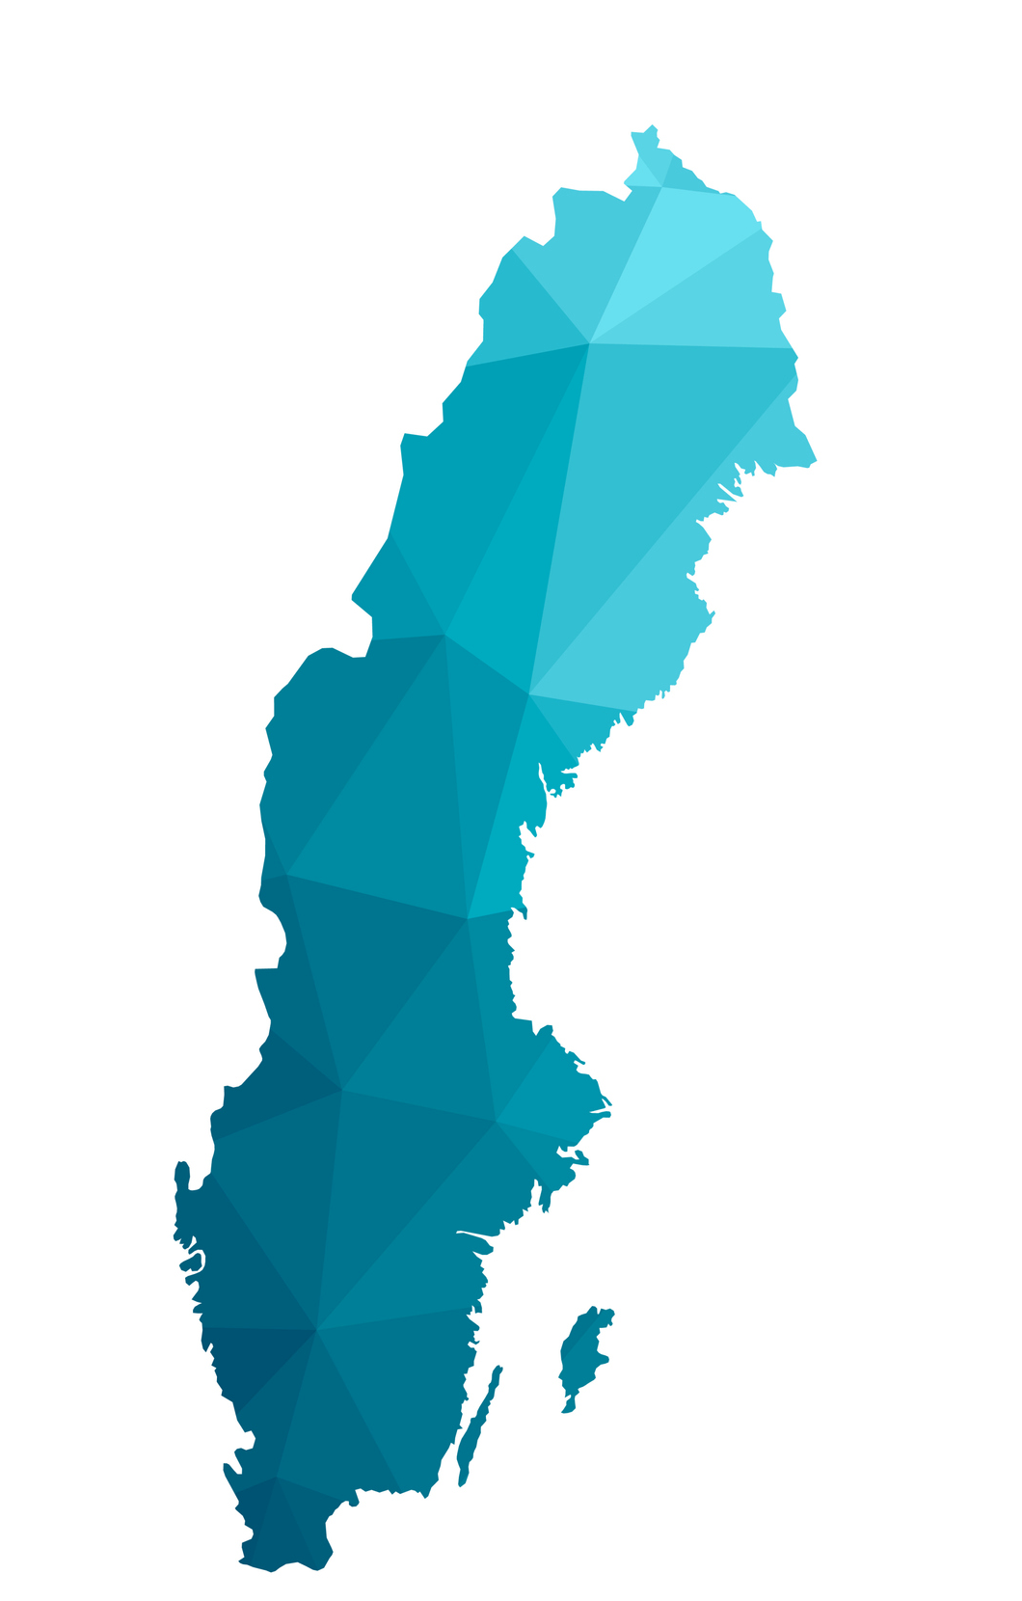
Swedish Consumption Development 2022-2030 (In TWh)
South of Sweden:
Datacenters 2.6 TWh
Transport: 4.4 TWh
Hydrogen: 3.0 TWh
Battery manufacturing: 3.0 TWh
Chemical industry: 1.8 TWh
Heat pumps: 2.1 TWh
Total: 16.9 TWh
North of Sweden:
Datacenters*: 2.7 TWh
Transport: 0.8 TWh
Hydrogen*: 12.1 TWh
Battery manufacturing: 1.9 TWh
Green Steel*: 14.0 TWh
Heat pumps: 3.8 TWh
Total: 35.3 TWh
* Delay due to grid connections?

Slide 14
Our Indications: Base Long-term Scenario Sweden
Climbing with weaker power balances
* Capture prices will normally be 7-20 €/MWh lower than base-load prices for wind/solar projects

Slide 15
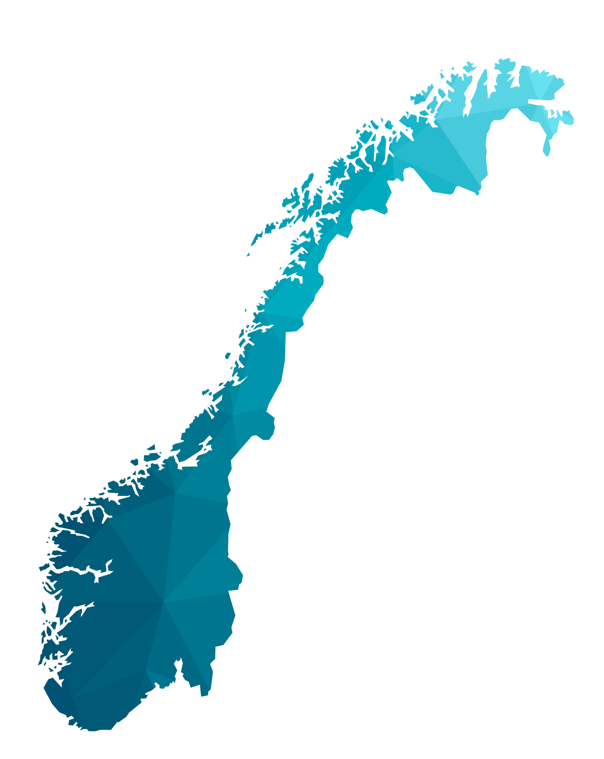
Norwegian Renewable Projects Faces Headwind
30-40% increase of costs (CAPEX) for hydropower, onshore/offshore wind, electrolyser projects
Few licenses available for new hydropower/onshore wind, except small-scale hydropower plants (<10 MW)
New Norwegian tax regime cap income. Increased resource tax (‘ground rent tax’) for hydropower from 37 to 45% (for >10 MW). Introduction of resource tax for onshore wind of 35%
Onshore wind tax: ‘Will scare away investors to other European countries’ (Aneo to Montel)
Many small-scale hydropower projects in pipeline. Nearly no other projects under construction work/new FID’s
Offshore wind: to be delayed to 2032 onwards

Slide 16
Norwegian Power Balance Development (In TWh)
 |  |  | Power Balance South of Norway (NO1, NO2 and NO5)
Year | Hydro | Onshore | Offshore | Solar | Thermal | Total production | Consumption | Balance
2022 | 93 | 7 | 0 | 0 | 1 | 101 | 84 | 17
2025 | 94 | 7 | 0 | 1 | 1 | 103 | 89 | 14
2030 | 95 | 9 | 0 | 3 | 1 | 109 | 108 | 1
2035 | 97 | 9 | 9 | 4 | 1 | 120 | 112 | 8
Weak development of renewables until 2030
Some offshore wind expected over mid 2030s
Healthy development of consumption until 2030
 |  |  | Power Balance North of Norway (NO3 and NO4)
Year | Hydro | Onshore | Offshore | Solar | Thermal | Total production | Consumption | Balance
2022 | 43 | 10 | 0 | 0 | 1 | 55 | 47 | 8
2025 | 44 | 11 | 0 | 0 | 1 | 56 | 51 | 4
2030 | 44 | 13 | 0 | 0 | 0 | 58 | 66 | -8
2035 | 45 | 18 | 5 | 0 | 0 | 68 | 69 | -1

Slide 17
Norwegian Consumption Development 2022-2030 (In TWh)
South of Norway:
Datacenters 5.7 TWh*
Transport: 4.4 TWh
Hydrogen 7.2 TWh
Petroleum 4.0 TWh
Battery manufacturing: 2.4 TWh
Total: 23.7 TWh
* Google, Skien:
2026 0.7 TWh, max. plan 7.5 TWh/830 MW
North of Norway:
Datacenters 1.5 TWh
Transport: 1.4 TWh
Hydrogen 6.1 TWh
Petroleum 5.6 TWh**
Battery manufacturing: 3.7 TWh
Total: 18.3 TWh
** Melkøya, Finnmark:
2030 3.6 TWh/360 MW

Slide 18
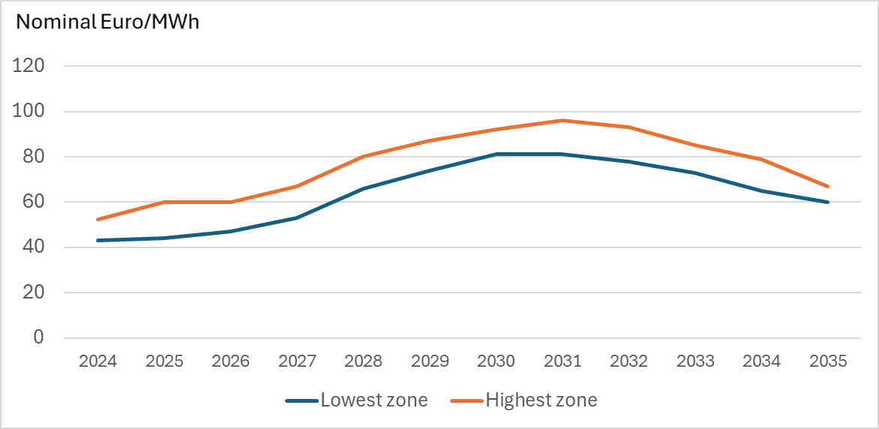
Our Indications: Base Long-term Scenario Norway
Climbing with weaker power balances
Falling with more supply
* Capture prices will normally be 7-20 €/MWh lower than base-load prices for wind/solar projects

Slide 19
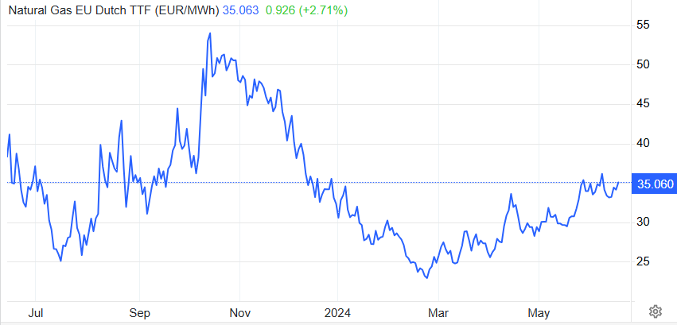
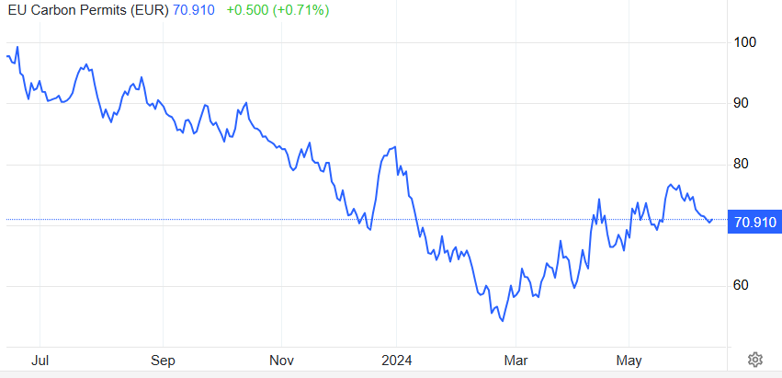

European Gas and EUA prices
Mid June 2024
High levels in European gas storages (72%)
Healthy supply via pipelines (except from Russia)
Potential fundamental downside
Risk of upside effects: Asian demand, outages, ongoing wars
More supply via LNG by 2026-2027
Weak industrial performance 2023 and 2024
Increasing renewable generation
More influence of right-wing politics to reduce ambitions?
Potential fundamental downside, but some link to gas prices

Slide 20
‘Mid-term’ Price simulations Finland (FI)
Input: Latest closing of TTF and EUA markets
Nominal Euro/MWh
Downside summer 2024, upside thereafter
Product | Market 11/6 | Our simulation 12/6 | Deviation
Jul-24 | 23 | 23 | 0
Aug-24 | 39 | 24 | -15
Q3-24 | 38 | 26 | -12
Q4-24 | 51 | 56 | 5
Q1-25 | 73 | 102 | 29
Q2-25 |  | 64
Q3-25 |  | 31
Yr-2025 | 49 | 64 | 15
Yr-2026 | 45 | 64 | 19
Yr-2027 | 43 | 70 | 27
Yr-2028 | 46 | 78 | 32

Slide 21
If Olkiluoto 3 on outage Q4+Q1: Finland (FI)
Input: Latest closing of TTF and EUA markets
Nominal Euro/MWh
Downside summer 2024, upside thereafter
Product | Market 11/6 | Our simulation 12/6 | OL3 outage
Jul-24 | 23 | 23
Aug-24 | 39 | 24
Q3-24 | 38 | 26
Q4-24 | 51 | 56 | 72
Q1-25 | 73 | 102 | 119
Q2-25 |  | 64 | 65
Q3-25 |  | 31 | 32
Yr-2025 | 49 | 64 | 69
Yr-2026 | 45 | 64 | 64
Yr-2027 | 43 | 70
Yr-2028 | 46 | 78

Slide 22
‘Mid-term’ Price simulations South of Sweden (SE3)
Input: Latest closing of TTF and EUA markets
Nominal Euro/MWh
Upside for most of products
Product | Market 11/6 | Our simulation 12/6 | Deviation
Jul-24 | 16 | 23 | 7
Aug-24 | 20 | 24 | 4
Q3-24 | 23 | 25 | 2
Q4-24 | 40 | 43 | 3
Q1-25 | 60 | 73 | 13
Q2-25 |  | 51
Q3-25 |  | 31
Yr-2025 | 39 | 51 | 12
Yr-2026 | 38 | 57 | 19
Yr-2027 | 39 | 66 | 27
Yr-2028 | 44 | 75 | 31

Slide 23
‘Mid-term’ Price simulations North of Sweden (SE1/SE2)
Input: Latest closing of TTF and EUA markets
Nominal Euro/MWh
Upside for most of products
Product | Market 11/6 | Our simulation 12/6 | Deviation
Jul-24 | 15 | 21 | 6
Aug-24 | 19 | 23 | 4
Q3-24 | 20 | 23 | 3
Q4-24 | 31 | 30 | -1
Q1-25 | 40 | 48 | 8
Q2-25 |  | 39
Q3-25 |  | 28
Yr-2025 | 27 | 37 | 10
Yr-2026 | 29 | 45 | 16
Yr-2027 | 33 | 60 | 27
Yr-2028 | 35 | 71 | 36

Slide 24



Thank you for your time!
obo@voltpoweranalytics.com
+47 908 42 640
Kirkegaten 5, 4836 Arendal, Norway

