Slide 1

Gas market update
Finland & Baltics
Finnish Energy Day
13th of June 2024
Jouni Liimatta

Slide 2
SUMMARY – Gas Market update Finland & Baltics
Gas market has been fairly stable, however war in Ukraine is not over.
  Is cold winter still an issue?
Gas prices in Finland & Baltics have followed TTF prices.
  Another anchor bites the dust?
Inčukalns Gas storage prices
  Blind auction comes back to haunt?
Bottlenecks?
  NIMBY

Slide 3
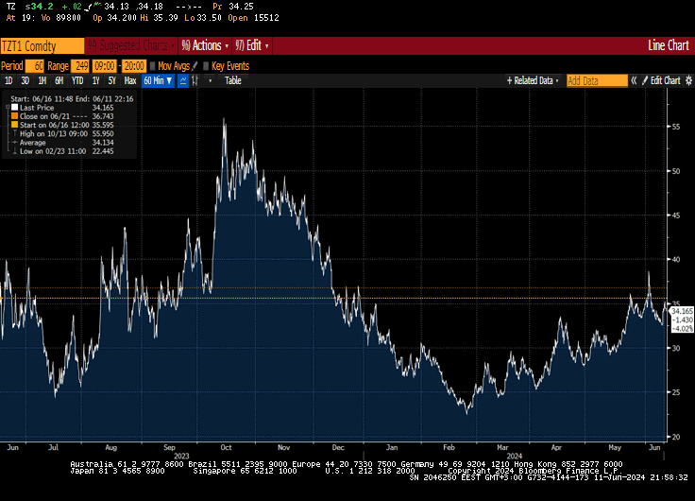
Gas prices in Europe
Short term volatility has again increased.
Demand from Asian market has diverted LNG-supplies away from Europe.
Geopolitical uncertainty and unexpected supply disruptions from Norwegian gas fields have increased prices in Europe.
Source: ICE

Slide 4
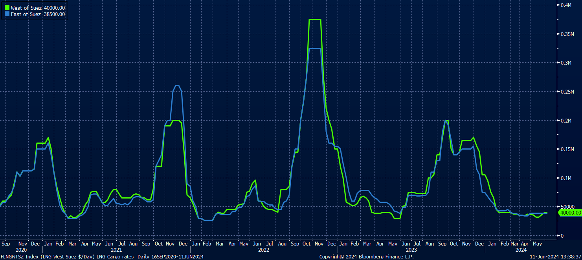
LNG Tanker Time Charter rates USD/day, in both East and West of Suez canal.
→ Cheaper to transport LNG from US Gulf Coast to Asia.
Source: Bloomberg

Slide 5

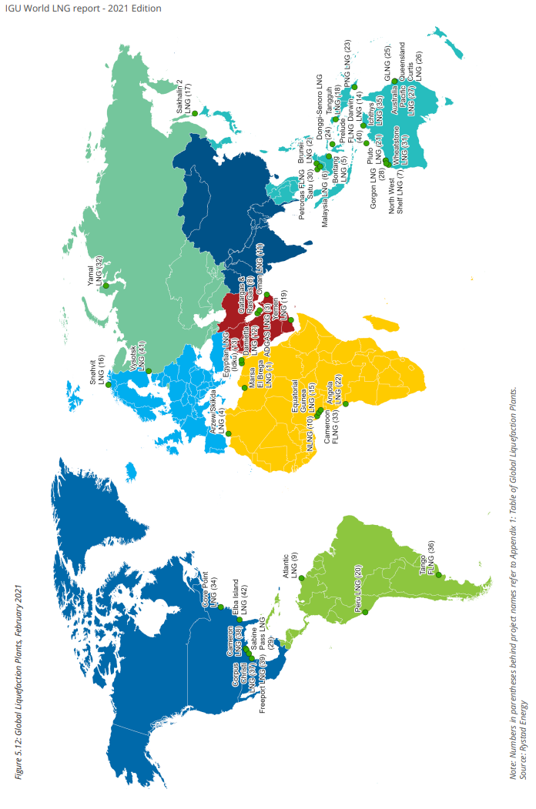
Global LNG plants
(Source IGU, Rystad Energy)

Slide 6
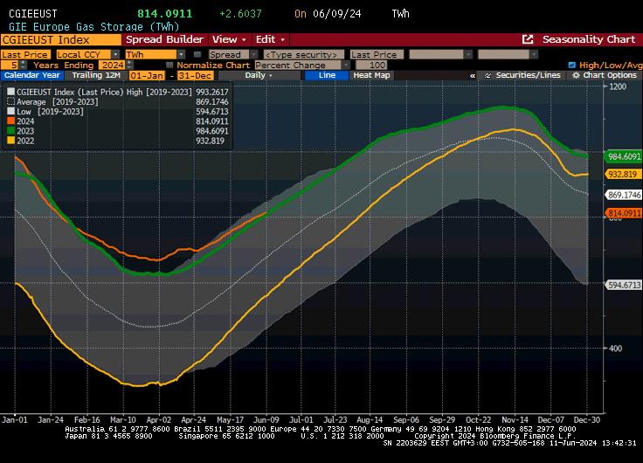
European gas inventories are almost at record high levels across Europe. The filling rate is almost two months in advance compared to the normal years.

Slide 7
European NG storages are at very high levels.

Slide 8
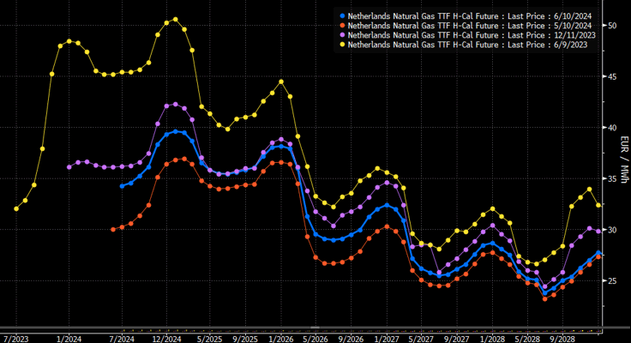
Summer-winter spread for next winter has opened to 6 EUR/MWh. Back end of the curve has stabilized around 35 EUR/MWh levels for year 2025 and below 30 EUR/MWh for further out.
Inčukalns auction results:
2,51 TWh @ 4,53
1,48 TWh @ 5,06
1,88 TWh @ 3,11
1,29 TWh @ 2,53
5,08 TWh @ 0,09
Source: ICE

Slide 9
Gas prices in Finland and in Baltics
Historically moved hand-in-hand with TTF
Since Balticconnector-pipeline destruction the situation has been totally different and the price difference was at some point over 50 EUR/MWh.
Could this happen again?

Slide 10
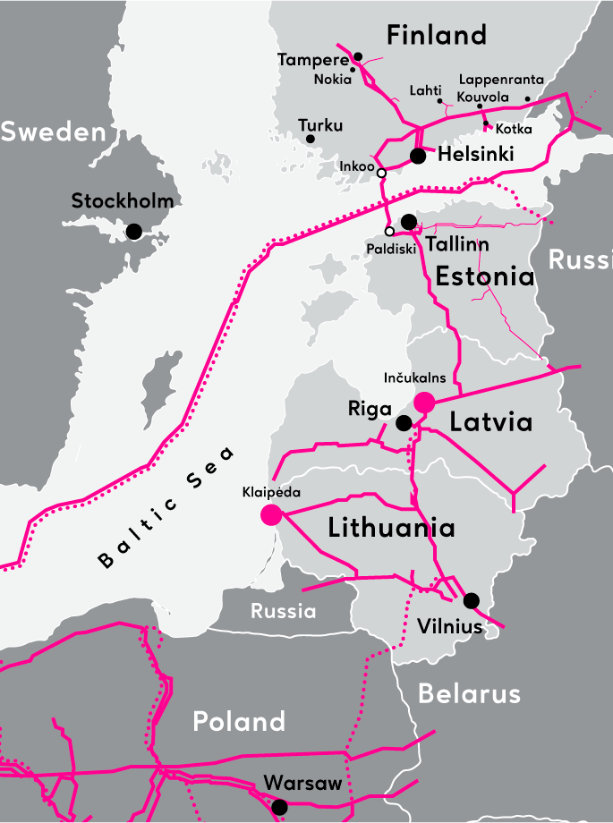
Pipeline gas routes to Finland and Baltics
→ FSRU Inkoo, Hamina, Klaipeda, GIPL
NOTE! Kiemenai connection point (Lithuania <-> Latvia) creates a bottleneck as capacity is fully booked, but utilisation rate is only 25%.
  no penalties for this?!
NOTE! FSRU Inkoo slot reservations for Q1-2024 were originally non-existent. What is the situation for Q1-2025?
  Cold winter day demand in Finland was over 100 GWh/day
  Balticconnector capacity is not enough
  Potential bottleneck for gas deliveries

Slide 11
SUMMARY – Gas Market update Finland & Baltics
War in Ukraine is not over → Gas market volatility has continued
  High inventories and good availability of LNG deliveries to Europe.
  LNG Tanker rates are cheap
Gas prices in Finland & Baltics have followed TTF prices.
  good availability of FSRU Inkoo volumes
  completion of Balticconnector repairs
Inčukalns Gas storage prices in the auction for next season have been surprising.
  First auction prices in February were over 5 EUR/MWh
  Last auction price in May dropped to below 0,10 EUR/MWh level.
  Summer-Winter price spread is about 6 EUR/MWh, which is incentivizing the storage use at least for those who booked capacity in the final auction.
Bottlenecks?
  FSRU Inkoo deliveries in Q1-2025?
  Kiemenai capacity?

