Slide 1
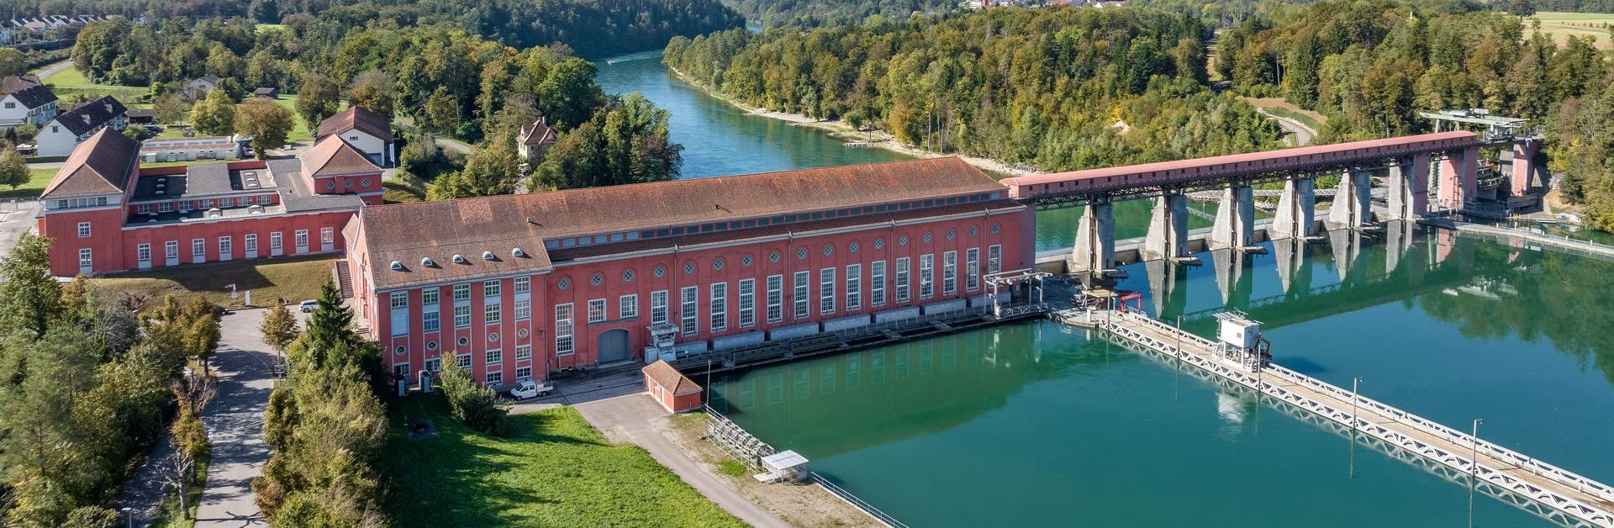
Spot market volatility is increasing – where are we heading?
Riku Merikoski, Senior Power Analyst
13 June 2024
Notes:
Eglisau power plant, Switzerland

Slide 2
Disclaimer
This document is exclusively prepared for existing clients of Axpo’s main business domiciled or incorporated in Switzerland or the EU/EEA. "Axpo" means Axpo Solutions AG or one of its subsidiaries, which is part of the Axpo group companies (the "Axpo Group" and companies of the Axpo Group the "Axpo Group Companies").
This document is for information purposes only. None of the statements and notes constitutes a solicitation, an offer or a recommendation for conducting any transactions. No warranty, either expressed or implied, is given for the information contained in this document. Actions based on this document made therein are the responsibility of those who undertake them. All liability for damages, which may result directly or indirectly from the use of this document, is disclaimed.
The authors of this document are listed below. The authors are employed by Axpo and this document contains the views, opinions and recommendations of Axpo's Energy Markets Analysis team. The members of Axpo's Energy Markets Analysis team routinely consult and exchange information with members of Axpo's Continental European Merchant Trading, Core Market Trading and Origination Hubs team. The members of these teams may enter into transactions as principal on the basis of the views and opinions of Axpo's Energy Markets Analysis team. A component of the compensation of Axpo's Energy Markets Analysis team is based on the revenue generated by Axpo's Continental European Merchant Trading and Core Market Trading team.
The accuracy, completeness or relevance of the information which has been drawn from external sources is not guaranteed although it is drawn from sources reasonably believed to be reliable.
Estimates regarding future developments and other forward looking statements regarding commodities and therewith connected derivatives mentioned in this document may be based on assumptions that may not be realized. Axpo reserves the right to change the views reflected in the document without notice and to issue other reports that are inconsistent and reach different conclusions from the information presented in this document.
Axpo Group Companies do, from time to time, deal, trade in, profit from, hold, act as market-makers or advisers or brokers in relation to the commodities and derivatives thereof or of persons or entities mentioned in this document and may be represented on the board of such persons or entities or hold directly or indirectly more than 5% of their share capital. Axpo Group Companies are under no obligation to disclose this document when advising or dealing with or on behalf of customers. Axpo Group Companies do, from time to time, act as a principal trader and may hold positions or related derivatives in commodities or related derivatives that may be referred to in this document. In particular, Axpo Group Companies do, from time to time, have long or short positions in relation to the commodities or related derivatives mentioned in this document. Employees of Axpo Group Companies, or individuals connected to them, may, from time to time, have a position in or hold any of the investments or related investments mentioned in this document.
© 2024. All rights reserved. No part of this document may be reproduced or distributed in any manner without the written permission of Axpo. In any case of reproduction, a reference to Axpo Solutions AG must be made. Axpo specifically prohibits the redistribution of this document via the Internet or otherwise and accepts no liability whatsoever for the actions of third parties in this respect.
Author: Riku Merikoski
Baden, 10 June 2024

Slide 3
Agenda
Background
  Electricity demand development in the Nordics
  Wind and solar power in the Nordics
  Our neighbours will not be able to help
  Thermal power development
  Transmission grid development
Volatile physical power markets
  The spot market is much more volatile, not only in Finland
  Balancing market tells the same story
  Negative prices becoming more common
  Which solutions could reduce the volatility?
  Future outlook

Slide 4
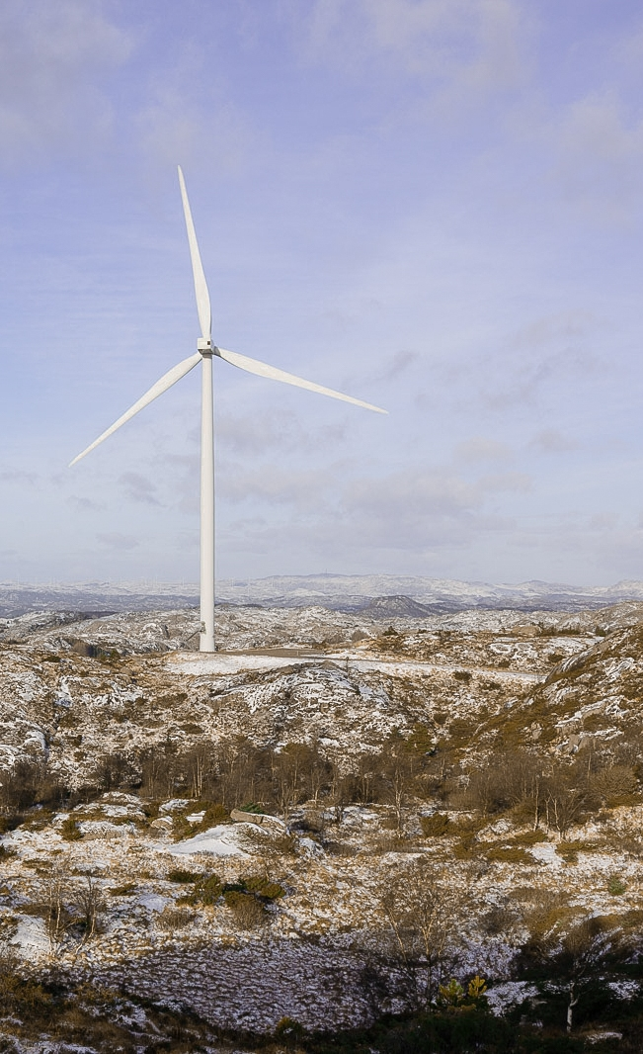
1. Background
Notes:
Egersund Wind Farm, Norway

Slide 5
25 years without demand growth in the Nordics
Nordic power demand has not grown at all
  Norway is the only exception, as the electrification in oil and gas industry has created almost 10 TWh new demand since 2000
  2024 is at least showing a small uptick, but a part of this, especially outside Denmark can be largely attributed to a colder winter than in 2023
  In Finland and Sweden, the small growth in other sectors has been balanced by a large decrease in forest industry power demand
Future will be different?
  Both the TSOs and various forecasters are now saying that we will have a new period of growth
  But the investments thus far are far short of the lofty promises and I expect a lot of delays in investments also in the future
  The estimated demand growth rates are above anything we have ever seen for such a long period, even if I would say it was much easier to increase electricity demand when many people were connected to the grid for the first time
Source: Eurostat, Volue for forecasts

Slide 6
Wind power development
Despite the lack of demand growth, we have doubled the Nordic wind power capacity in 5 years
  Very strong growth in Sweden and Finland
  Denmark has seen only modest growth as it has recently concentrated on large offshore projects
  Norway has stopped wind power development
More of the same ahead
  Sweden and Finland still see around 1000 MW of wind power additions this and next year, even according to national wind power organizations
  But I cannot see how the development can continue with higher building costs, higher interest rates and relatively low power prices, except if we finally start seeing the demand growth
  Danish power prices are much higher, but the ambitious offshore wind projects remain challenging in current environment
  The full stop of Norwegian wind investments is actually positive for FI/SE wind investments
Source: Long-term forecasts from wind power associations and TSOs, adjusted by Axpo

Slide 7
Solar power development
Very strong growth the last 2 years
  About 1 GW of new solar power has been built in Sweden and Denmark, these being the countries with highest power taxes
  Finnish solar power growth has taken off as well
  Norway is behind the others, as the state is generously subsidising household electricity consumption
Outside Norway, everyone seems to be expecting significant growth in the future as well
  But cannibalization of solar power will hit the investments hard at some point as shown also by a recent paper on cross-border effects on solar and wind cannibalization
  There is still no doubt that we will see Nordic solar power being doubled in a couple of years, but some most optimistic visions should be questioned
  But unlike in wind power, solar power investment costs can continue to fall for quite some time, as the manufacturing is not as material intensive
Source: Long-term forecasts from authorities and TSOs, adjusted by Axpo;
Stiewe et al. Cross-border cannibalization:Spillover effects of wind and solar energy on interconnected European electricity markets
Notes:
But does it really make sense to build 20 000 MW solar in Denmark by 2030 as the Danish TSO base scenario says
Chinese industrial target? / How reliant on China do we want to be?

Slide 8
Our neighbours are not helping – they are heading for RES overcapacity as well
All countries are building plenty of solar simultaneously
  Soon, there will not be any country which needs to import power when the sun is shining, but everyone has more than they need themselves
  What are we going to do with all that power?
  And if everyone wants to save their solar power to batteries, we are going to need huge amounts of Chinese batteries
Wind power growth is not as extreme, but there will be a lot of it as well
  Geographical variation on wind power helps a bit, as the wind conditions are not the same simultaneously over all Europe
  But the wind capacities are so much larger than the international transmission capacities that power exports can only be a partial solution
Source: Long-term forecasts from authorities and TSOs, adjusted by Axpo

Slide 9
Thermal power development
The Swedish nuclear power closures have contributed to the increased vulnerability of the Nordic power system to the upside
    Barsebäck closures (1999, 2005) were a major reason for the Swedish spot area division
    Oskarshamn (2013, 2017) and Ringhals (2019, 2020) closures created room for RES growth but also made Swedish power balance much weaker on calm days
    The Finnish Olkiluoto 3 opening has been able to offset the loss of Russian imports, Finland would have had problems without it
  Until recently, there was still some combustion-based thermal power to replace, but the Finnish statistics show that there is not much else than bio-based industrial CHP left, especially in the summer
    Replacing that is not particularly beneficial as it would make it harder to reach the EU RES targets and it would not contribute towards reaching EU ETS emission reduction targets
    Lowest monthly emission intensities were recorded in summer 2023, just 10 gCO2/kWh
Source: Finnish Energy, Statistics Finland, *preliminary data
Notes:
This explains the price peaks, also the loss of Russian imports

Slide 10
New transmission capacity will not be there
New transmission connections between Nordics and other countries, built 2016-23
    SE4-LT 2016, 700 MW (Nordbalt)
    DK1-NL 2019, 700 MW (Cobracable)
    DK2-DE 2021, +400 MW (Kriegers Flak CGS)
    NO2-DE 2021, 1400 MW (NordLink)
    NO2-GB 2021, 1400 (North Sea Link)
    DK1-GB 2023, 1400 MW (VikingLink)
    Large capacity increase between DK1 and Germany, often 1500 MW more capacity available than in 2016
  In total, 7.5 GW new export capacity came online (~1 GW/year)
    Without these cables, the occasional oversupply would already have been a big problem in the Nordics
Future outlook 2024-30?
    Some improvement in the capacity between DK1 and Germany, possibly ~1 GW over the whole period
    Denmark will build a connection to Belgium (TritonLink) and there will be more capacity from DK2 to Germany through the planned ”energy island” - but neither will do much before 2030
    NorthConnect, the other cable from Norway to Great Britain will not proceed
    Sweden is unlikely to do much for the proposed new connection to Germany (Hansa Power Bridge) either
    Furthermore, with every passing day of Russian atrocities in Ukraine, it becomes more unlikely that the Finnish electricity connection to Russia would be activated, so the east is closed as well
    I do not see that exports could help balancing RES investments this time

Slide 11
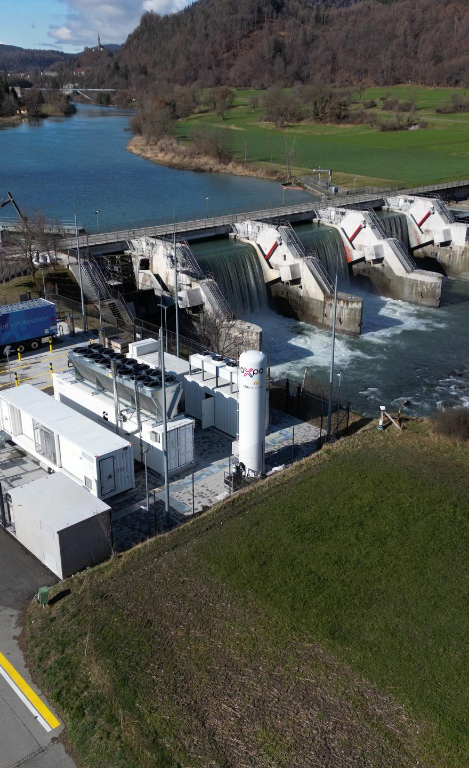
2. Volatile physical power markets
Notes:
The largest renewable hydrogen production plant close to Chur in Switzerland, 2.5 MW

Slide 12
Spot market volatility in the ”good old times”
Data source: Nord Pool, SKM Market Predictor

Slide 13
Spot market volatility has skyrocketed
 | 2013 | 2018 | 2023
Average spot price in FI area | 41,21 | 46,80 | 56,58
Spot price volatility has increased even if the average prices are not much higher – especially if inflation is considered
    We have large weekly variation all the time, even in the summer
    No wonder that the risks in retail sales have increased, leading to consolidation and companies withdrawing from the market
    This is not only caused by higher maximums but also lower minimums due to large amount of solar and wind power
    There are no investments in required scale which would return us to the “good old times” especially as we keep retiring thermal power and adding solar and wind
  However, one can question if this is really what most customers would like to see – I think this development is politically unsustainable
Data source: Nord Pool, SKM Market Predictor

Slide 14
It is not just a Finnish phenomenon
Data source: Nord Pool, SKM Market Predictor

Slide 15
What about regulating power market?
Almost half of the weeks have such variation in regulating power prices!
Data source: Nord Pool, SKM Market Predictor

Slide 16
Negative prices are now regular
How many hours had negative prices?
Year | Finland | SE3 | NO2 | Germany | Netherlands
2013 | 0 | 0 | 0 | 64 | 0
2014 | 0 | 0 | 0 | 64 | 0
2015 | 0 | 0 | 0 | 126 | 0
2016 | 0 | 0 | 0 | 97 | 0
2017 | 0 | 0 | 0 | 145 | 0
2018 | 0 | 0 | 0 | 134 | 0
2019 | 0 | 0 | 0 | 210 | 3
2020 | 9 | 9 | 5 | 298 | 97
2021 | 5 | 12 | 5 | 139 | 70
2022 | 27 | 29 | 0 | 83 | 92
2023 | 467 | 429 | 174 | 287 | 308
2024* | 195 | 185 | 74 | 183 | 190
We have clearly surpassed some critical limit in the Nordics
    Finland was the European power market with largest amount of negative prices in 2023, and 2024 thus far is no different
    We have run out of hydro flexibility which traditionally protected us
    I think we should be worried that about 5% of the time, power is a waste product according to the market
    From grid perspective, oversupply is just as bad as undersupply
  All kind of subsidies, tax benefits, grid fee reductions and netting arrangements for worthless production are questionable
    “Let someone else deal with problems” was fine when wind and solar were a minor part of the market, but not any more
    TSOs have already been complaining that wind power producers are not active enough in the regulating markets
    Small scale solar infeed into the grid is often even more problematical as the owners do not usually follow the market or are even shielded from its effects
Data source: Nord Pool, SKM Market Predictor. *Note: data for 2024 until 9 Jun
Notes:
More than 1000 hours of negative downregulation prices in Finland in 2023!

Slide 17
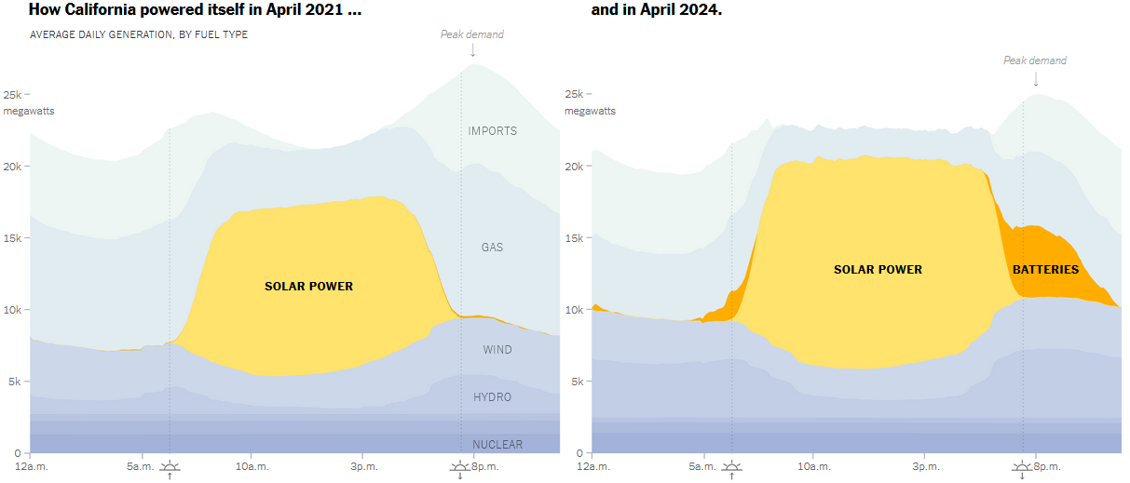
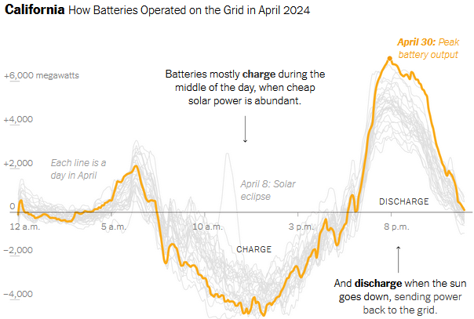
Possible remedies
Batteries can start affecting the market quite fast
    But they cannot solve the problem of calm winter periods
    Wind production patterns are not as predictable as the solar patterns in California
    Most Nordic batteries are mainly aiming for other business than spot arbitrage
  Heat pumps and power-to-heat boilers in district heating increase the demand side flexibility
    Finland and Denmark are good examples, but this will not happen elsewhere without taxation and/or grid fee changes
    However, their total maximum capacity is not many gigawatts, so with current RES growth, they can only slow down the increasing cannibalization of wind and solar
  Pumped storage projects can provide some help
    We already see significantly more interest in them in Iberia, for example
    But good locations are not plentiful and costs are high
  Flexibility from the “new industrial demand” would be valuable, but the news thus far is not supporting the view that many industries would plan to be weather dependent
Source: New York Times, based CAISO data
Notes:
Maybe Finland could have 2-3 GWs of heat boilers, but 5 GW sounds already much too high
If one asks me, I think quite some industries are heading out of Europe to somewhere else where their power price is less dependent on weather

Slide 18
Future outlook on volatility
It is going to get worse before it can get better – even more volatility in the horizon
The current incentives are clearly not balanced, I think it is very hard to avoid a capacity market with current development
    Especially if Germany will push new thermal capacity to market and/or extend the lifetimes of current thermal plants, this will become even more acute in Nordics, as that German capacity will reduce the revenue of Nordic firm capacity
    Even if Nordics put brakes on RES development, the continental subsidy-driven investments would still affect us
  There will not be a single remedy, but at least batteries and large heat pumps/power-to-heat boilers connected to district heat networks will be part of the Nordic solution
    It remains very important that we let our existing hydropower to function as a large flexible element in the system
    Additional pumped storage projects or industrial demand flexibility will not help any time soon
    Building flexible new thermal plants based on hydrogen or other renewable gases as fuel seems to be years away
  New interconnectors would help with wind-related volatility, but few projects will be constructed in this decade
  Adding nuclear power will not help with volatility unless new plants would be much more flexible than current units

Slide 19
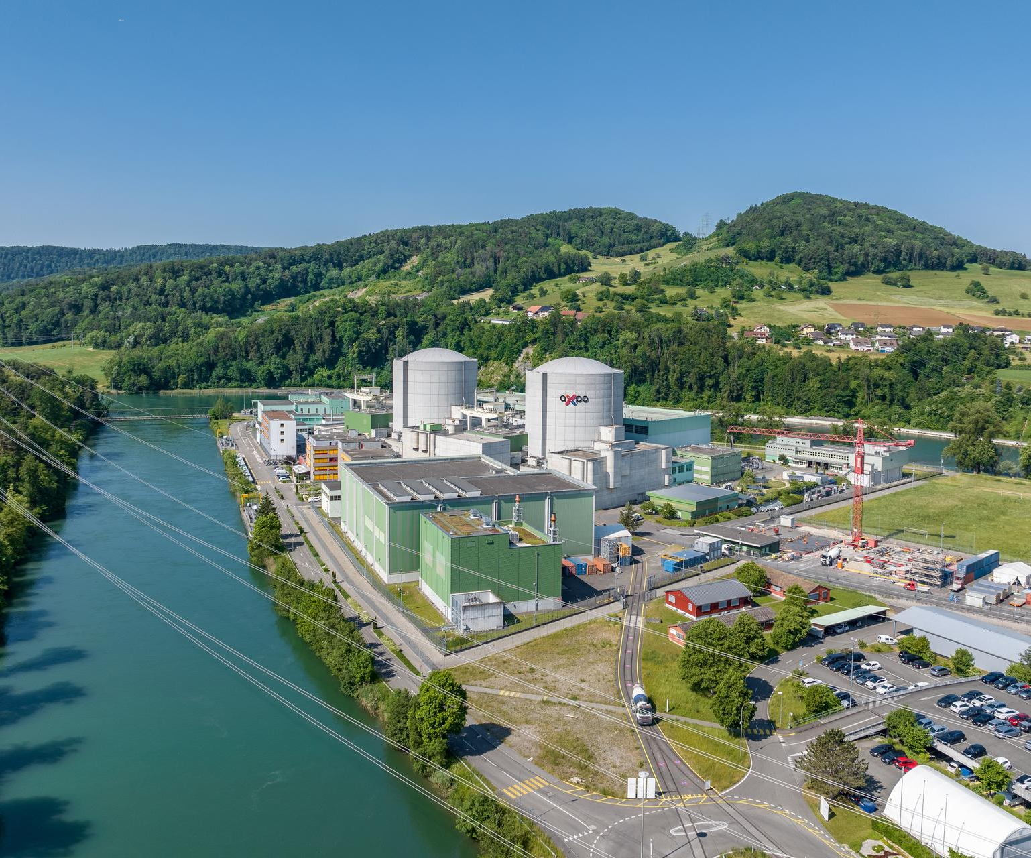

Thank you!
Axpo Solutions AG
Parkstrasse 23
5401 Baden
Switzerland
www.axpo.com
info@axpo.com
Follow Axpo Group on
Notes:
Beznau nuclear power plant, Switzerland

