Slide 1
Outlook for wind and solar power in Finland
Jenny-Li Holmström, Legal Director & Head of ESG
Finnish Energy Day 13 June 2024

Slide 2
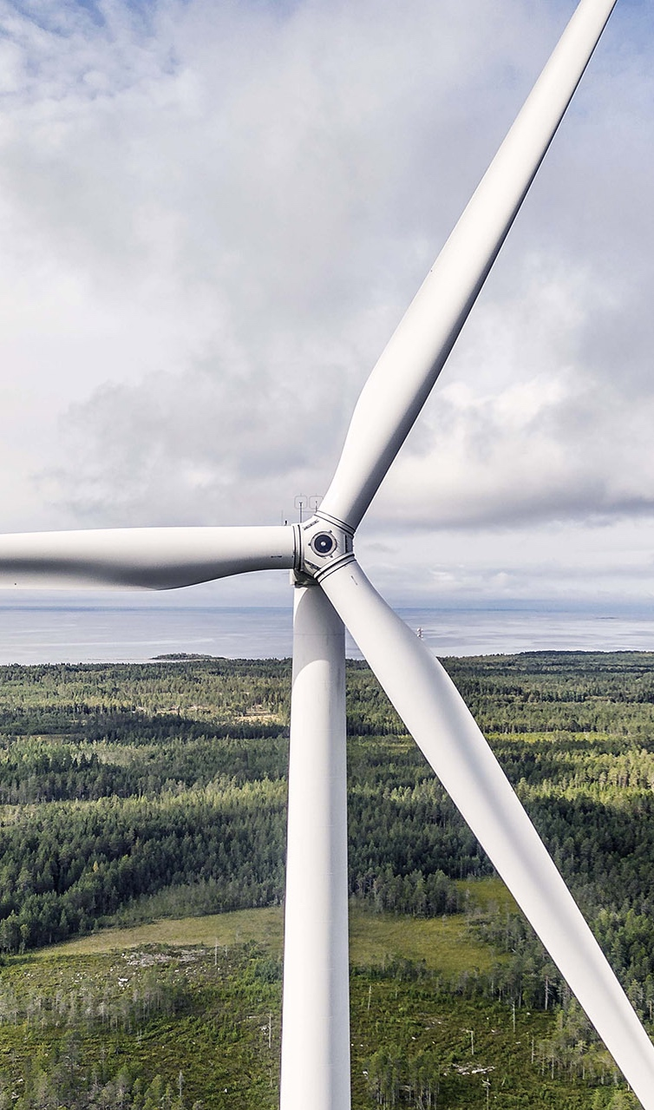









Taaleri Energia
Established in 2011
AUM of EUR 1.1 billion
The largest wind power producer in our home market, Finland
6 Article 9 funds in utility scale onshore wind, solar and battery storage
9.6 GW portfolio of development projects and operating assets
“Most Consistent Top Performing Unlisted Infrastructure Fund Managers”
49 employees, making one of the largest wind and solar investment teams in Europe
In 2023, our operating assets offset 1.6 million tonnes in carbon dioxide and supplied green electricity to c. 624,000 households
5-star rating from PRI for Infrastructure

Slide 3
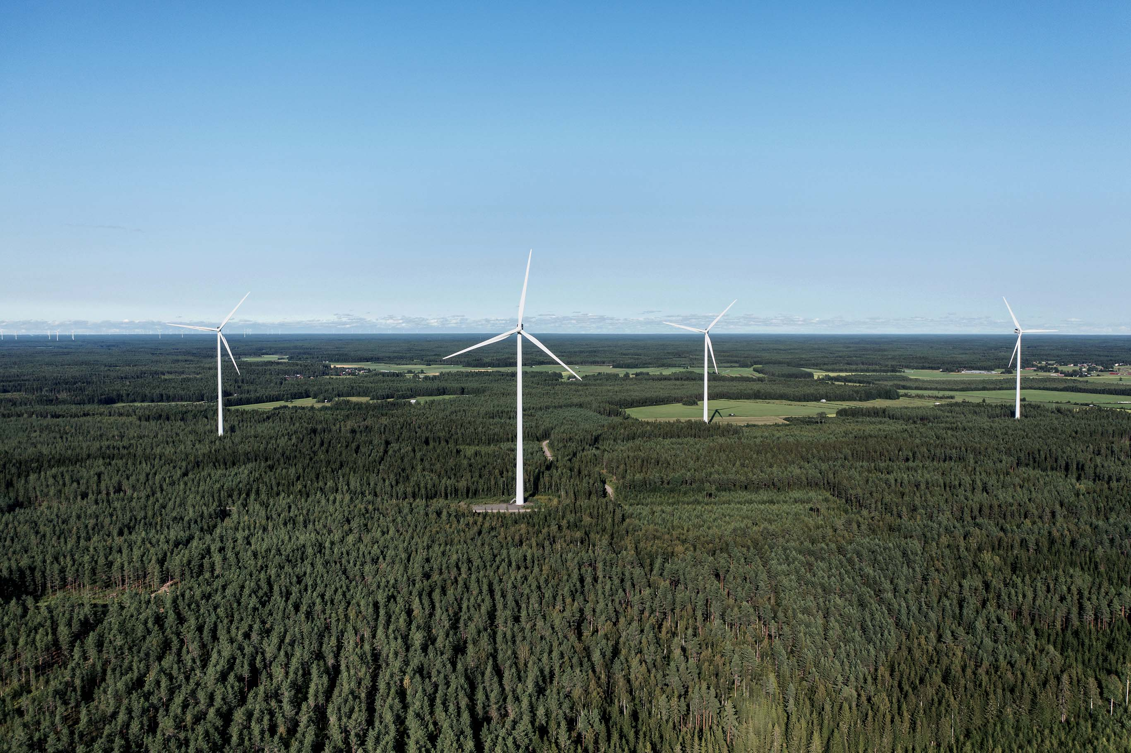
Year 2023
Installed capacity | 1.3 GW
Installed turbines | 212 WTG
Dismantled | 4 WTG (12 MW)
Cumulative capacity (by the end of 2023) | 6,9 GW
Number of wind turbines (by the end of 2023) | 1 601 WTG
Annual production | 14,5 TWh
Share of Finnish electricity production | 18,5%
Source: Finnish Wind Power Association

Slide 4
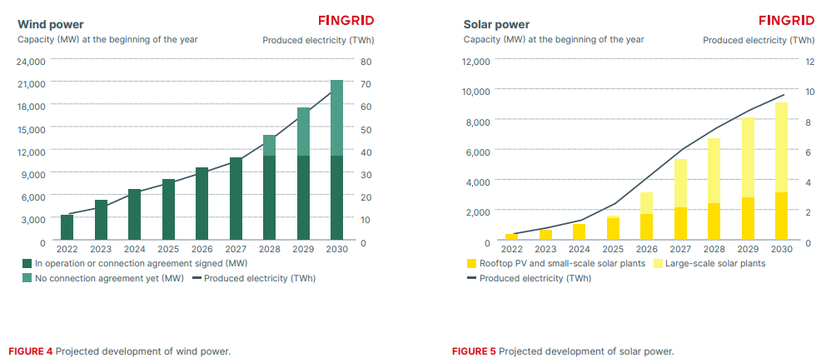
Fingrid estimates strong growth for renewables production
Source: Fingrid

Slide 5
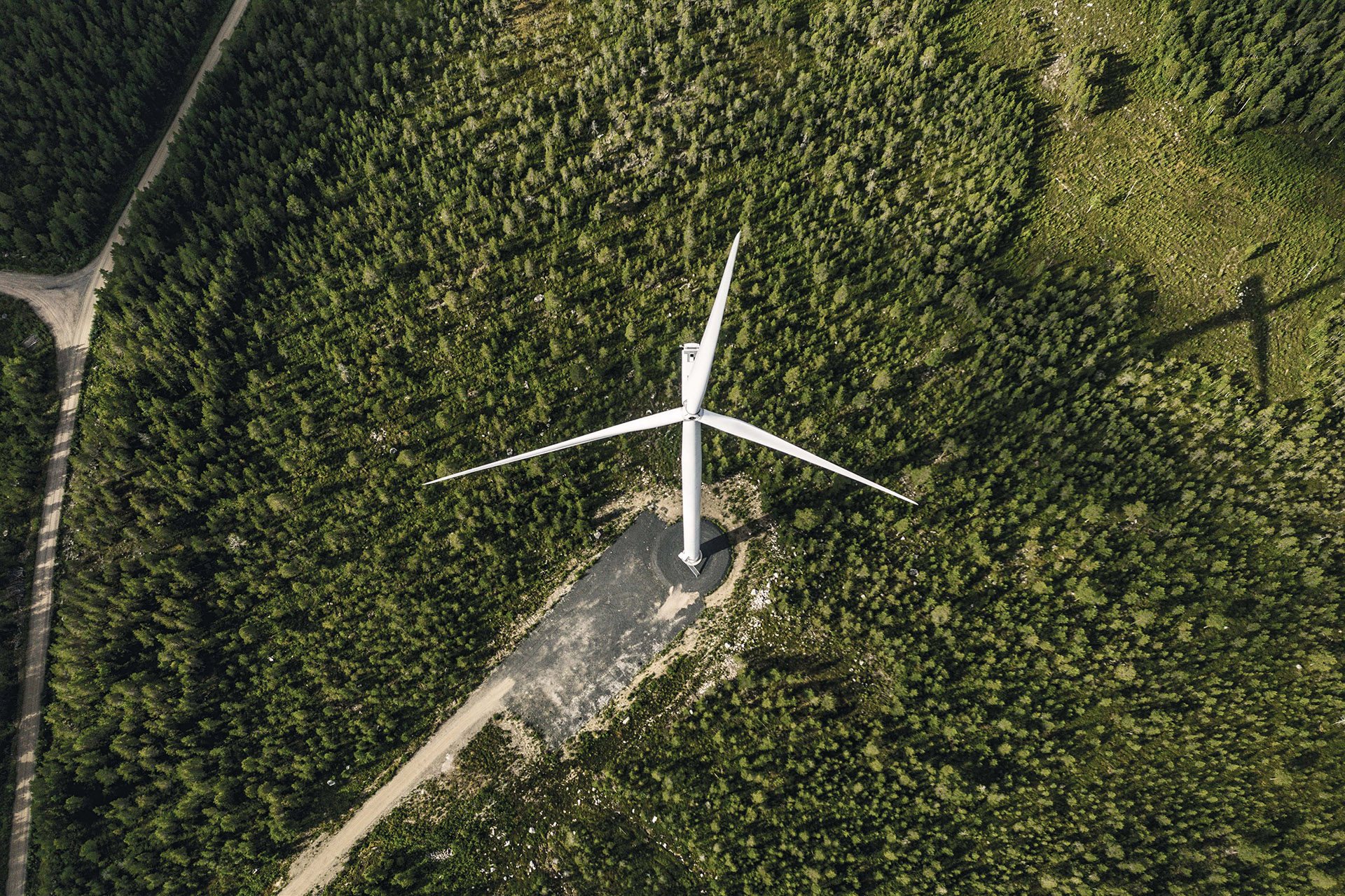
Steady 1 GW deployment rate after a record year 2022 (MW)
2024-2025
according to the published investment decisions
Source: Finnish Wind Power Association

Slide 6




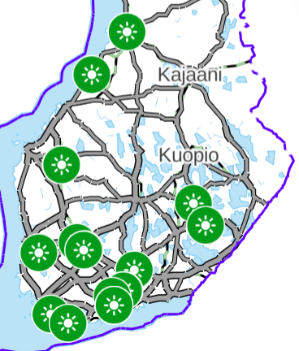
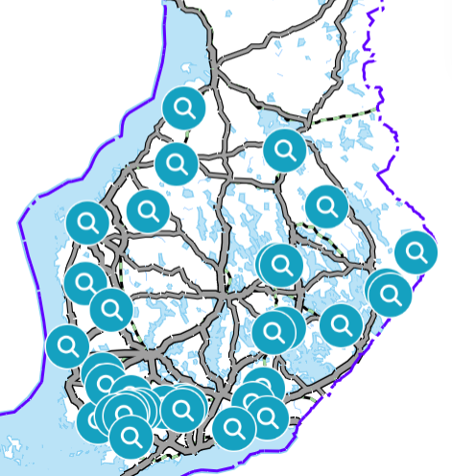
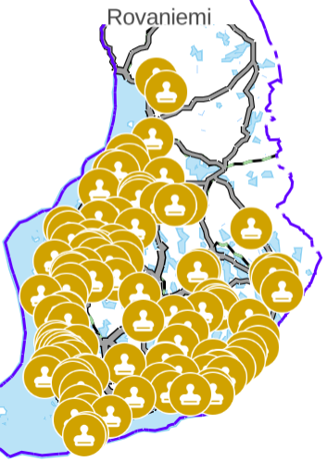
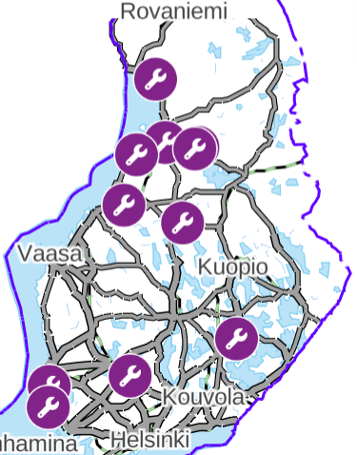
Solar power capacity & pipeline
Over 1 MW of plants (4/2024)
In production
Pre-study
Permitting
Under construction
~58 MW
~3 284 MW
~9 244 MW
~441 MW
In production including rooftops >1 000 MW
Source: Motiva & Fingrid

Slide 7
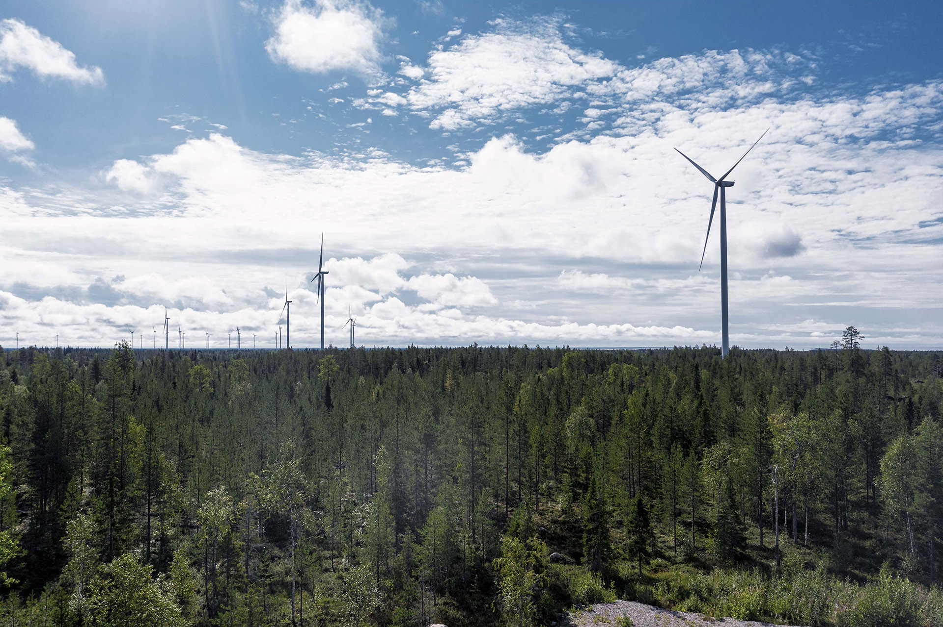
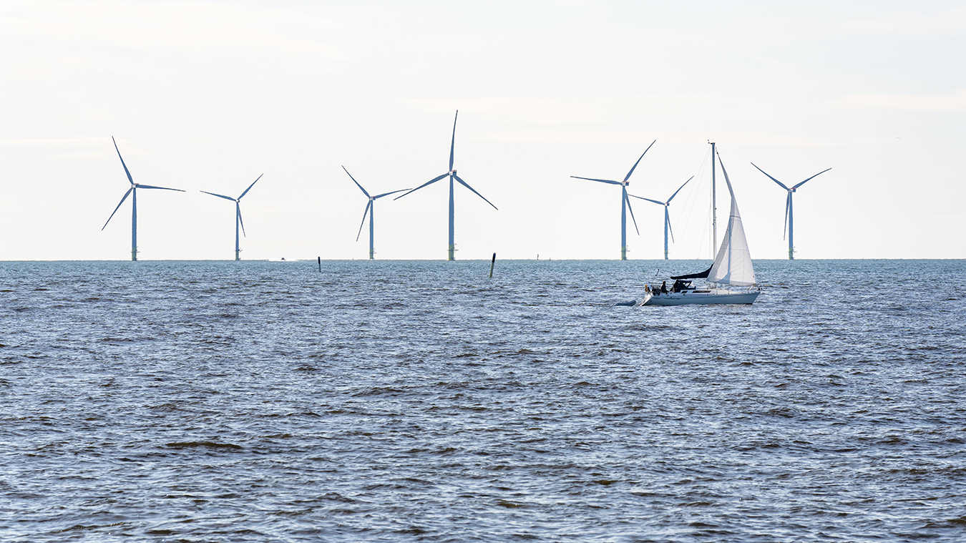
Wind Power Project pipeline 1/2024
Onshore
~ 68,8 GW
376 projects
Offshore
~ 66 GW
32 projects
Source: Finnish Wind Power Association

Slide 8
Any challenges?

Slide 9

Renewable Energy Fundraising 2022 vs 2023
Renewable energy fundraising (EUR billion)
Source: Preqin Global Report 2024
Notes:
Our ideal fund equity investment in a deal ranges between EUR 10-40 million and we offer co-investments to our LPs in larger projects

Slide 10
Finnish onshore wind capture rates
Source: ENTSO-E transparency platform

Slide 11
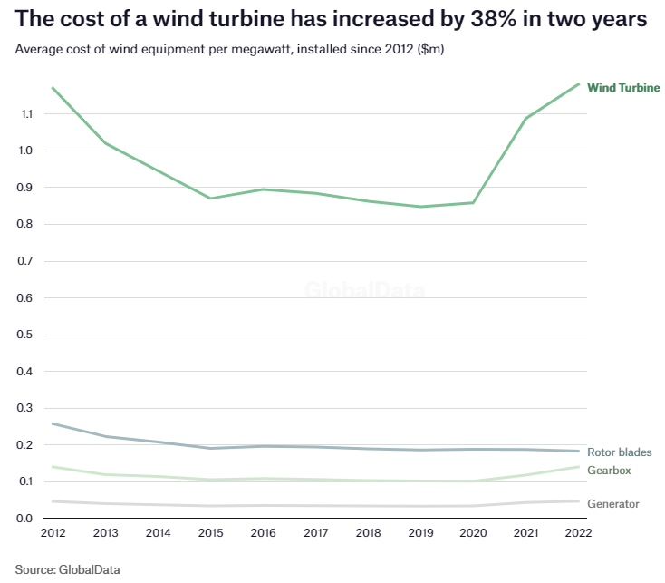
Wind turbines are expensive
Average cost of wind equipment per megawatt, installed since 2012 ($M)
The cost of a wind turbine has increased by 38% in two years
The cost of solar panels and battery energy storage still declining
Notes:
Otskikko kuvasta

Slide 12
Debt is expensive
Source: Finlands Bank

Slide 13
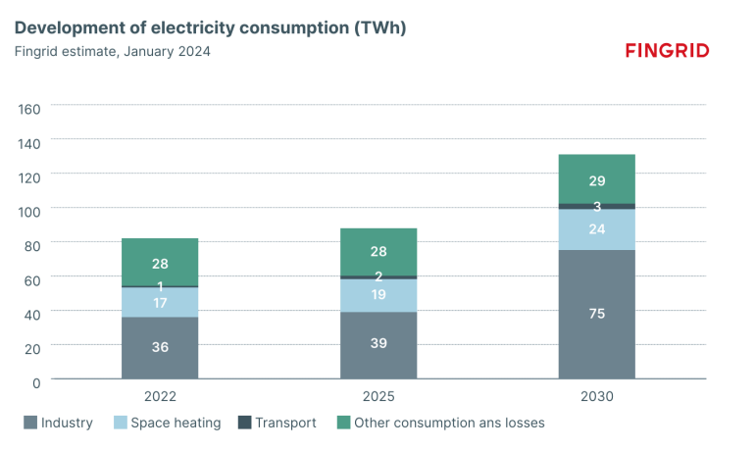
Electricity consumption still low
Fingrid estimates consumption to increase to more than 130 TWh by 2030
Source: Fingrid

Slide 14
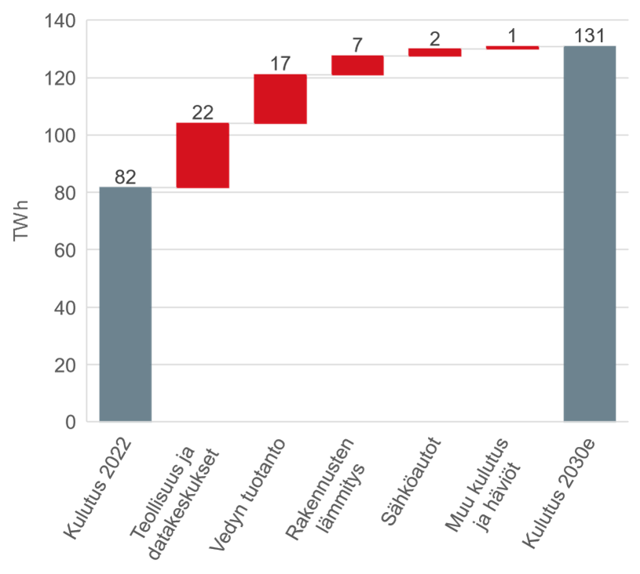
Electrification of industry, hydrogen production etc. increase consumption
Consumption
2022
Industry and
Data Centres
Heating
Others and
Losses
Consumption
2030
Hydrogen
Vehicles
Source: Fingrid

Slide 15

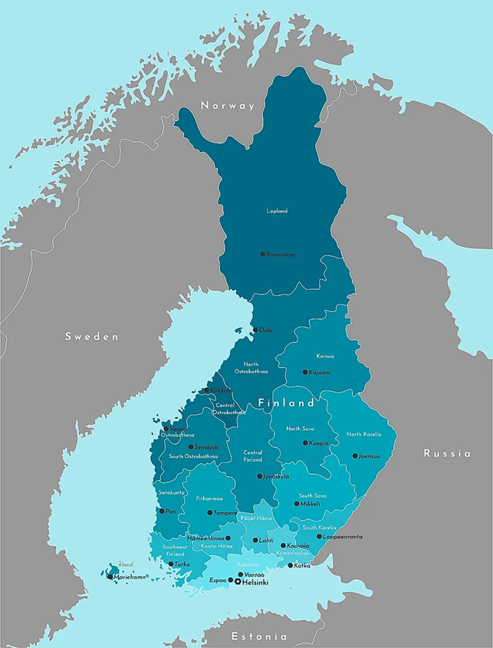
Hydrogen projects
planned in Finland
Green hydrogen – the ideal PPA
Projects: > 30
Power: > 1500 MW
H₂ production: > 300.000 t/a
Investment: > 9 B€
More than 735 billion € worth of projects published.
Gasgrid: preliminary inquiries for connection to the gas pipeline
  H2 production more than 80 TWh
  H2 consumption more than 20 TWh
The annual wind power production of the current project pipeline is more than 80 TWh.
Ranua
ET Fuels
Raahe
Raahen Monivoima
Kokkolan Energia
Kokkola
Flexens
Hycamite
Aurelia Turbines
Joensuu
P2X
Vaasa
EPV Energia
Tampere
Ren-Gas
Mikkeli
Ren-Gas
Kristiinankaupunki
CPC Finland
Lempäälä
Flexens
Lahti
Ren-Gas
Pori
Ren-Gas
Lappeenranta
St1
UPM
Harjavalta
P2X
Åland
Flexens
Orkla
OX2
Hamina
STR Tecoil
Lieto
Flexens
Vantaa
Vantaan Energia
Kotka
Ren-Gas
Source: EK hankeikkuna, Gasgrid, FWPA, H2 cluster
Naantali
Green North Energy
Inkoo
Blastr
Espoo
Convion
Helsinki
Helen
Porvoo
Neste
Notes:
Fontit oma

Slide 16
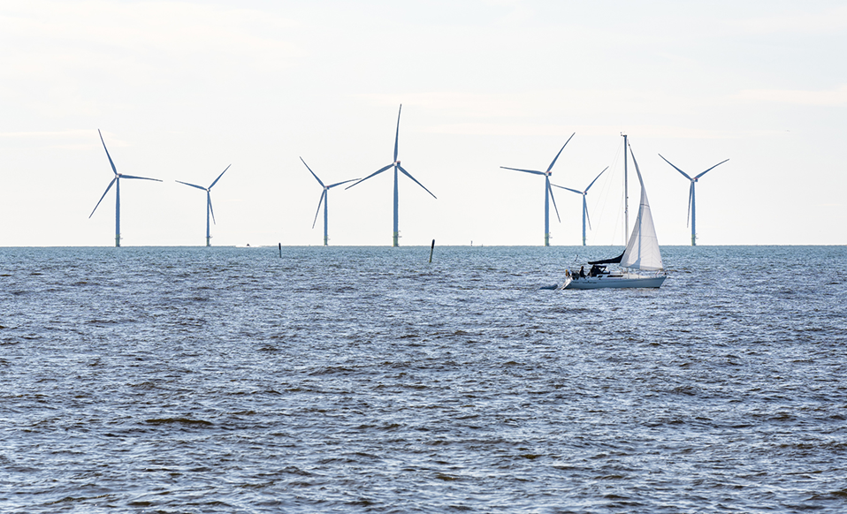
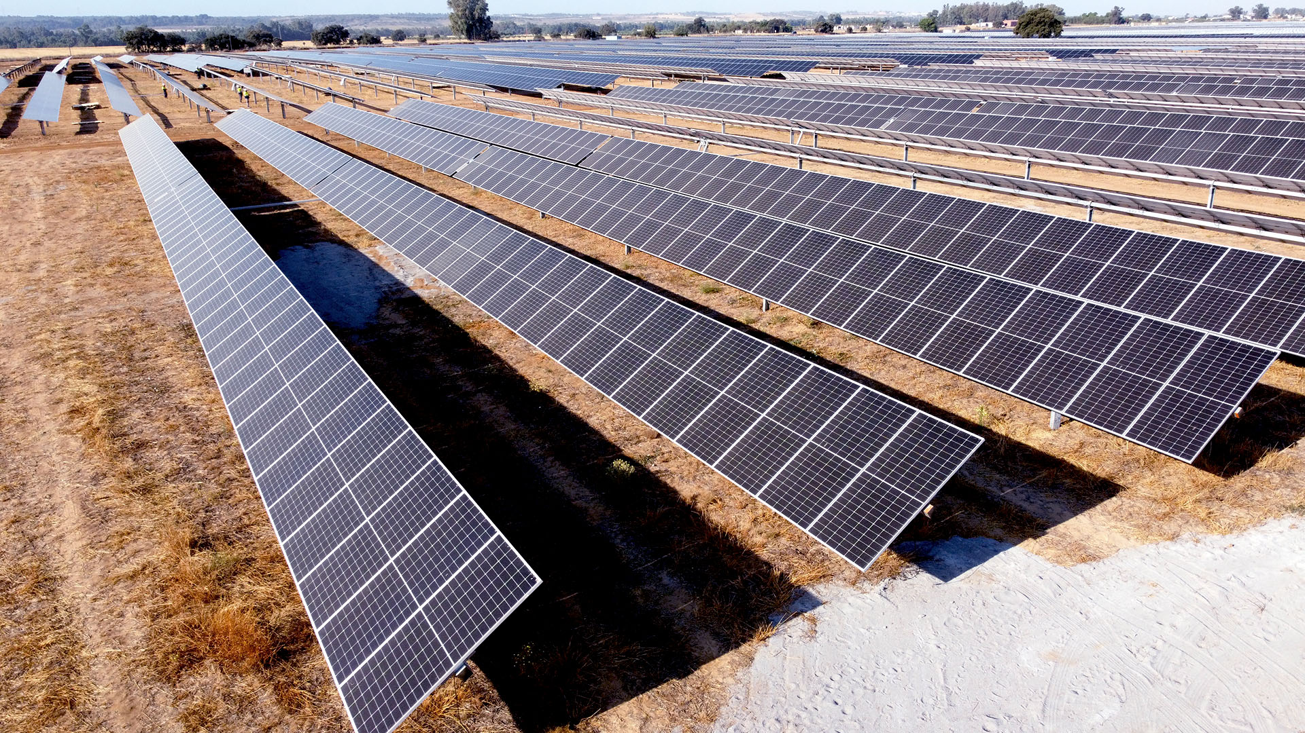
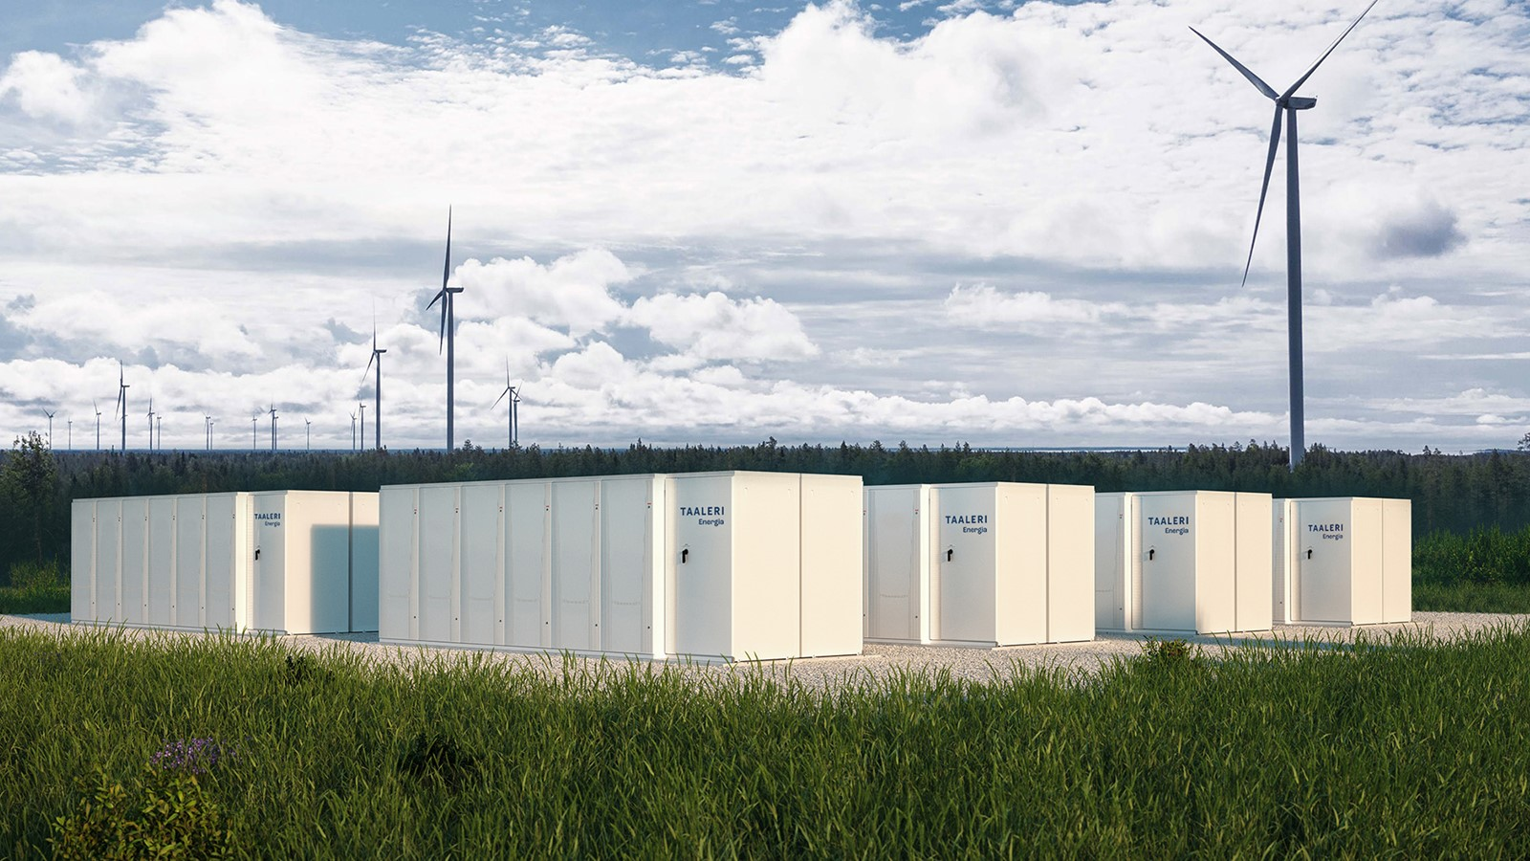
Policy-making: Ministerial working groups, legislation etc.
Onshore
Offshore
Spring 2024: High-level working group to identify solutions for better coexistence of military operations and wind power in Eastern Finland
Spring 2024: Interministerial working group on offshore wind energy
Clarifying the legislation on EEZ
  Law proposal Autumn 2024, the first auction at the end of 2025
Autumn 2024: Lowering the property tax on territorial waters
Solar
BESS
Solar development regulation in its cradle
Grid connection of projects with BESS and production

