Slide 1
Enabling the Finnish energy transition – grid, operation and market perspectives
Finnish Energy Day
June 13th, 2024
Scandic Grand Marina, Helsinki

Slide 2
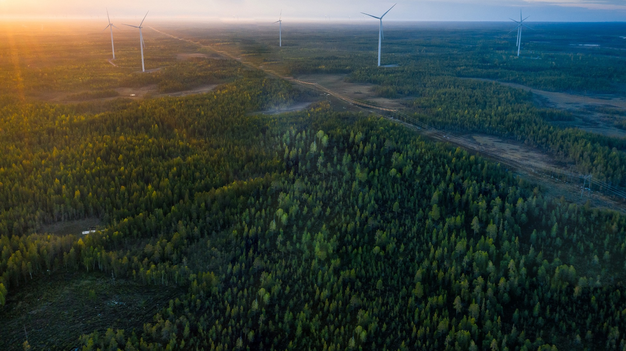
Key figures
Transmission reliability rate of the main grid
99.99995 %
71.7 TWh
transmitted electricity
Turnover
1,193 M€
Balance sheet total
2,900 M€
Paid income taxes
30,4 M€
Investments in the main grid
310 M€
14,500
kilometres of transmission lines
83.1 %
of total electricity transmissions in Finland
527personnel
Our values
Open
Fair
Efficient
Responsible
Our vision
The energy system is clean, reliable and creates economic prosperity for Finland. Fingrid is the cornerstone of the energy system.
NPS
Personnel
75
NPS
Customers
45

Slide 3
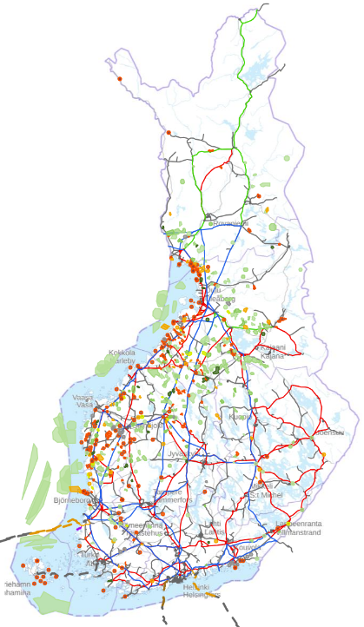

Finland has excellent potential in the clean transition
Onshore
wind
Offshore
wind
Solar
Industry / Demand
BESS
Fingrid's forecasts for the development of electricity consumption and production: Prospects for future electricity production and consumption updated – Fingrid prepares for substantial growth during the ongoing decade - Fingrid

Slide 4
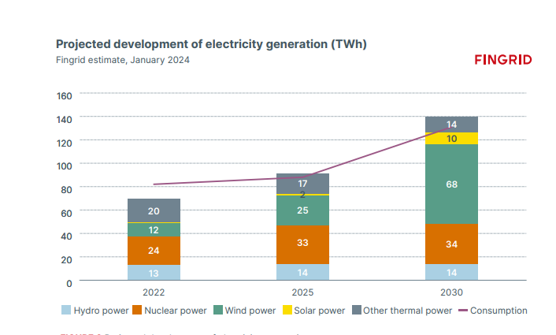
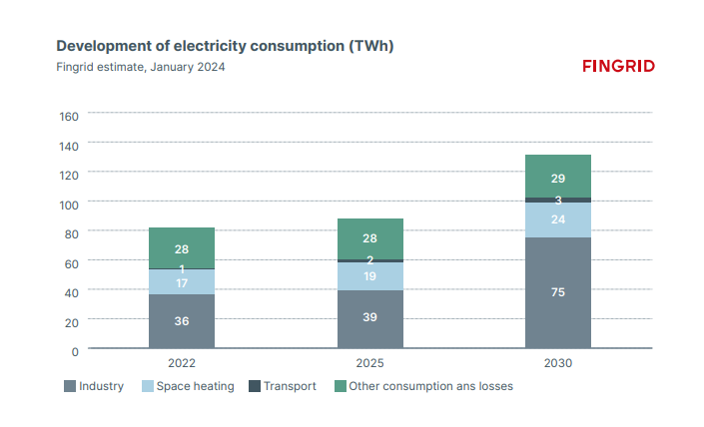
Electricity generation and consumption growing

Slide 5
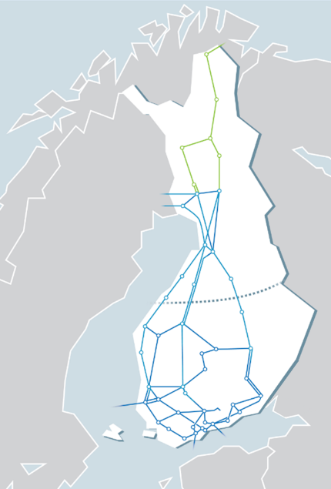
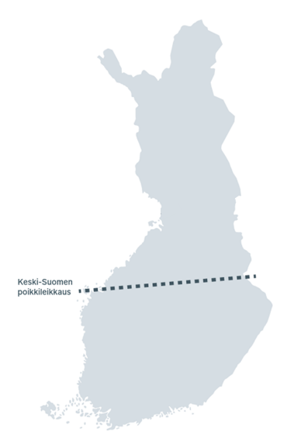
Huge grid investment needs
Investment plan of the main grid
Current main grid
17
Kemi-Oulujoki cross section
7
2024 – 2033:
Some 6000 km of transmission lines and about 200 substation projects
2
Surplus area
Aurora Line
5
19
12
Middle-Finland cross section
Middle-Finland cross section
6
11
4
Forest Line
Lake Line
Coastal Line
Growing transmission
9
Ridge Line
River Line
8
18
10
1
13
15
14
Deficit area
16
3

Slide 6
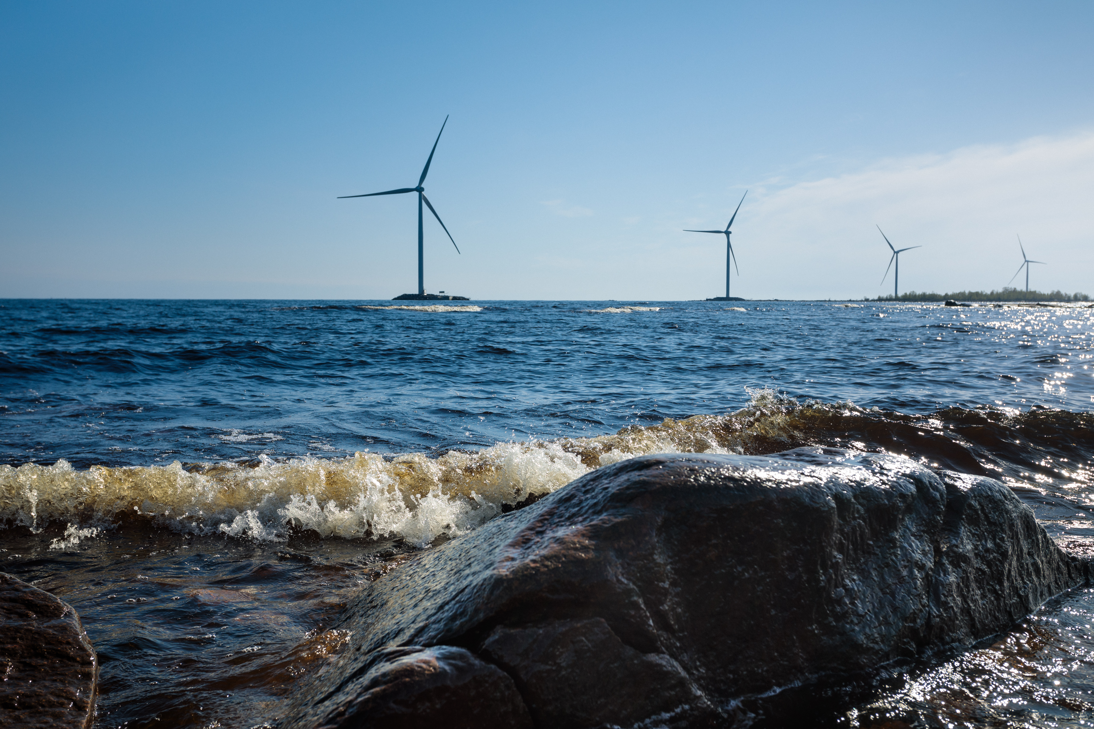
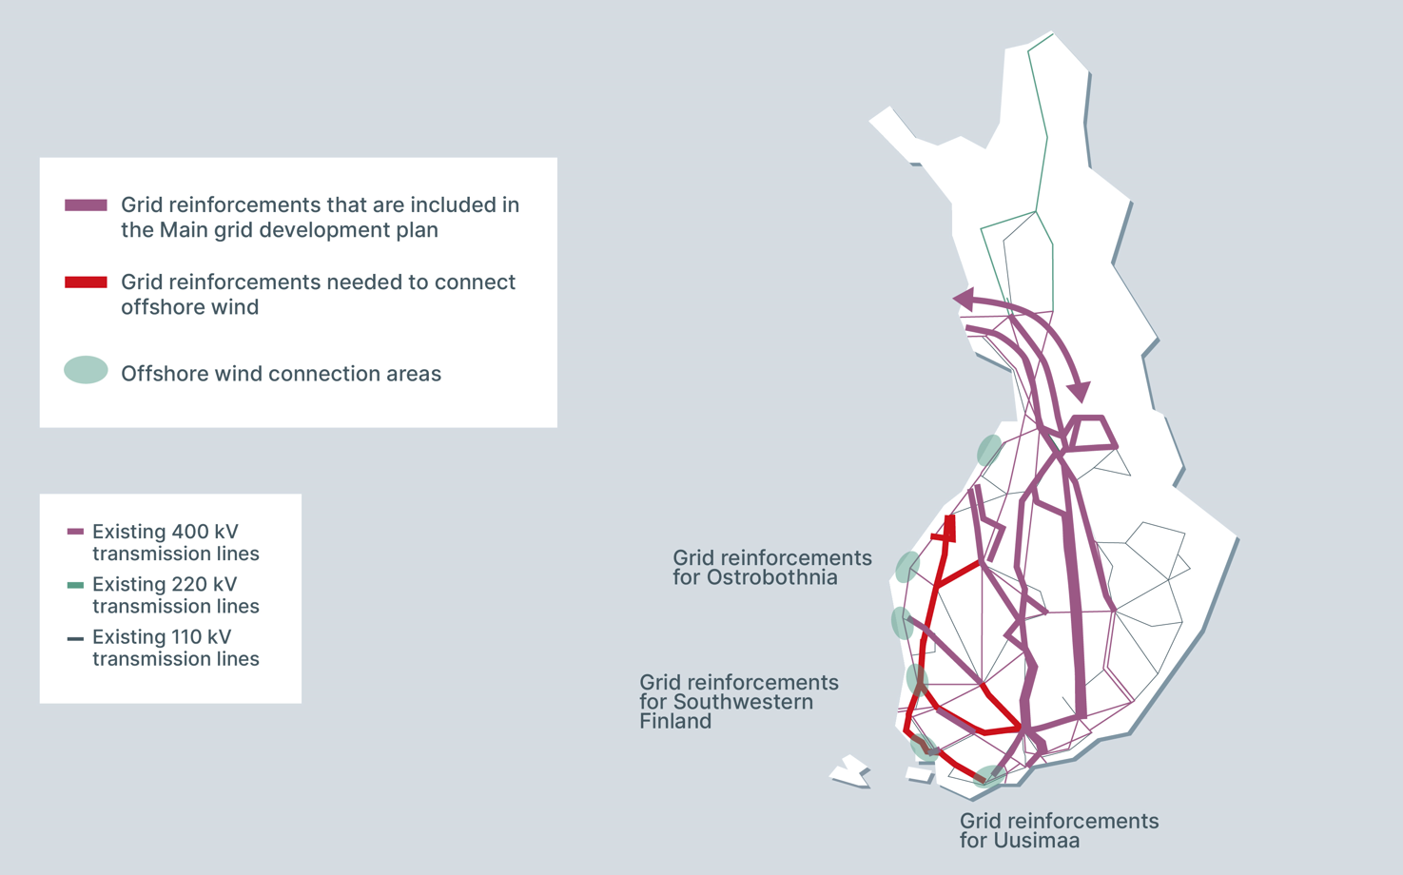
Offshore wind connection proposition

Slide 7
Developing market design to enable transition
Flow-based capacity calculation
October 2024
15 min aFRR energy market
12.6.2024
MARI, PICASSO (European balancing energy platforms)
15 min mFRR energy market 3.12.2024
Nordic aFRR and capacity market
Intraday auctions (60 min)
13.6.2024
15 min DA and ID markets
One balance model
15 min imbalance settlement
2021
2022
2023
2024
2025
2026
2027

Slide 8
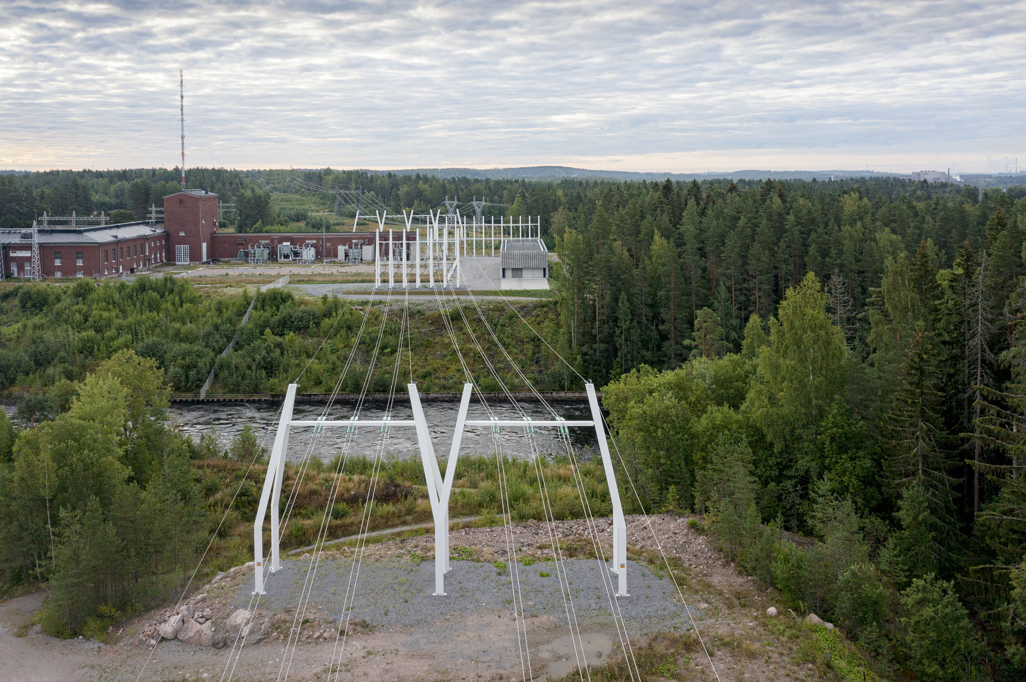
Increased operation of the system and new technologies needed to support transition
New tools are needed to manage congestion and keep the system in balance
We need to get the most out of the existing grid
Increased need to use redispatch and countertrade
Increased need for reserves
15 min market time unit
Investing in synchronous compensators
Dynamic Line Rating
Incentivising through connection and transmission fees

Slide 9
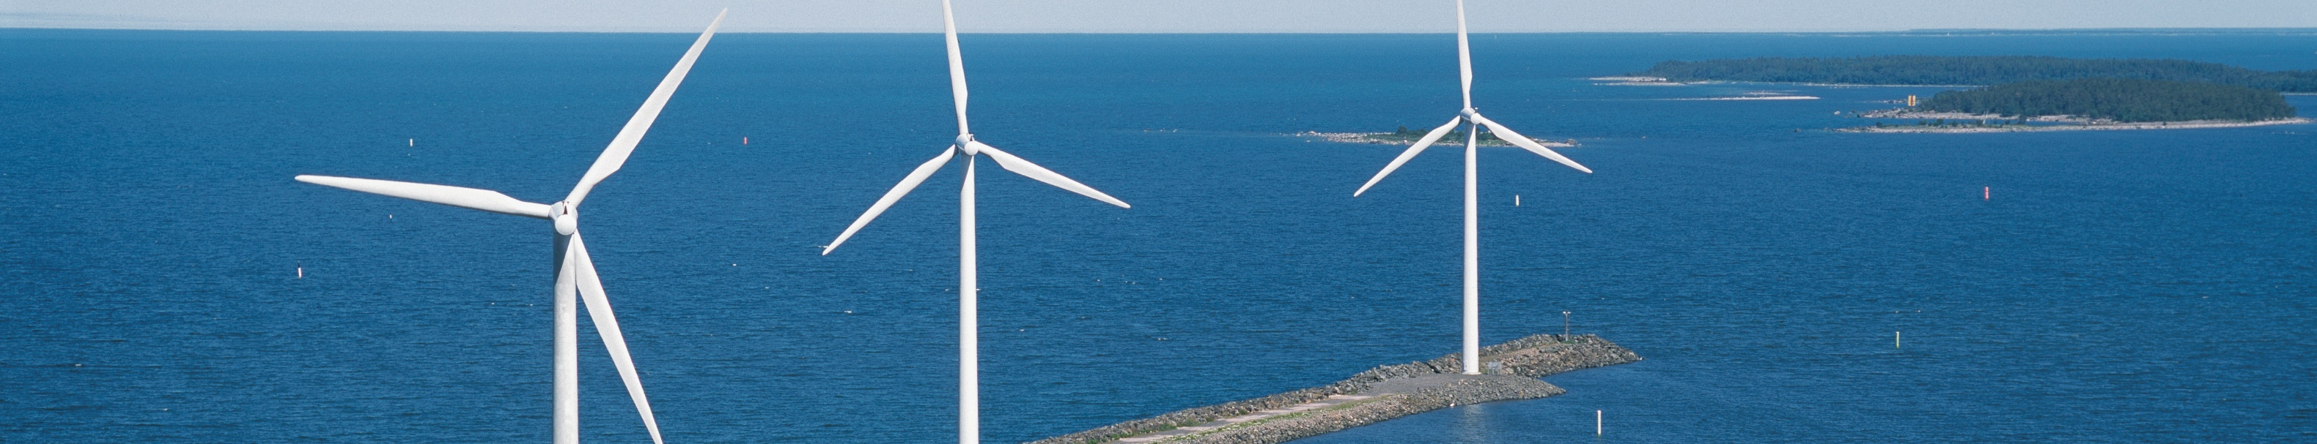
Thank you!

