Slide 1
How can Finland play a leading role in the energy transition?
Kai Mykkänen, Minister of Climate and the Environment
Finnish Energy Day 2024
13th June. 2024

Slide 2
How to accelerate the transition from fossil fuels and support sustainable economic growth?
Carbon neutral
Finland
Fossil-free heating and industry
Clean electricity

Slide 3
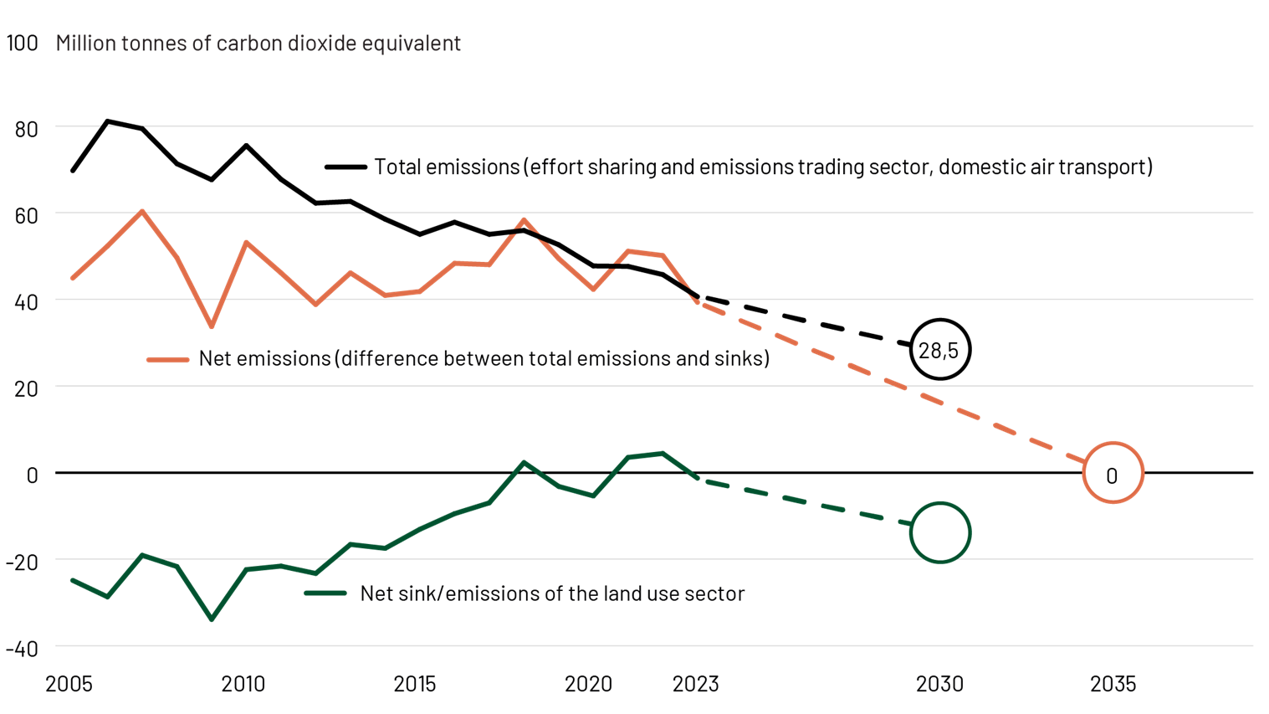
Fossil emissions are declining - challenges with the land use sector
?

Slide 4
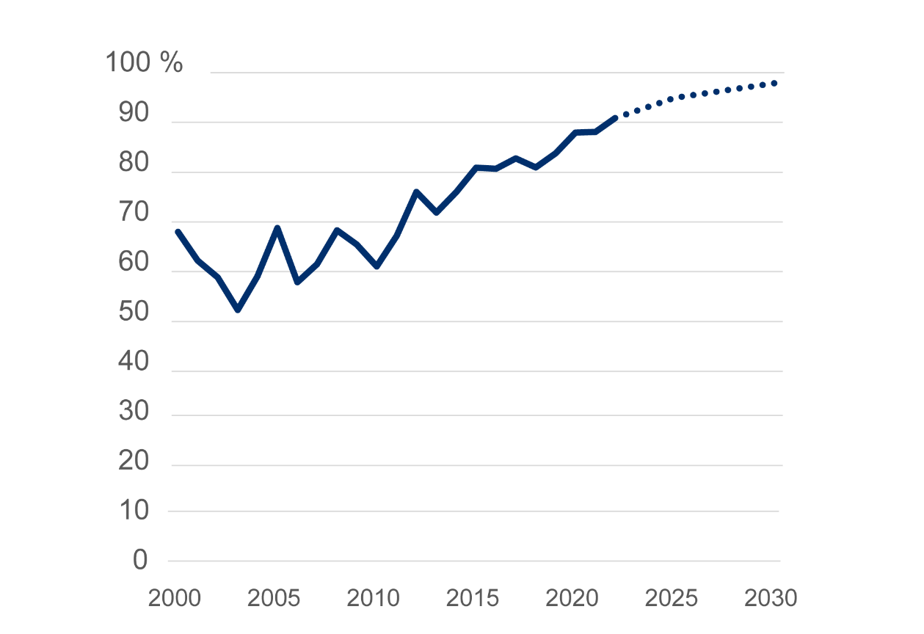
Share of zero-emission electricity in production

Slide 5
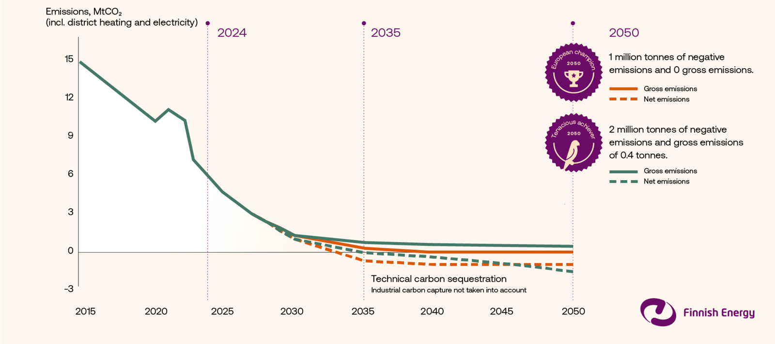
Net emissions from the energy sector to be zero or even negative by 2035
Source: Finnish Energy: Climate Road Map 6th June 2024

Slide 6
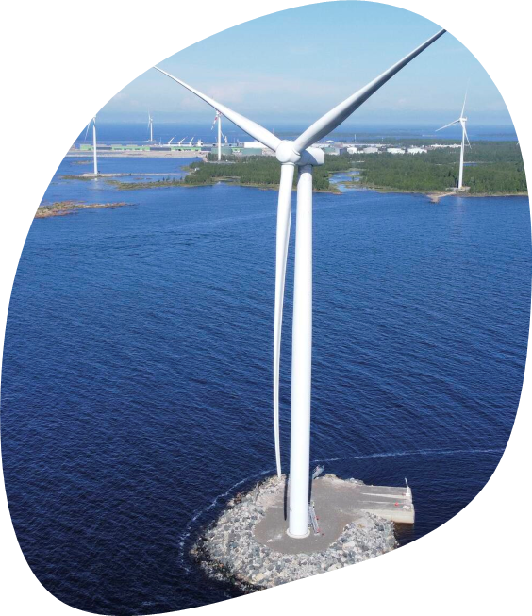
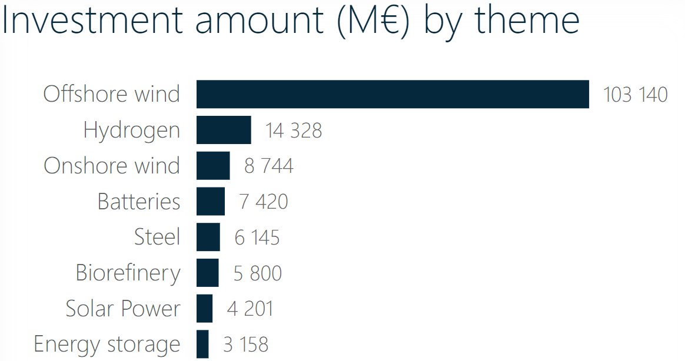
Immense investment potential in offshore wind power
Source: Confederation of Finnish Industries, Green Transition Data Dashboard (updated 26th April 2024)

Slide 7
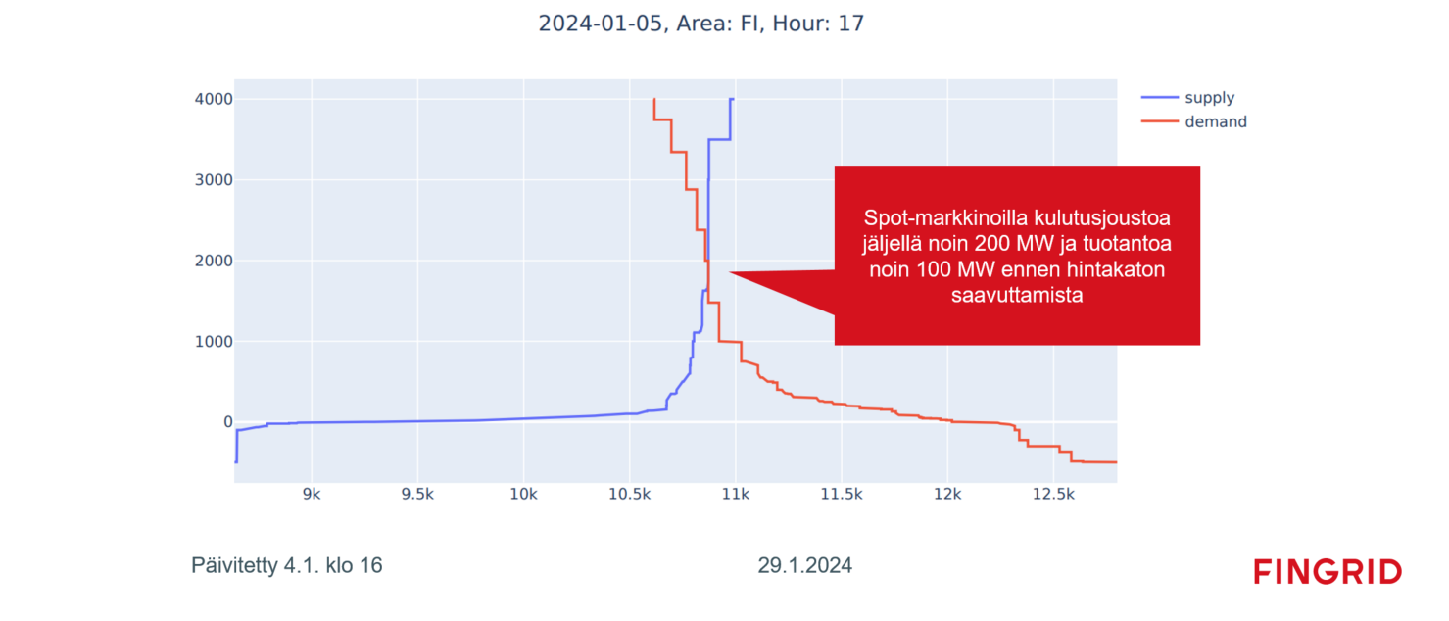
Example of spot market supply and demand during a peak hour (Nord Pool)
In the spot market, there was approximately 200 MW of demand response and 100 MW of production remaining before reaching the price cap

Slide 8
Government energy actions
Tax credit for large-scale industrial investments that support the transition to a net zero economy.
Capacity mechanism and nuclear support solution
  Due to the increase in variable electricity generation, a new capacity mechanism will be introduced to ensure that there is enough electricity in Finland at a reasonable price even during windless and cold periods.
Nuclear energy law reform and promoting nuclear energy in EU legislation
Interest deduction (Mankala companies)
A competitive investment environment for offshore wind and rules for the EEZ
Streamlining investment authorisation and grid connection rules
Increased electricity transmission capacity promoted: the construction of the 400 kV Aurora Line between Finland and Sweden is progressing. One of the most important investments to improve security of electricity supply. The project is due to be completed in 2025.
Investment aid has been granted for energy projects, including heat generation solutions and heat storage to mitigate electricity price fluctuations during winter periods.
Promoting consumption flexibility automation

Slide 9
Smoother one-stop shop for investment permits
Reform of land use regulation (authorisation procedures)
Several actions under the government programme, such as
Establishment of the Licensing Guidance and Control Agency
One-stop legislative project
Environmental objectives and derogations for water management
Preparation of the legislation of the Licensing, Guidance and Inspection Agency in the legislation of the Ministry of the Environment
(Ministry of Finance-preparatory responsibility)
Implementing the one-stop shop for licensing: "The aim is that by combining licensing procedures, an application will in principle lead to a single administrative decision and a single appeal."
"The Government will respond to the requirements of the Water Framework Directive with national legislation”
"The national flexibilities allowed by the Water Framework Directive will be utilised"
"One way the Government will make it easier to invest in Finland is through industrial parks"
"The Government will promote the possibility to begin processing an environmental permit, as appropriate, based on an approved decision on a plan without waiting for it to become final"
-Explore the possibility of compensation in the conditions of the environmental permit
-Precautionary Principle Statement
-Evaluate the possibility of reintroducing permit conditions for the inspection of permits
-Automation, target times
-Evaluation and development of the priority procedure, pumped storage power plants
Aim for one-stop shop principle
-Evaluate the possibility for the Government to provide for an accelerated procedure (projects of exceptional importance)

Slide 10
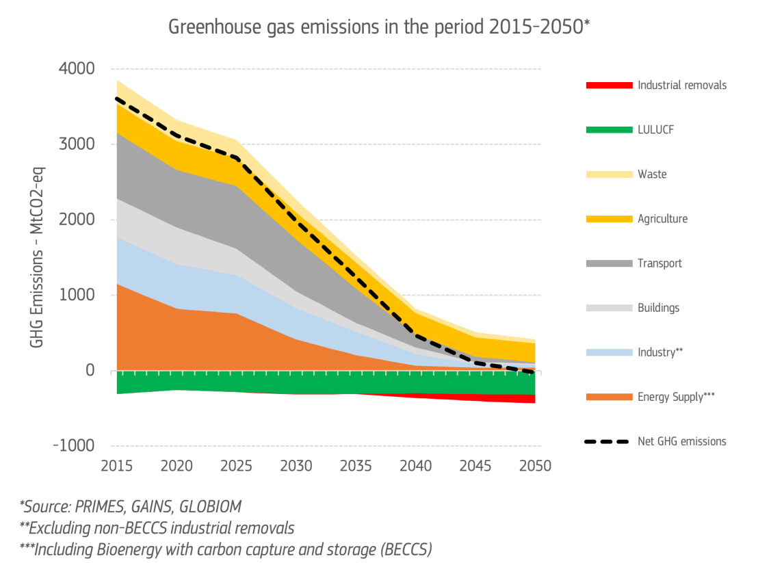
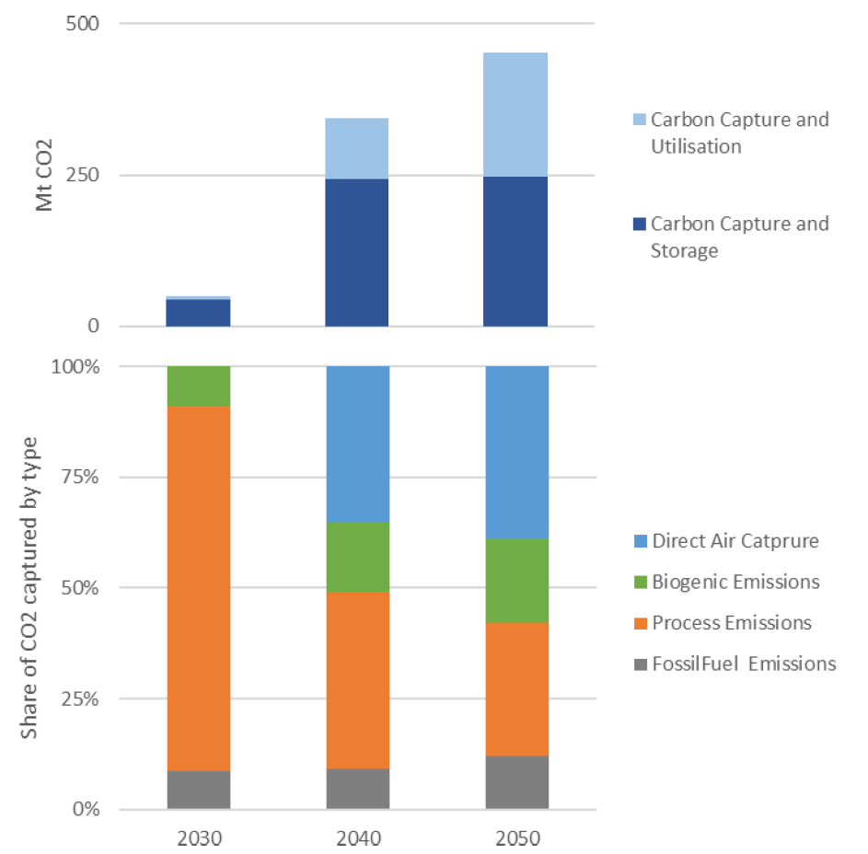
The European Commission’s assessment for a 2040 climate target for the EU
90% net emission reduction compared to the 1990 level.
The proposal takes into account themes important to Finland: a focus on emission reductions, technology neutrality, and technical sinks.
450
50
~5
90Mt CO2
source: European Commission:Towards an ambitious Industrial Carbon Management for the EU [6.2.2024]

Slide 11
Thank you!

